Slide 1
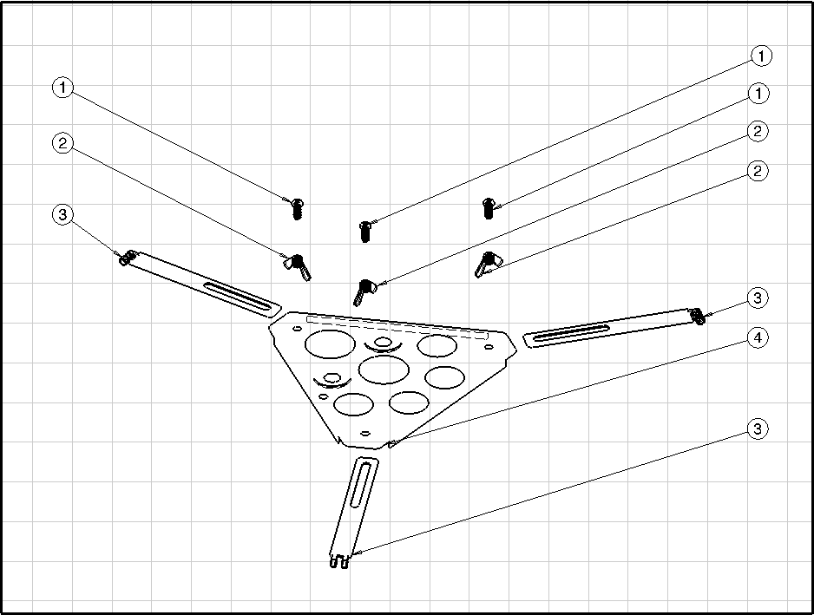
Enhancing the Novice Optical Telescope
Karen Maurer; Haoran Deng; Hunter Magill Department of Engineering Fundamentals Embry-Riddle Aeronautical University
Abstract
Methodology
Results
In this project a Tasco “Novice” telescope was modified in order to provide users more convenience and comfort. The modifications included a new system for spreading and folding the tripod legs, a rotating lens system, a cushioned eyepiece, an adjustment handlebar, and a pouch for holding miscellaneous items while using the telescope.
In order to eliminate the inconveniences and make the telescope more user friendly, considerations were given to each challenge. To combat the issue of the telescope not being able to collapse to a manageable size, the triangular accessory piece needed to be eliminated. Therefore, a new system of for spreading and collapsing the legs was required. With no accessary stand, however, the problem of switching lenses was intensified due to a lack of location for placement of unused lenses. As a result, there was a need to accommodate unused lenses and enhance seamless switching. To make the lens piece more comfortable for extended use, the team observed the lens designs of other telescopes and microscopes, knowing that those with smaller, softer contact points would provide more user comfort. Solving the problem of making fine adjustments was clear to the team initially; something graspable that could change the direction of the telescope smoothly with little force was needed. Finally, a platform for personal item storage needed to be a part of the design, but the team decided that it must be flexible or the platform would prevent the tripod from collapsing just like the triangular accessory stand.
On top of the new rotating eyepiece, the variable magnification lens received a new upgrade. A rubber eye cushioning system was developed and attached to the end of the lens to reduce the external light interference and enhance comfortability during usage.
Figure 1. Original and Modified Assemblies
Figure 7. Modified Lens with Eye Cushion
Introduction
A telescope direction adjustment handlebar was a newly added the feature to reduce the hassle of over adjusting the telescope via hand contact with the main body while the user is looking through it, greatly enhancing the continuity and fluidity of movement. The handlebar also reduces the stress on the user’s hand by minimizing the force needed for movement.
The Novice telescope is a small inexpensive telescope intended for personal use.
Figure 4. Original Parts: Triangular Accessory Stand, Diagonal Eyepiece, Regular Lens
Results
Figure 2. Main Telescope Body
To combat the dilemma of a fully collapsible support and spreading system for the legs , leg-locks were created. In this manner the legs will be able to maintain proper spacing when the tripod is fully extended. When the tripod needs to be collapsed for storage ,the leg locks will fold upward allowing the legs to fold inward into the most compact form.
When utilizing the telescope users experience several inconveniences. The triangular accessory stand prevents the tripod from collapsing fully.
Figure 8. Adjustment Handlebar
The triangle accessory holder’s clumsy size in addition to its poor flexibility and usability was a major obstacle when collapsing the telescope. In response to such problem, a collapsible pouch was made in place of the triangle accessory holder. It is made out of very strong synthetics including fabric and Kevlar.
Conclusion
As demonstrated, the Novice telescope’s design had a few flaws that reduced its optimal performance. However, with the addition of certain modifications, the telescope was made more ergonomic and user-friendly.
Figure 3. Triangular Accessory Assembly
Figure 5. Leg-Lock System and Fabric Pouch
Switching the lenses is tedious. The lenses are not comfortable for the face, making fine direction adjustments difficult. There is no place to set down personal items such as flashlights and phones.
One major modification implemented was the tetrahedral rotating eyepiece system. It enables the switching of lenses between multiple magnifications in just a twist, rather than having to replace the lenses on a traditional optical eye piece. This change proves to be much superior to the previous eyepiece in because the lenses can be easily utilized from the same location.
Table 1. Lens Holder Assembly
# | Component | Material
1 | Screw | Steel
2 | Wingnut | Steel
3 | Leg Connector | Aluminum
4 | Plate | Aluminum
Figure 6. Rotating Lens System
Figure 9. Render of the Modified Telescope
Department of Engineering Fundamentals
Fall 2015 EGR 120 10

