Slide 1
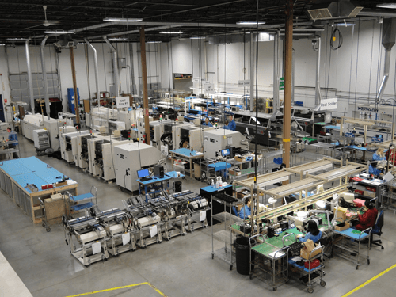
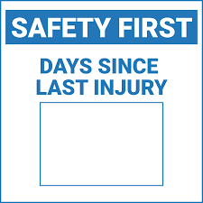
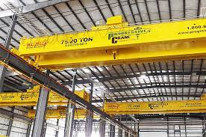
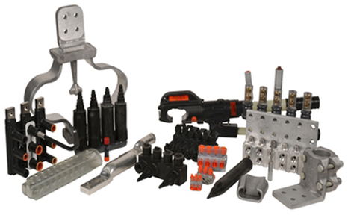
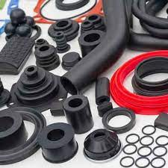
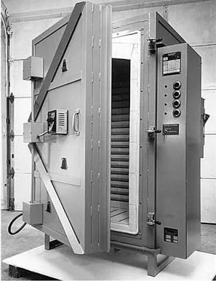
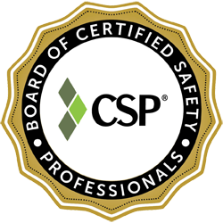
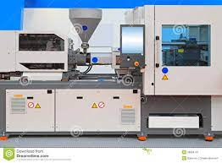
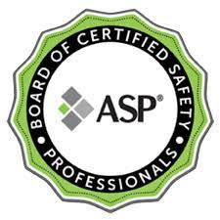
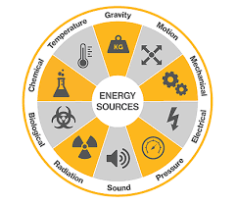
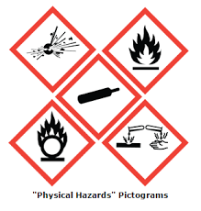
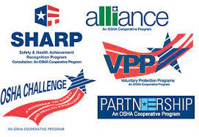
SAFETY CONSULTATION: A DIRECTED PRACTICAL RESEARCH PROJECT
Consultation Team: William Fearn, Irina Gheorghieva, Althea Gibbons, Cristhian Padilla Palacios, Daniel Sokol
Embry-Riddle Aeronautical University, College of Aviation
Company Background
Audit Results: Program Observations
Company identified via Chamber of Commerce (participation voluntary)
NAICS code 33531: Electrical equipment manufacturing
International corporation
Central Florida location
A few hundred employees
Two shifts, six days a week
On site health, safety, and environmental coordinator
Small quantity hazardous material waste generator
Focus on descriptive lagging performance indicators instead of predictive leading indicators not reflective of actual health & safety risk posture
Limited health & safety professional education and professional certification
Inadequate dissemination of company health & safety program documents
Lack of formal safety committee
PPE policies are not based on documented hazard analysis (e.g., inconsistent hard hat and respiratory protection policies)
“Days Since”: A
lagging indicator
Example Products
Safety Management System (SMS) Eval
Circuit breakers
Fuses and fuse holders
Ground fault devices
Voltage indicators
Substation components
Metering equipment
Relays and controls
Generator components
Switches and disconnects
Purpose and Method
Company is ISO 45001 certified, however, shortfalls were noted
Safety Policy: Company health & safety program documents are not printed, documents remain in the electronic “cloud,” documents are not readily available to workers
Safety Risk Management: No documentation of hazard analysis to support nonstandard activities and change
Safety Assurance: No documentation of a regular pattern of inspection and audit; company appears to rely on yearly ISO certification
Safety Promotion: Company overreliance on safety scorecards and reward programs may serve to deter reporting and mask hazards
Primary Goal: Enhance learning relevant to graduate studies in occupational health & safety management
Secondary Goal: Provide meaningful health & safety input to visited company
Method: Combine inspection and audit techniques to identify hazards and assess health & safety program effectiveness as a basis for practical improvement recommendations
Production Processes
Recommendations to Company
Injection molding (metal, plastic, rubber)
Hot dip coating
Electro plating
High temperature baking and processing
Machine cutting & stamping
Machine & hand sorting
Automated & hand packaging
Advantages & Limitations
Establish a professional development program for selected personnel to achieve Board of Certified Safety Professionals (BCSP) certification
Implement OSHA 10 and OSHA 30 training for selected personnel
Implement competent person level and train the trainer programs in selected, high-hazard production areas
Implement and document a job hazard analysis program with employee involvement
Conduct comprehensive review of hazardous waste programs
Consider implementing a total worker health program
Evaluate high energy release potential areas and implement a Serious Injury and Fatality (SIF) reduction program
+ Independent analysis of a functioning commercial enterprise
+ Interface with company Health & Safety Manager
+ Direct observations
+ Multiple observers provide diverse observation/analysis
- Time limitations
- Limited opportunity for reports & records review
- Tests limited to sound level readings with NIOSH smart phone Sound Level Meter
- No photos allowed
- No follow up visit planned
Top OSHA Standards Violated in Industry
Inspection Results: Hazard Observations
Conclusions
October 2010 to September 2021
OSHA Standard | Violations
19100217 | Mechanical power presses
19101200 | Hazard communication
19100030 | Training requirements
19100134 | Respiratory protection
19100137 | Electrical protective equipment
19100176 | Handling materials – general
19100212 | General requirements for all machines
19100332 | Training
19100333 | Selection and use of work practices
19100335 | Safeguards for personal protection
5A0001 | OSH Act General Duty Paragraph
Multiple high energy release points without adequate safeguards (e.g., high temp ovens, gantry cranes, forklifts, injection machines)
Molding processes create potentially dangerous levels of environmental heat and toxic vapors in work areas
Reliance on manual lifting persists despite slip, trip, and fall hazards
Unmarked chemical containers
Inadequate spill response
No hearing conservation program despite sound at OSHA action level (85 dBA)
Falling object hazards posed by gantry cranes and high rack storage systems
Fire extinguishers blocked, overdue inspections
Blocked eye wash stations
NOTE: Hard hats were not in use despite overhead hazards. Respiratory protection was not in use despite vapor hazards.
Complacency is dangerous. Past performance does not equate to a guarantee of future success.
ISO certification merely enables safety success, the utility of a SMS is based on consistent application of all structural elements over time.
A more robust program of hazard analysis to include investigations, inspections, and audits is required to further advance health, safety, and environmental programs at the visited facility.
The existing health and safety program provides a solid foundation for improvement. This company is postured to benefit by enrollment in an OSHA sponsored safety consultation program.
Project provided valuable insight into the practical complexities of occupational safety management.

