Slide 1
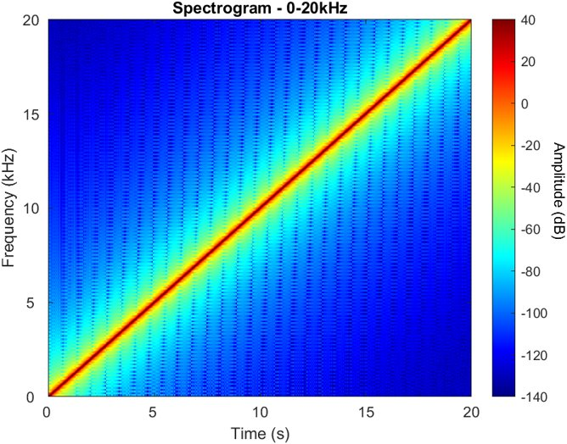
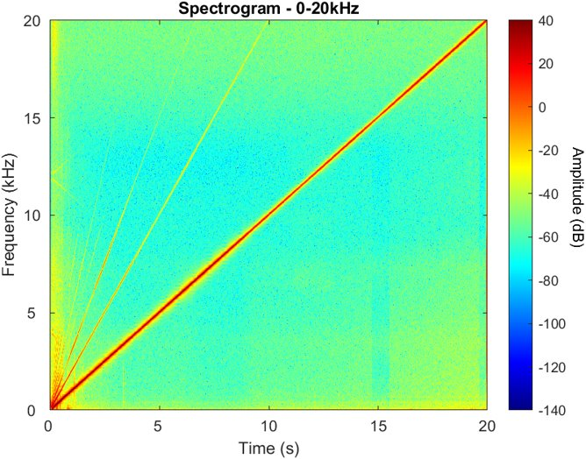
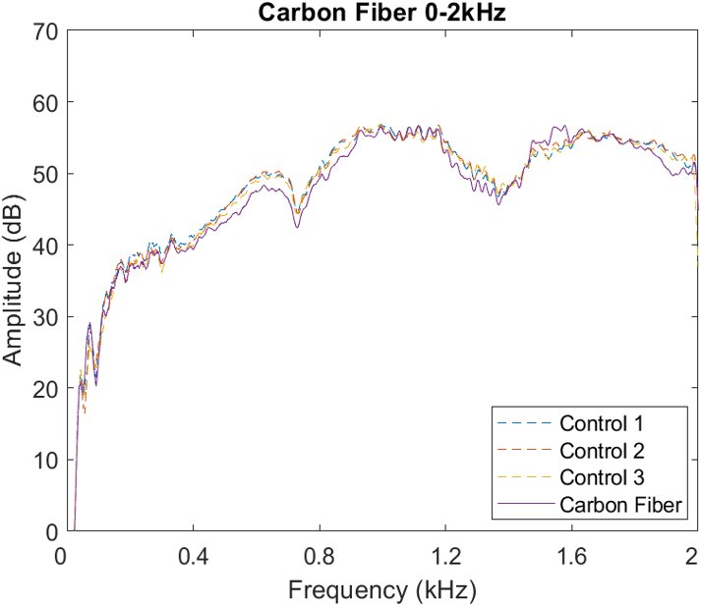
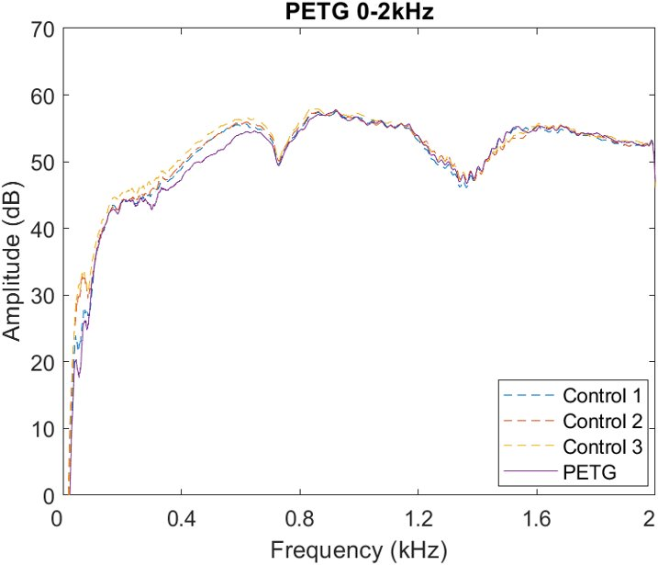
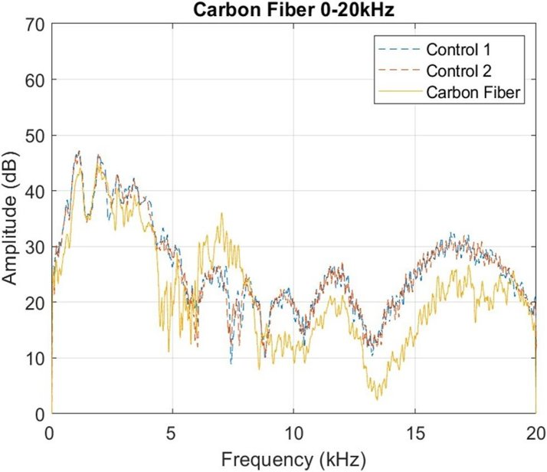
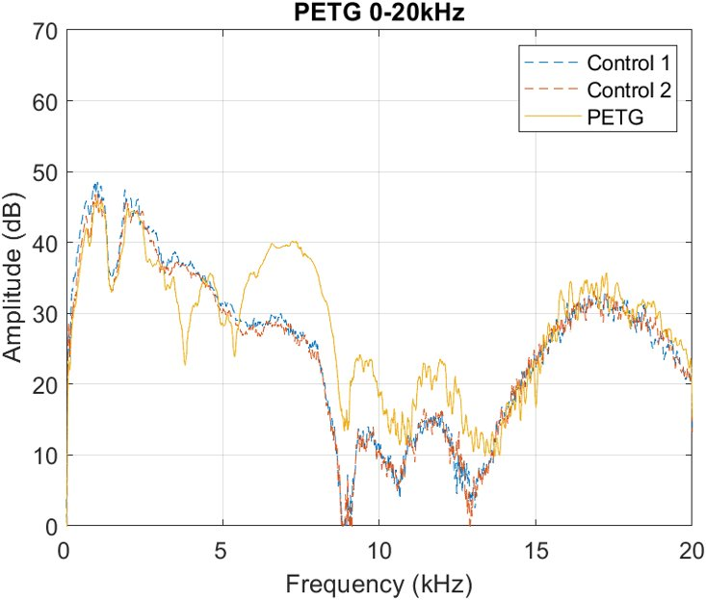
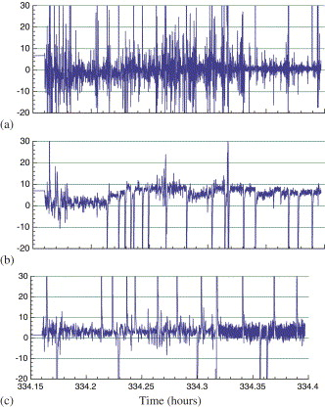
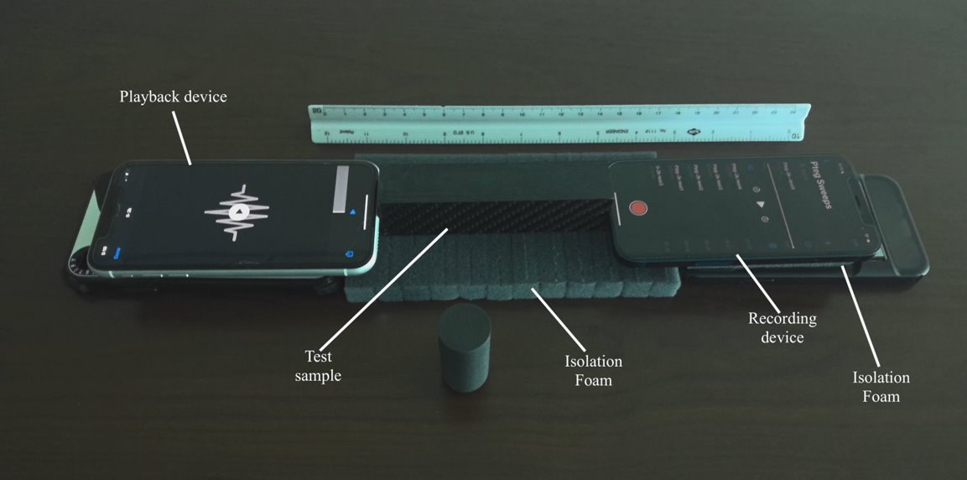
Application Of Vibrational Damping On Spacecraft Crew Capsule Design Using Common Aerospace Materials
Kody Parsotan & Seshan Jayapregasham
Embry-Riddle Aeronautical University, Daytona Beach, FL, 32114
ABSTRACT
MATERIALS & METHODS
RESULTS
RESULTS CONT.
During spacecraft reentry and launch, vibration due to aerodynamic drag and rocket propulsion can lead to the damage of important payloads and affect crew being transported into or out of Earth’s atmosphere. The load-bearing structures inter-mediating the inside and outside of the spacecraft must meet several standards to be able to perform their intended operations. This study aims to identify light-weight fiber composites that can alter vibrational frequencies and reduce high amplitudes of oscillation. A frequency sweep audio test is used to generate vibration through tested materials. The wave signals are recorded to determine the best materials for the design of vibration damping honeycombs. The results demonstrate how various alloys compare in their ability to attenuate vibration. The findings highlight a novel data sampling that can be further researched under the conditions of vibrations for applications in spacecraft for the protection of the payload and the crew.
Experimental design was driven around easily accessible testing equipment. Using a speaker, a linear audio sweep from 0Hz to 20kHz is produced through the sample. On the opposing side a microphone recorded the audio passing through the sample. Figure 2(b) shows the linear sweep is visualized through the smartphone microphone with air as the medium of travel by the sound waves. The spectrogram visualizes frequency and amplitude in decibels against time as indicated by the sloped red line. It can be assumed that the cutoff frequency of this microphone is beyond 20 kHz since the red line reaches this point. The clarity of this plot indicates the reliability of this microphone for data collection.
Figure 4 displays the frequency response function for both materials from 0–2kHz.
At a sweep rate of 0.1 kHz/s, neither material showed a definitive resonance peak.
Damping quality factors could not be provided through the half-power method below the range of 2 kHz.
Slight damping can be noticed in the regions of 0.3 to 0.6 kHz in the PETG sample
Slight damping 0.5 to 0.7 in the Carbon Fiber sample.
Controlled room with little noise does not reflect spacecraft situations
Temperature and environment of crew capsule during ascent and descent are subject to extreme temperature and vibration
Damping quality factor at room conditions could be measured
Crew capsule honeycomb is not represented in the study
Natural frequency is dependent on shape of structure
Error originates inability to simulate a free-free end system as assumed in theoretical values
Vibrational loss into acoustic foam is not represented in any equations
INTRODUCTION
CONCLUSIONS
The design of a spacecraft requires a complex union of all involved parts where each component fulfills several roles. Materials that intermediate the walls of a spacecraft must be able to sustain high temperatures and great amounts of alternating shear. During the most physically strenuous stages of a spacecraft’s mission, launch and atmospheric reentry, fluctuating pressure loads caused by unsteady flows induce vibration of the spacecraft [1, 2]. Figure 1 shows acceleration of NASA’s Space Shuttle Orbiter mass center during the STS-62 mission. The change of acceleration raises concern for spacecraft integrity and human safety.
PETG functions well as a damping material at lower frequency ranges
Carbon fiber has little to no effect below 2 kHz range.
CFRP displayed better damping abilities at higher frequencies of 10 kHz whereas PETG displayed resonance peaks
Smartphone recording and sound generation can provide consistent data for damping information
Limitations include lack of simulation of spacecraft conditions: temperatures, G-loads, & structural shapes
Errors originate from sample layout
Fixed-free end system can be better simulated in a lab and mitigate errors from vibrational loss into foam
Alternate filtration methods can isolate peaks close to each other
(a) The original audio sweep processed into a spectrogram
(b) Recording of the original audio sweep played from the speaker, recorded by the smartphone microphone
Fig. 4 Frequency response function for 0-2kHz sweep in PETG and Carbon Fiber
Fig. 2 Spectrogram of the audio sweep used in the experiment
PETG and Carbon Fiber from 0-20kHz shown in Figure 5
PETG performs well as a damping system in lower regions but resonates beyond 5 kHz
CFRP acts as a better damping system from the range 10kHz to 2kHz
A linear audio sweep is played from 0-2kHz with a rate of 0.1kHz/s
3 control trials separated by empty space (length of each sample)
5 trials with samples in between
Mental performance decreases occur 0 to 300 Hz ranges [3]
Whole body vibration studies have indicated tactile sense is affected between 30-300Hz [4]
Muscle stiffening occurs 4-9Hz
Crew capabilities may be hindered by these challenges
The same process was followed for the 0-20kHz audio sweep. The testing setup is shown in Figure 3.
Structural damage becomes prominent in the kilohertz range.
Heat resistant materials are used to maintain safe internal temperatures
Alloy/composite honeycomb adds stiffness with little weight.
Rubber can provide damping from viscoelastic properties, but metals are efficient due to physical structure
Grain boundaries and phase dislocation contribute to damping abilities of metals
Choice of honeycomb materials are critical in reducing the vibrations transmitted to crew
Vibrations from spaceflight make civilian transport difficult for space travelers.
REFERENCES
[1] Cockburn, J., and Robertson, J., “Vibration response of spacecraft shrouds to in-flight fluctuating pressures,” Journal of Sound and Vibration, Vol. 33, No. 4, 1974, pp. 399–425.
[2] Blanchard, R. C., and Nicholson, J. Y., “Orbiter rarefied-flow reentry measurements from the OARE on STS-62,” Tech. rep., NASA, 1995.
[3] Buckhout, R., “Effect of Whole Body Vibration on Human Performance,” Human Factors, Vol. 6, No. 2, 1964, pp. 157–163. URL https://doi.org/10.1177/001872086400600205, pMID: 14211968.
[4] Clark, J. B., “Human Issues related to Spacecraft Vibration during Ascent,” Consultant Report to the Constellation Program Standing Review Board
[5] “Boeing: Starliner CST-100 Reusable Spacecraft Capsule,” https://www.boeing.com/space/starliner/
Fig. 5 Frequency response function for 0-20kHz sweep in PETG and Carbon Fiber
At a sweep rate of 1 kHz/s and a max frequency of 20 kHz, damping factors were calculated from all five trials and displayed in Table 1. With this information, the maximum sweep rates were determined for both materials. The maximum sweep rate for both materials are significantly greater than 0.1 kHz/s. The experimental values for natural frequency and their corresponding relative standard deviation indicate the experimental natural frequency for both materials consistently found by following this experimental method. The theoretical values for natural frequency do not however follow this trend.
Fig. 3 Smartphone sweep experimental setup, isolation foam added underneath test specimen and phones.
Fig. 1 Axial (a), vertical (b), and lateral (c) acceleration data from Space Shuttle mission STS-62 [2].
Common materials in aerospace engineering are titanium, aluminum, steel, and carbon fiber
Carbon fiber is one of the lightest options with a density of 1.8 𝑔/𝑐𝑚3, 2/3 the density of aluminum
Crew capsule designs such as the Boeing CST-100 need to have weldless honeycombs to avoid weak points in the structure [5]
Carbon fiber Reinforced Polymer (CFRP) does not need to be welded but regular layup of material can be too difficult to shape or mold
3-D printed CarbonX (PETG) can be designed and printed efficiently into a honeycomb shape
Critical damping of PETG and CFRP can be obtained by plotting frequency bandwidths and using the half-power bandwidth method for analysis
Table 1 Natural frequency, damping ratio, and sampling rate obtained from 0-20kHz experiment.
A commonly used method to identify damping capacities is through frequency bandwidths. The half-power bandwidth method can be used to estimate single and multi-degree-of-freedom damping of structures. Through the identification of resonant peaks in a frequency-amplitude function, damping capacity can be calculated using the width of these peaks. Utilizing common microphone and speaker equipment, damping and natural frequency of free-free end systems can be discerned.
Material​ | $F_{avg}$(Hz)​ | ​$F_{RSD}$(Hz)​ | $F_{theoretical}$(Hz)​ | ​$Q_{avg}$ | $S_{avg}$ (kHz/s)​
CarbonX PETG​ | 6997.9​ | 0.0273​ | 7359.1​ | 4.42​ | 625.1​
CFRP​ | 7717.3​ | 0.0014​ | 6647.9​ | 53.61​ | 56.8​
ACKNOWLEDGEMENTS
PETG can filter out frequencies harmful to humans during spaceflight
Frequency sweeps using smartphones can be a consistent method of identifying frequency response
CFRP performs well as a damping system from 10 kHz to 20 kHz
The authors wish to thank faculty at Embry-Riddle Aeronautical University for advice and opportunities that led to the ideas for the topic of this paper. Dr. Stanislav Sikulskyi and Nicholas Reed for their guidance on the project. Alexander Lanyi for proposing alternative analysis methods.

