Slide 1
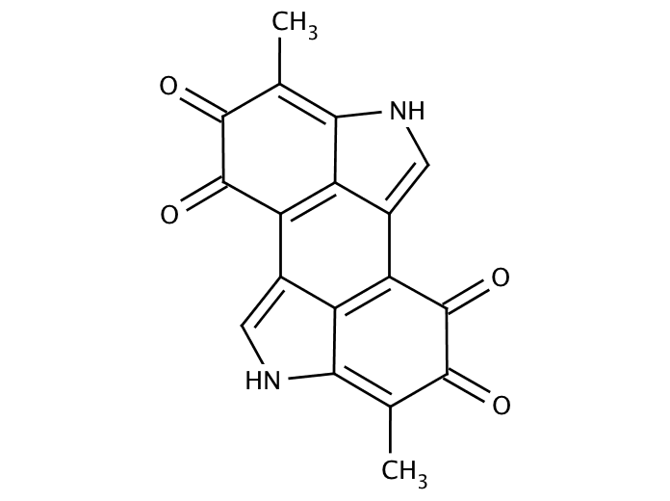
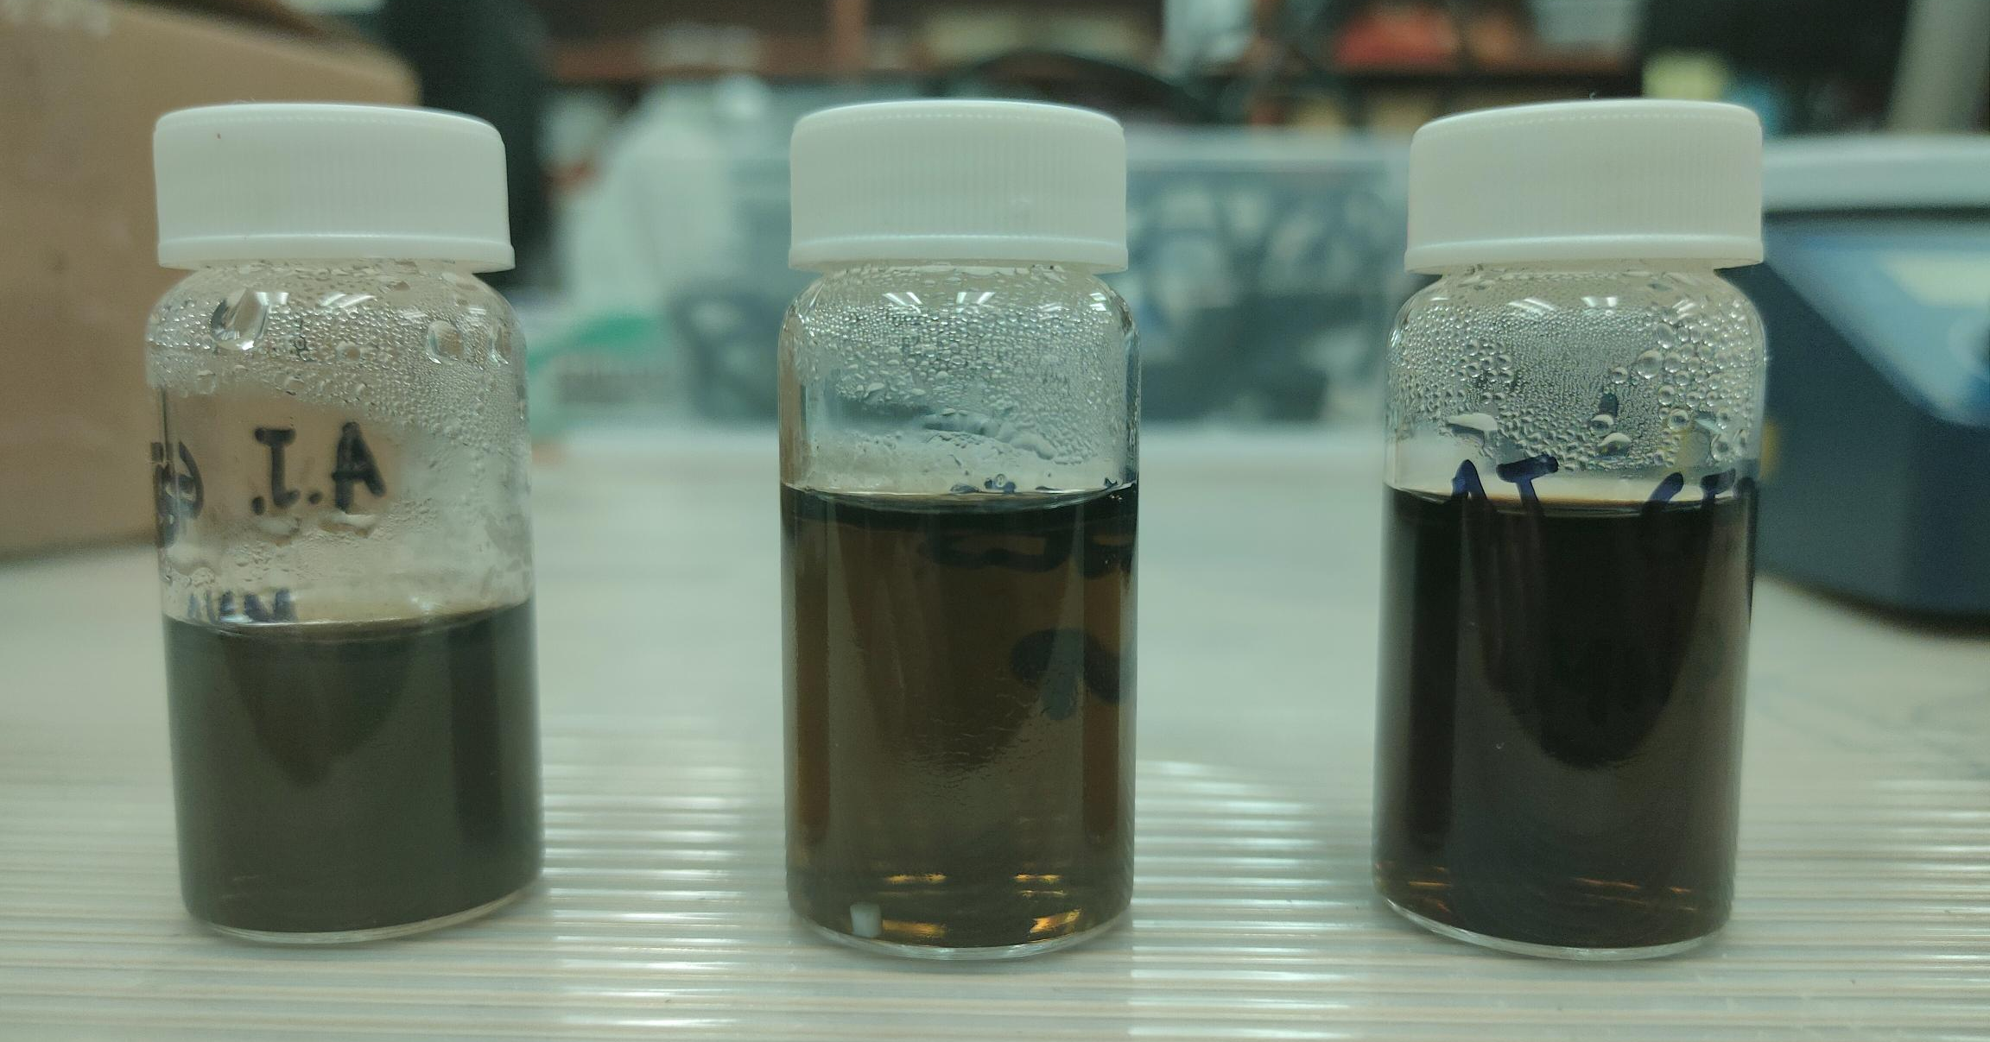
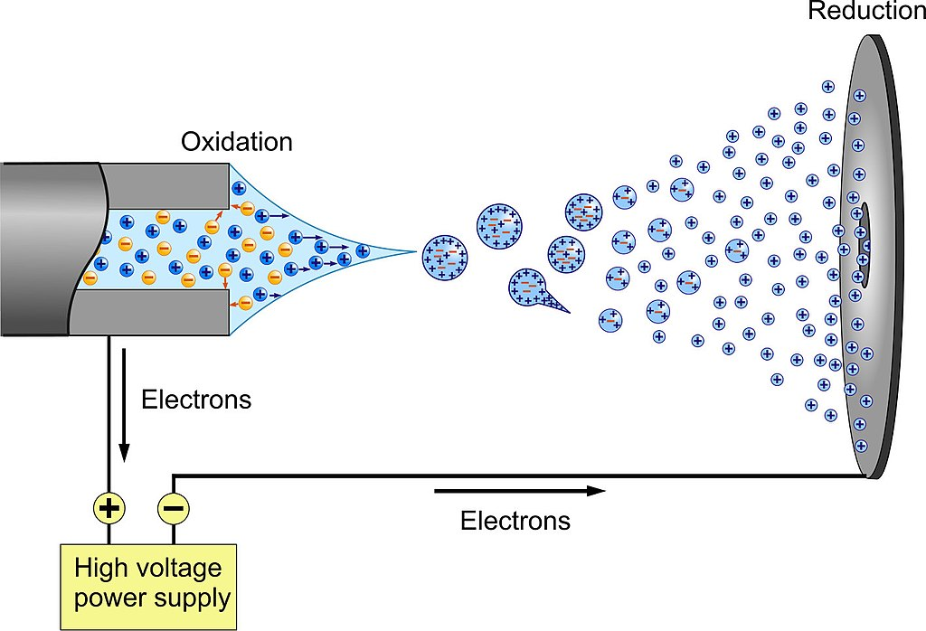
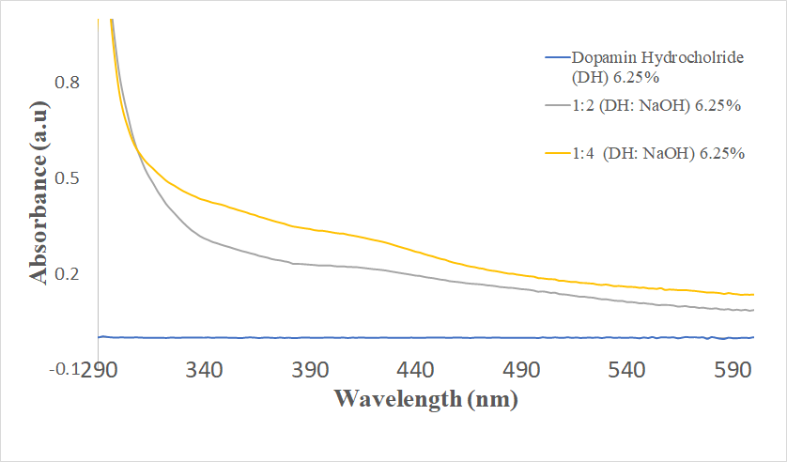
Synthesis and Electrospray of Radiation-blocking Melanin Nanoparticles
Giulia Stewart*, Aria Jafari*, Amelia Hartnett, Sahil Ghate, and Foram Madiyar
*Department of Aerospace Physiology and Neurobiology, Department of Aerospace Engineering, Department of Physical Science, Embry Riddle Aeronautical University, Daytona Beach, FL
I. Introduction
III. Results
IV. Future Applications
Melanin, an organic dark pigment naturally produced in most mammals, is known to shield cells from radiation damage by absorbing UV rays. This project’s objective is to fabricate a novel radiation-blocking material by synthesis of melanin nanoparticles (MNP)
Goal: electrospray of MNPs onto glass slides to produce thin-layer of nanoparticles
Future Characterization Methods of Nanoparticles
- FTIR analysis
Zeta Potential measurements to understand surface charge
TEM to measure diameter and distribution of the particles
SEM images with Energy Dispersive X-­Ray
Electrospray on flat substrates and UV radiation blocking tests
Organic compound with anti-radiation properties
Affordable to fabricate
Wide range of applications
Fig 3: Investigation of the change in concentration of the dopamine hydrochloride and sodium hydroxide 1:1, 1:2, 1:4 ratios. A change in color from clear (beginning of the reaction) to black (end of the reaction , 3 hours) was observed.
II. Materials and Methods
MNPs are synthesized using three methods
Method 1: Eumelanin synthesis in basic solution
Method 2: Chitosan-coated eumelanin
Method 3: Selenomelanin
Currently, melanin synthesis has been conducted using Method 1 with pH and temperatures as variables.
Fig 5: Schematic image of electrospray process
Results
V. References
[1] Cho, Soojeong; Kim, Shin-Hyun (2015). Hydroxide ion-mediated synthesis of monodisperse dopamine–melanin nanospheres. Journal of Colloid and Interface Science, 458(), 87–93. doi:10.1016/j.jcis.2015.06.051
(2) Roy, S.; Hai, L. V.; Kim, H. C.; Zhai, L.; Kim, J. Preparation and characterization of synthetic melanin-like nanoparticles reinforced chitosan nanocomposite films. https://www.sciencedirect.com/science/article/pii/S0144861719313979 (accessed Feb 16, 2022).
Acknowledgments: We thank for the financial support of the Office of Undergraduate Research at Embry-Riddle Aeronautical University, Daytona Beach, FL
Fig 4: UV-spectrophotometric analysis of different concentration ratios of the Dopamine Hydrochloride and Sodium Hydroxide solutions. Water was used as a blank solution and Dopamine Hydrochloride was used as a comparison solution (reaction, 3 hours)
Fig 2: Schematic image of the experimental procedure for the synthesis of eumelanin nanoparticles using Dopamine Hydrochloride and Sodium Hydroxide.

