Slide 1
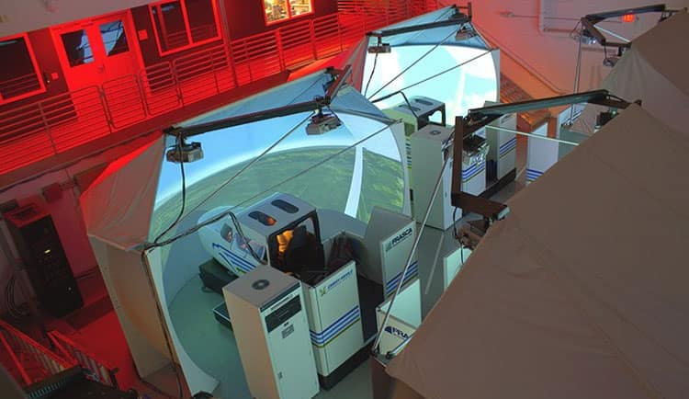
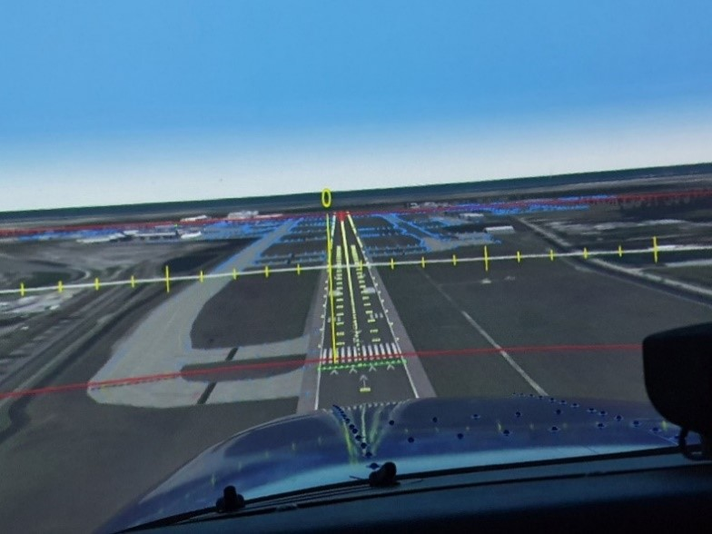
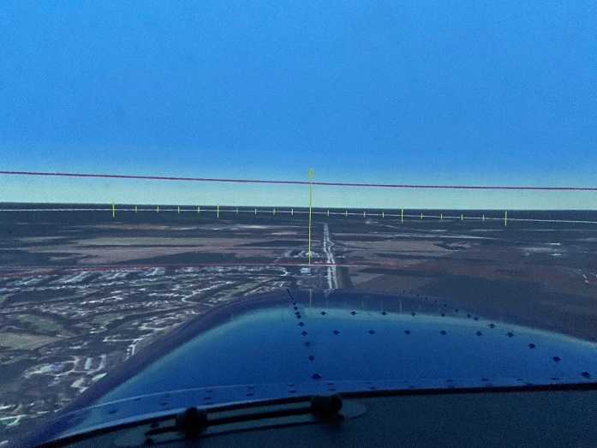
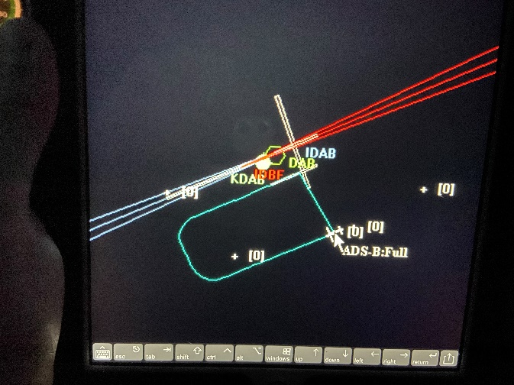
Visuals
Usability Analysis of a Landing Visual Aid as an Instructional Aid for General Aviation Pilots
Researchers : Shlok Misra, Victor Fraticelli Rivera, Nikhil Khale, and Jorge L.D Albelo
Simulator Visual Aid
Abstract
Un-stabilized approaches pose a major risk for the safety of flight. As of October 2020, there were over 220,000 active general aviation aircraft in the United States, and there were 3,257 general aviation accidents in the landing phase of flight from 2009 to 2019. Enhanced pilot training and the use of simulation techniques have been recognized as effective risk mitigation techniques by accident investigation agencies globally. This study will be targeted towards the further development and testing of a training aid (Crosswinds Training Aid) for General Aviation pilots with special emphasis on collegiate aviation flight students.
A crosswind landing visual aid was conceptualized and developed by the researchers and technicians at the Advanced Flight Simulation Center at Embry-Riddle Aeronautical University’s Daytona Beach campus.
The researchers aim to test the usability and validity of the training aid through simulations with up to 70 flight students of the university.
The data collected will include quantitative data.
The findings of the study will be used to further enhance the training aid that will benefit the Embry-Riddle student community.
Front- Pilot Perspective Traffic Pattern Configuration
Problem Statement
Teaching an ab-initio pilot to land an airplane is a challenging task for a flight instructor. Landing is a safety critical phase of flight that requires high precision and a deep understanding of the airplane. Some key challenges that students face while learning normal and crosswind landings include:
Visualizing the effect of crosswinds on the flight path
Understanding and implementing the change of flight controls during the round-out and flare segment of a landing.
Visualizing the effect of aileron and rudder inputs to maintain a “wing-low” landing method.
Visualizing the longitudinal axis of an aircraft to be parallel and aligned with the runway centerline.
Applying flight control input to avoid a side-loading condition during aircraft touchdown.
Method
Data Collection:
Data will be collected from 70 participants who are at least certified as Private Pilots but not certified as Airline Transport Pilots or Flight Instructors. The participants will be asked to fly a few traffic patterns at an airport with a crosswind condition in two phases: without the visual aid and with the visual aid. Data will be collected from two surveys that will measure the familiarity of the participants with crosswind landings and their feedback on the visual aid. Additionally, the Instructor Pilot conducting the study will grade five elements of the landing on a 5 point scale that has been validated to measure crosswind landing performance. The Instructor Pilot will grade the landing performance without the use of the visual aid and with the use of the visual aid.
Process Data:
The study utilized a within-subject experimental research design. The two surveys will be used for descriptive statistics to assess the familiarity of the participants to crosswind landings and their experience using the visual aid. The 5-point grading scale used by the Instructor Pilot to grade the landing performance without the visual aid and landing performance with the visual aid will be used to conduct paired sample t-tests to assess THE hypotheses. A total of five null hypotheses in regards to landing performance will be tested.
Expected Results
At the conclusion of the study, we expect to gather:
Data from two surveys that will be used for descriptive statistics. The data will be used to assess the experience of the participants with different aspects of the visual aid and their experience with crosswind landings.
Data from the Instructor Pilot evaluation. The evaluation without the visual aid and with the visual aid will be used to test five hypotheses regarding different aspects of a crosswind landing. The data will be used to conduct paired sample t-tests at a significance p<0.05 to test the null hypotheses.
The results of the study will be shared with the Flight Department administration and published in a peer-reviewed scholarly journal to share our findings with the academic and flight training community.
References
Aircraft Owners and Pilots Association. (2020). Accident Analysis. https://www.aopa.org/training-and-safety/air-safety-institute/accident-analysis

