Slide 1
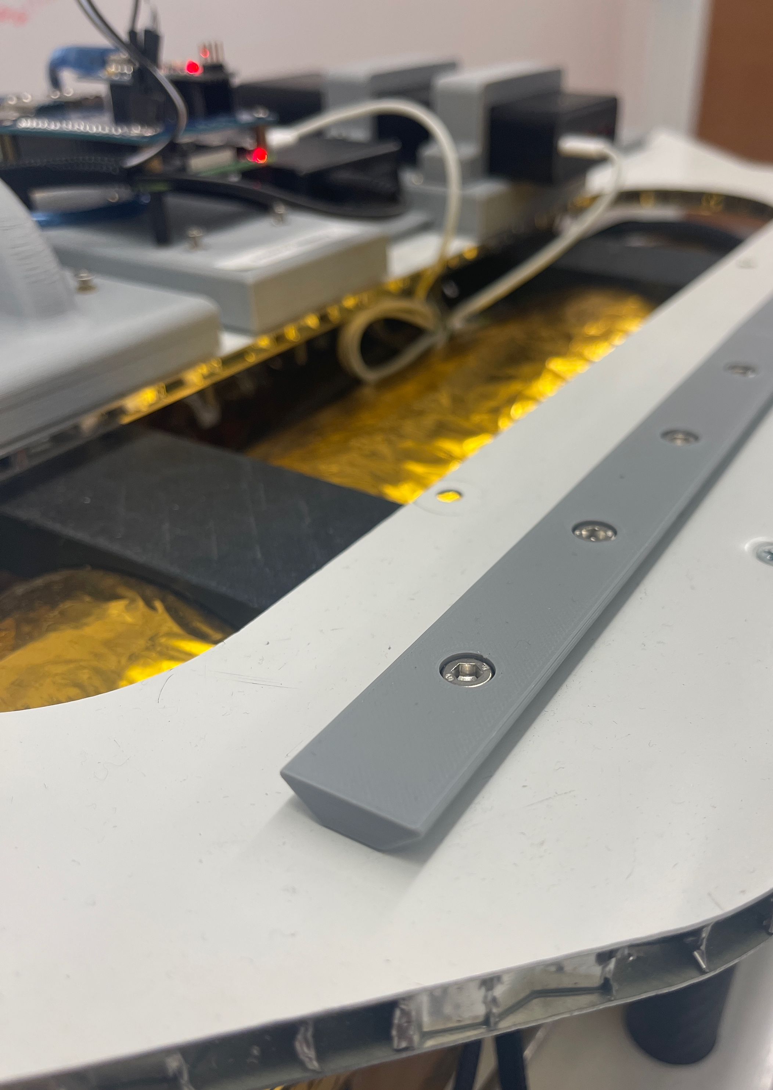
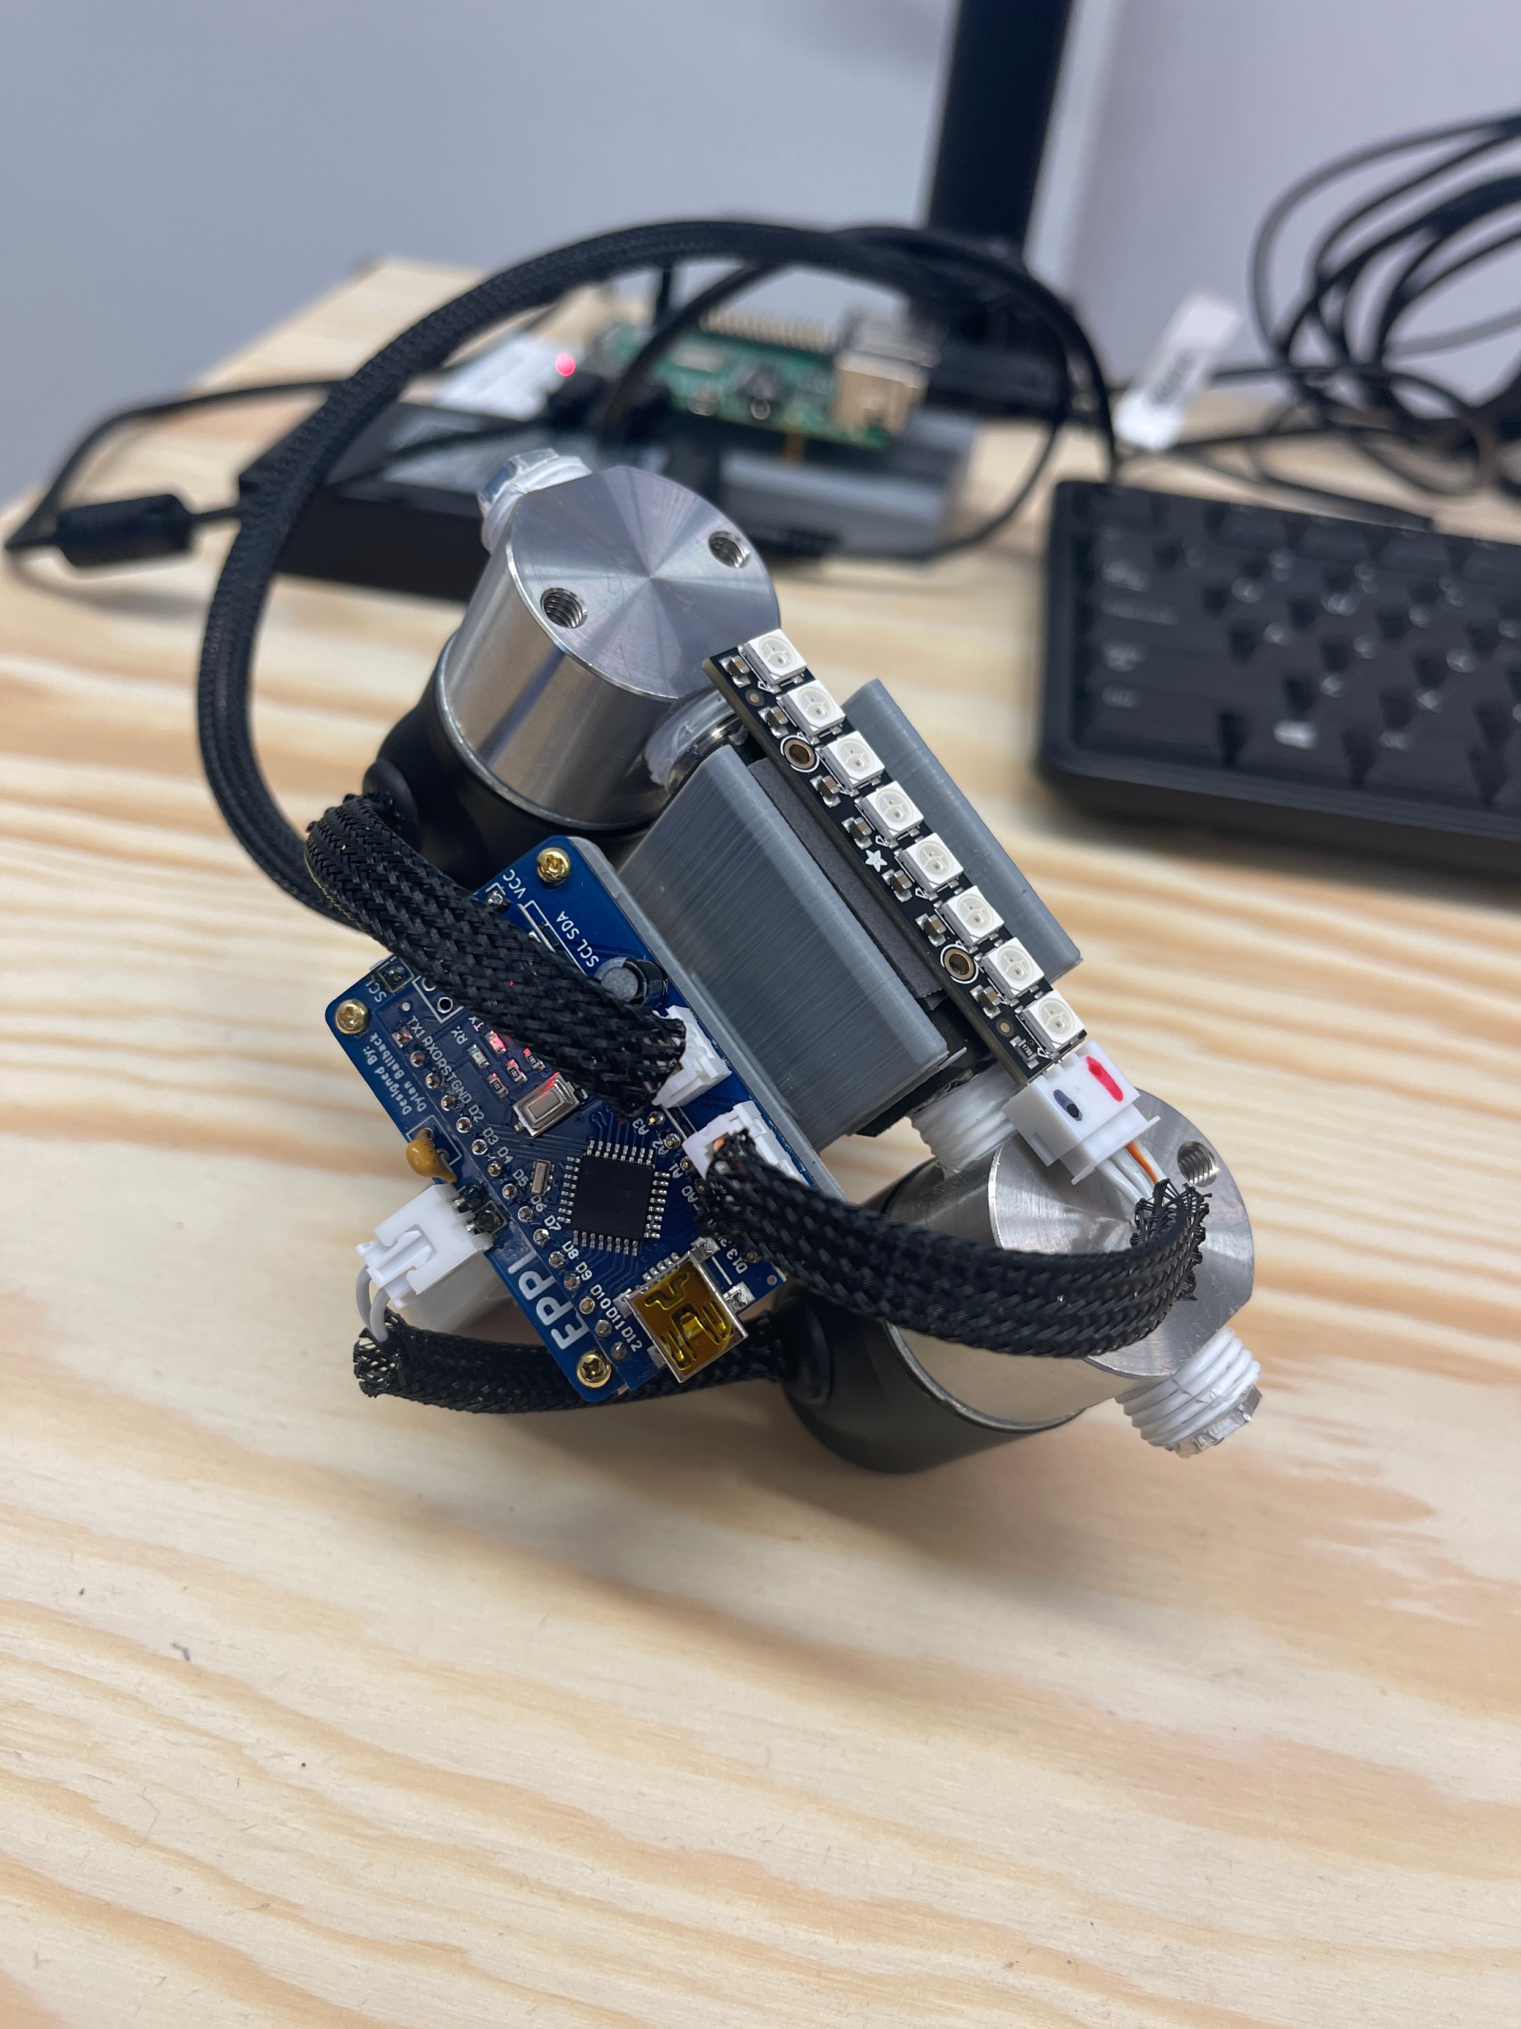
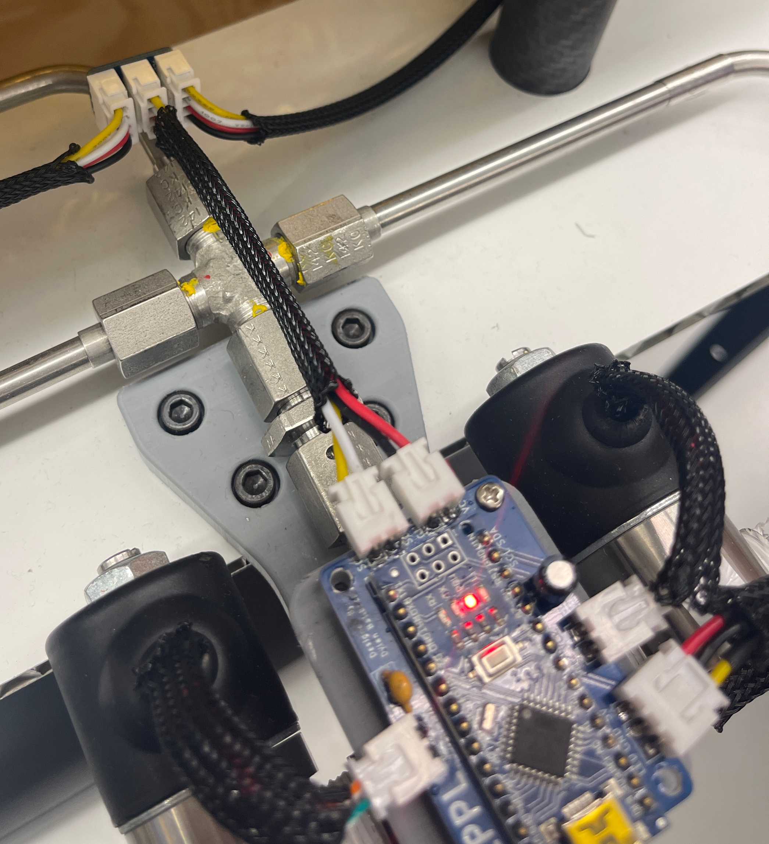
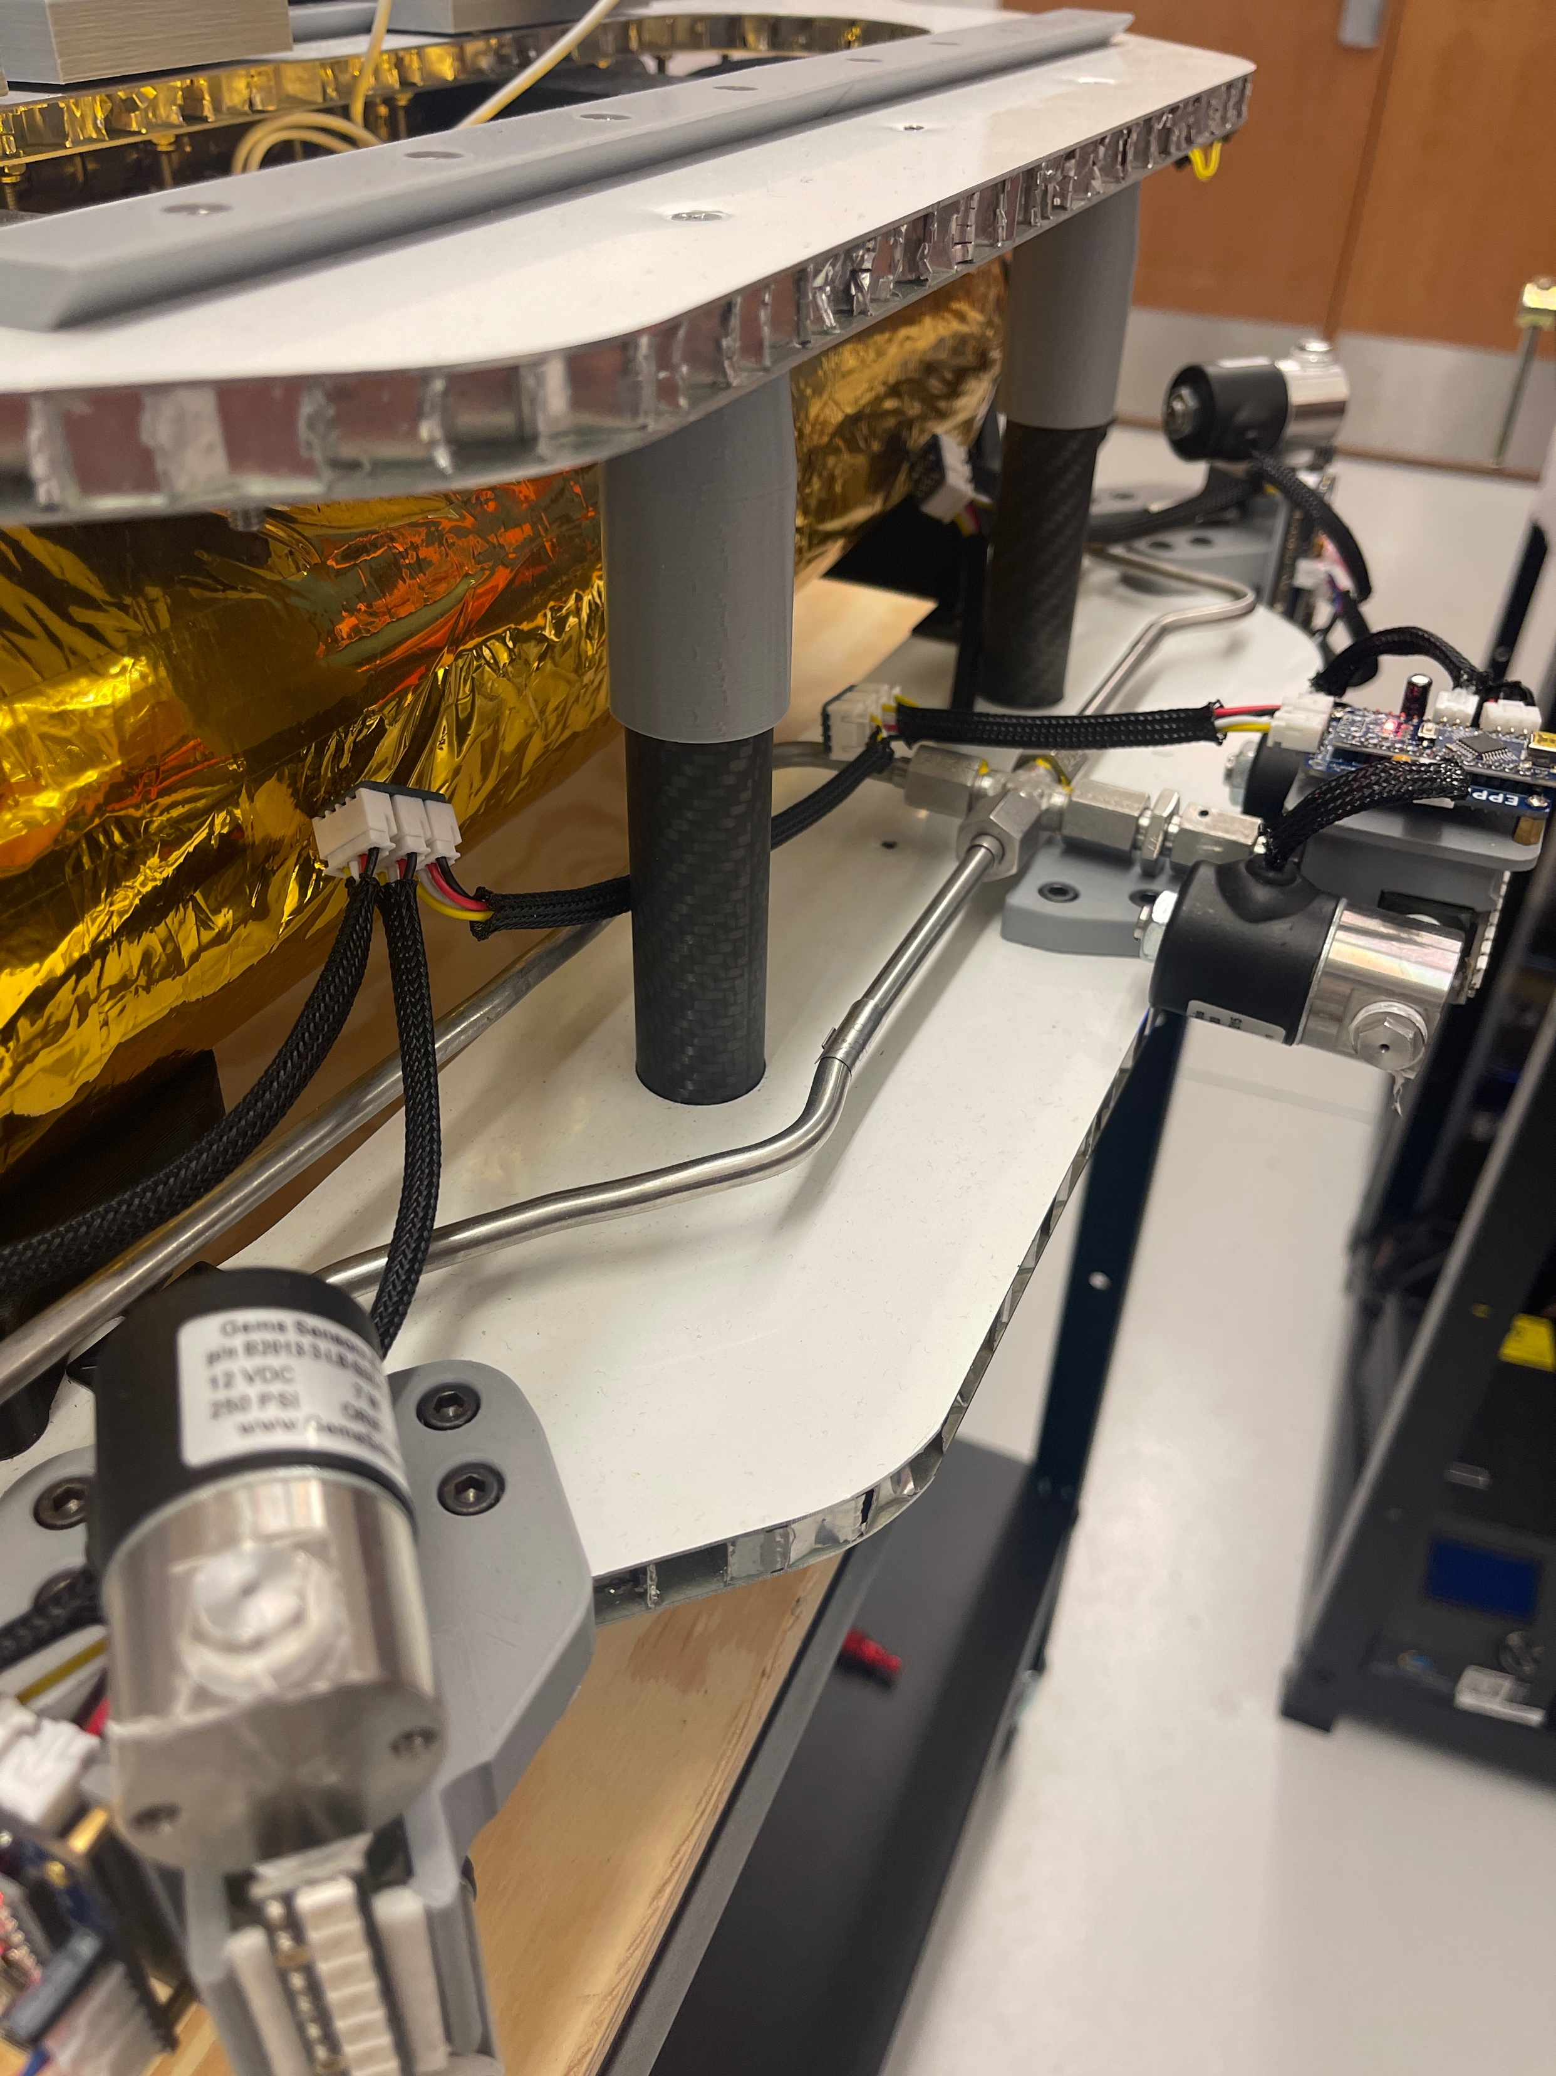
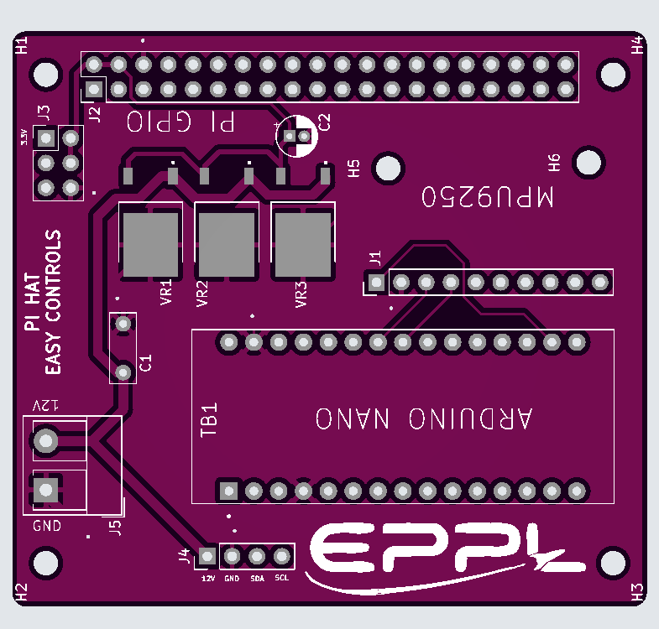
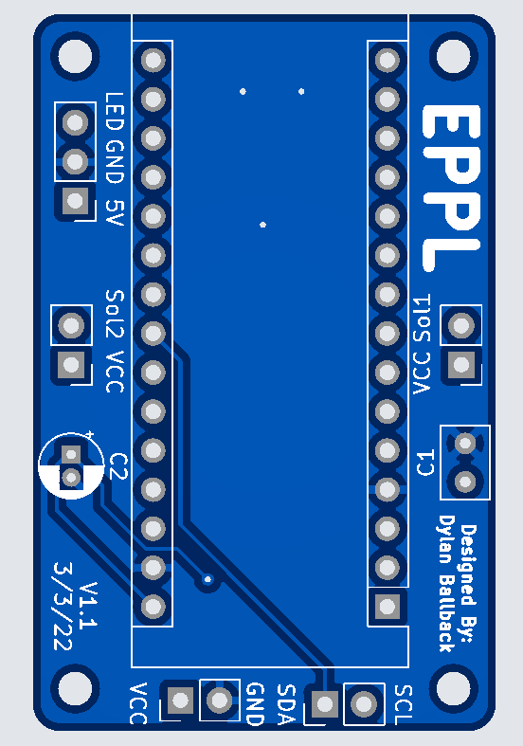
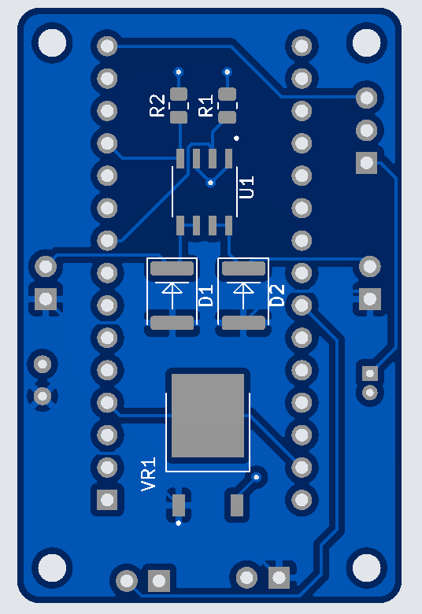
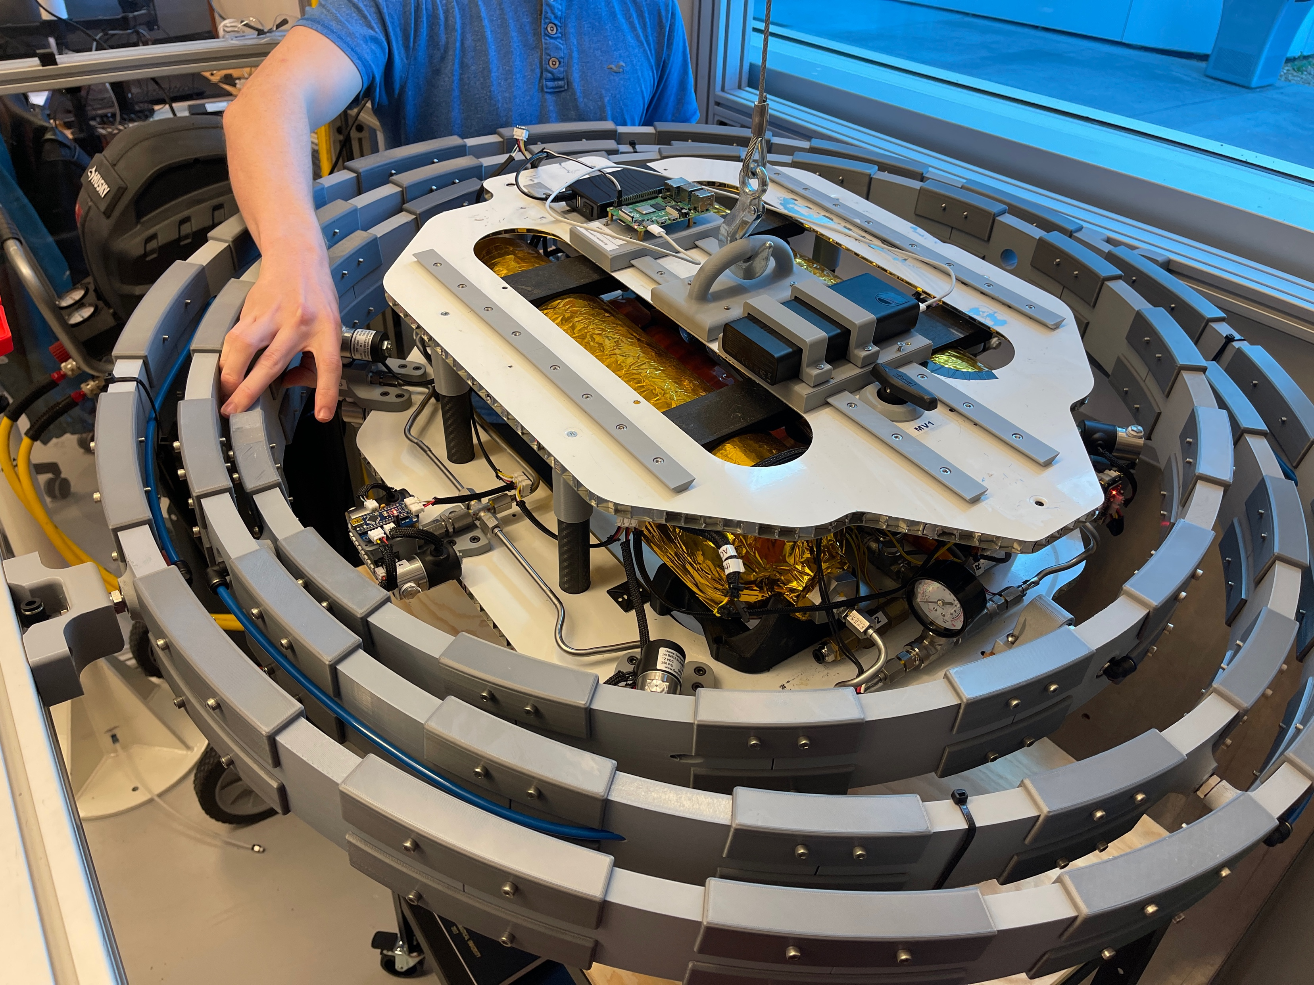
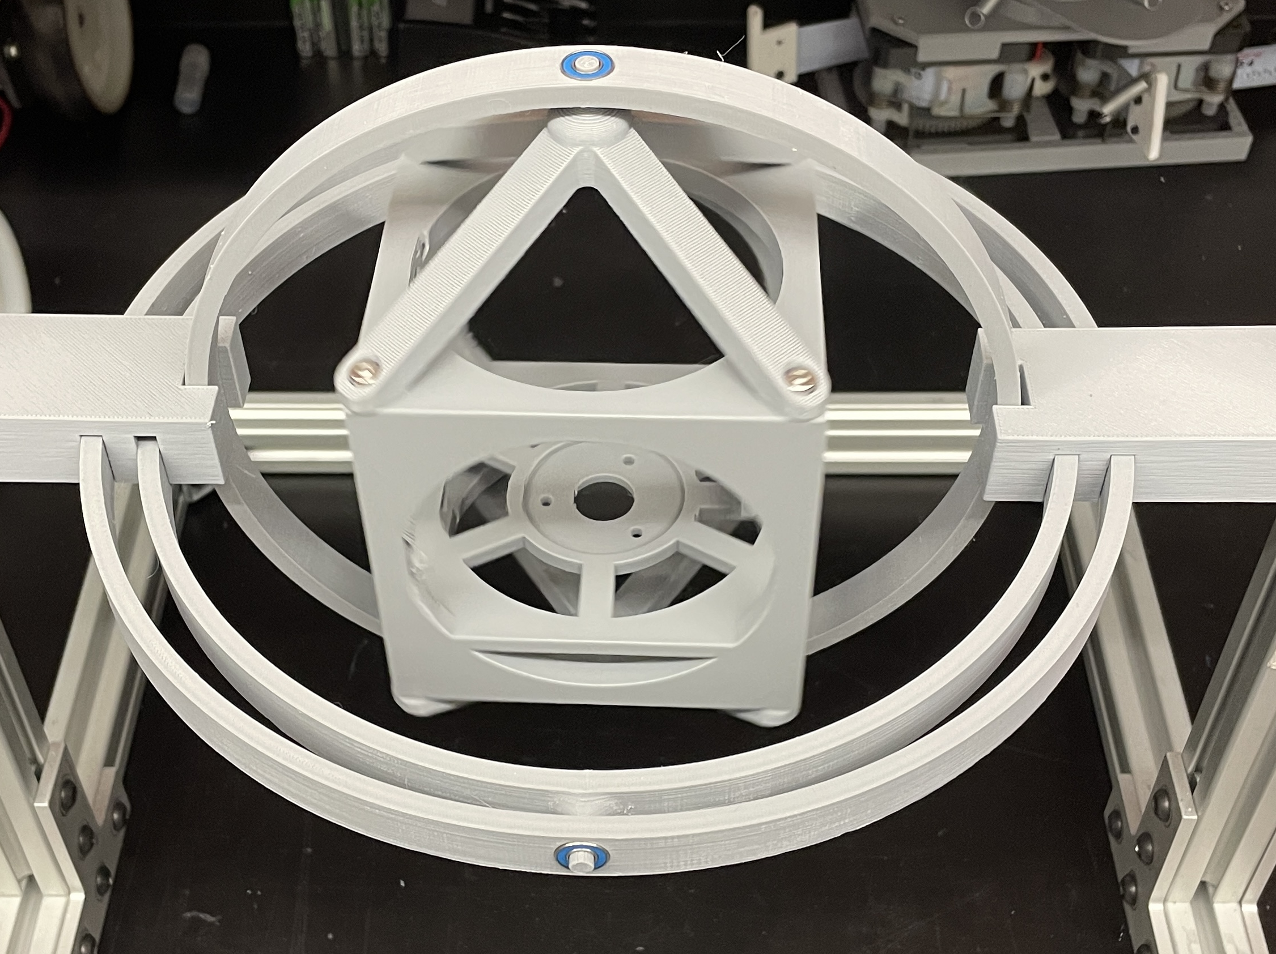
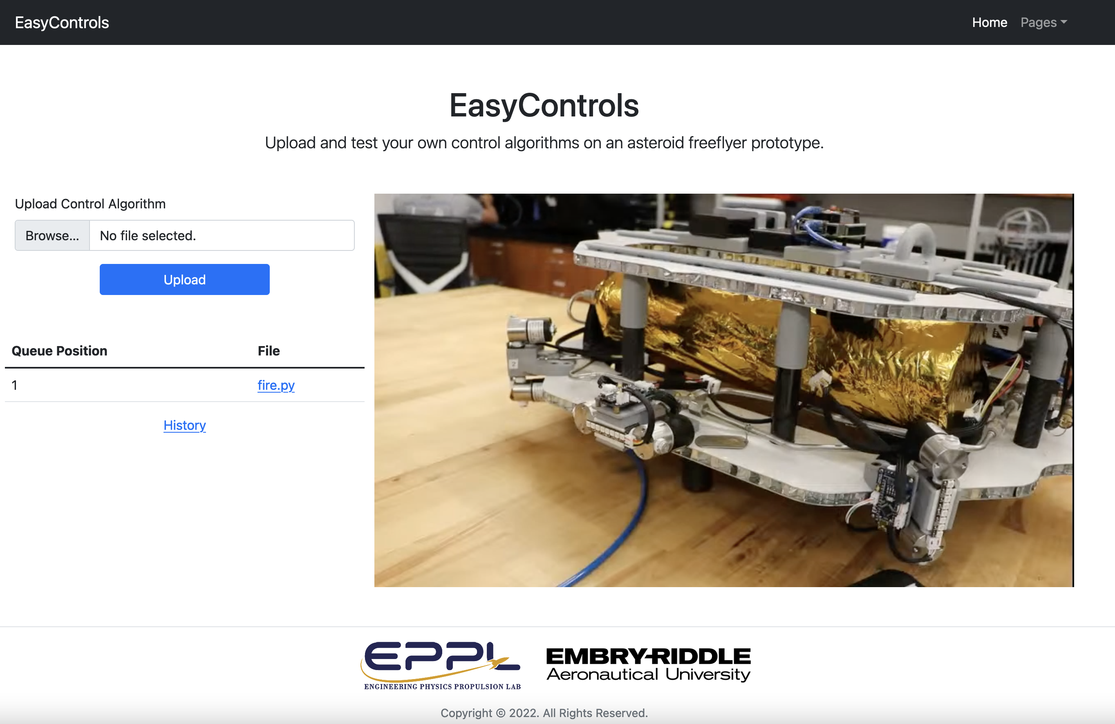
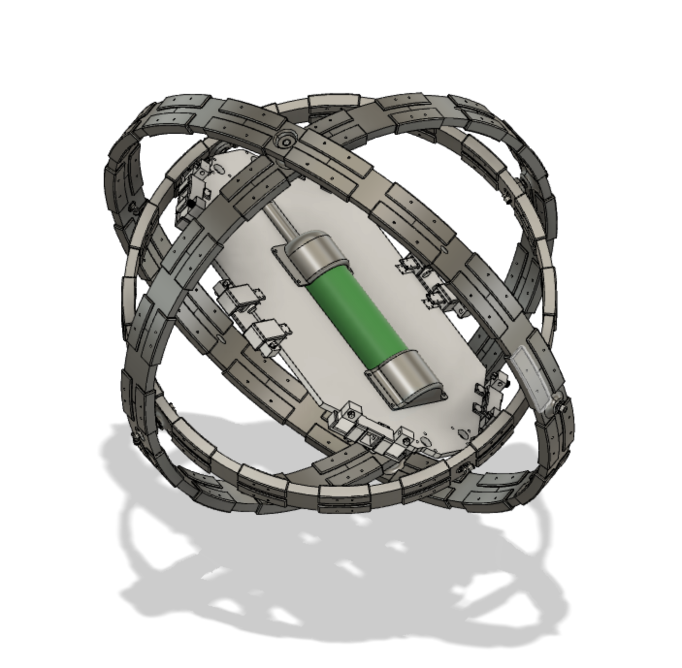
EasyControls.org - A real life platform to learn spacecraft controls from your browser.
By Daniel Wilczak, Dylan Ballback, Leonard Farrell, Jacob Romeo, Adam Duke and Kyle Fox
Developed in the EPPL under Dr. Sergey Drakunov
Abstract
Spacecraft modification
Spacecraft Electrical
The purpose of this project is to retrofit the existing NASA asteroid prospector flyer prototype electronics, software, and gimbal system to allow anyone interested in controls to go online and connect with a real working device. Test their own control algorithms on a live device that is connected to the global internet. The Asteroid prospector flyer prototype spacecraft was created by Swamp Works engineers at NASA's Kennedy Space Center in Florida for prototyping flying robotic vehicle that can gather samples on other worlds in places inaccessible to rovers.
RAIL SYSTEM: Rails were added to allow for easy instillation and removal of different components.
Hoist Adapter: Due to the size and complexity of mounting to the gimbal rings a host point adapter was created.
A PCB was developed for each of the six thrusters so that each can be connected independently. A PCB hat was also developed to allow a nano to sit on top of the raspberry pi to allow for continuous IMU data via serial while reducing the number of power system on the spacecraft.
I2C Wiring: Was used to simplify the wiring scheme. This greatly reduced the amount of wiring by 10x while also allowing for built in redundancy via two-way i2c communication to each device on the bus.
future goals
1. Carbon fiber rings to prevent bowing.
2. Update website example code and easier useability.
3. Build v2 of hat and implement gyro code for user.
Gimbal system
Website
Research collaborations
3D printed gimbal: With such a complex system rapid iteration was necessary to quickly come to an optimized solution. 3D printing with multiple printers gave us this ability.
The EasyControls.org website was developed to give users the ability to upload python code that would directly run on the hardware and watch run using a YouTube live feed directly on the page.
CubeSat: Inspired by NASA free flyer, but instead of using a large spacecraft with pneumatic thrusters it uses reaction wheels house inside a 1U CubeSat for attitude controls.
CAD Drawing: Using fusion 360 we developed the entire gimbal system with all its individual components. This allowed us to rapidly iterate on our design without having to worry about tolerancing and fit of the spacecraft to the gimbal
ISAAC: New version of NASA free flyer, with the goal to reduce the overall weight to improve efficiency by reduce the testbed’s inertia for increased attitude control performance.
Notes:
To change this poster, replace our sample content with your own. Or, if you'd rather start from a clean slate, use the New Slide button on the Home tab to insert a new page, then enter your text and content in the empty placeholders. If you need more placeholders for titles, subtitles or body text, copy any of the existing placeholders, then drag the new one into place.

