Slide 1
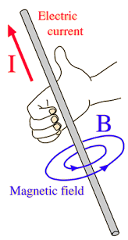
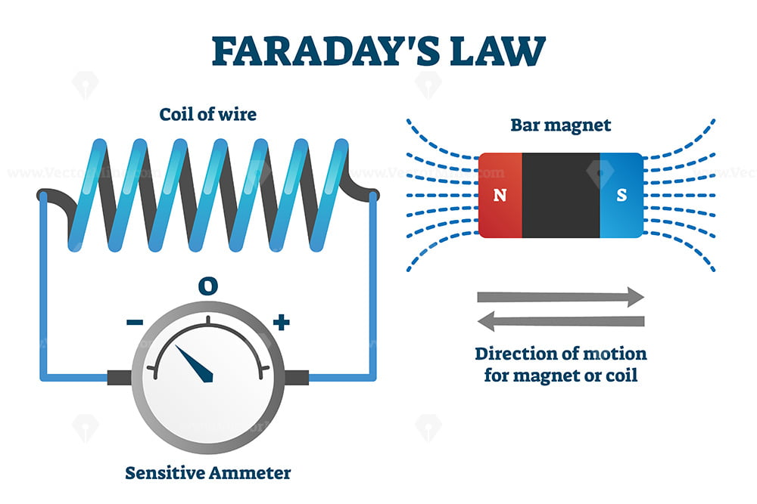
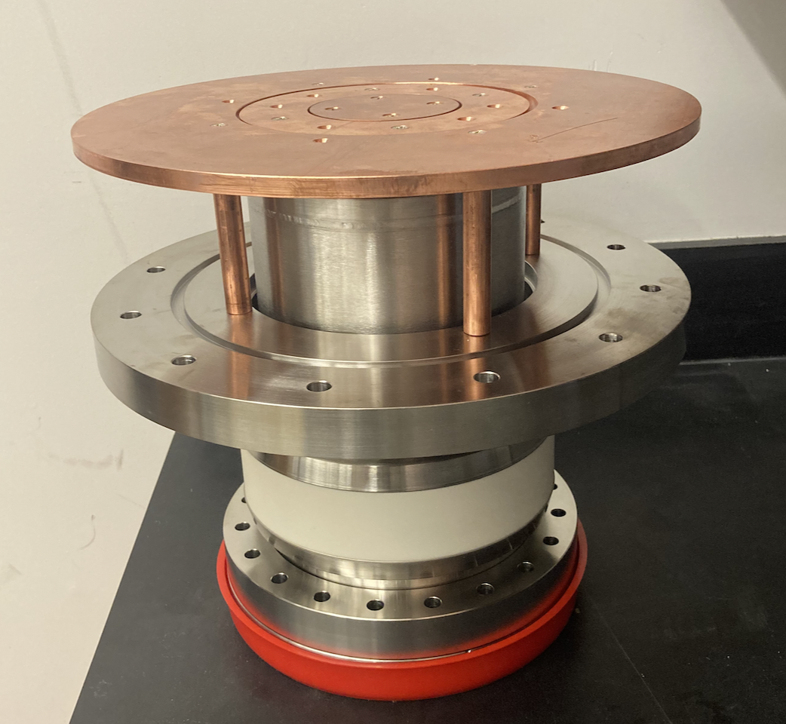
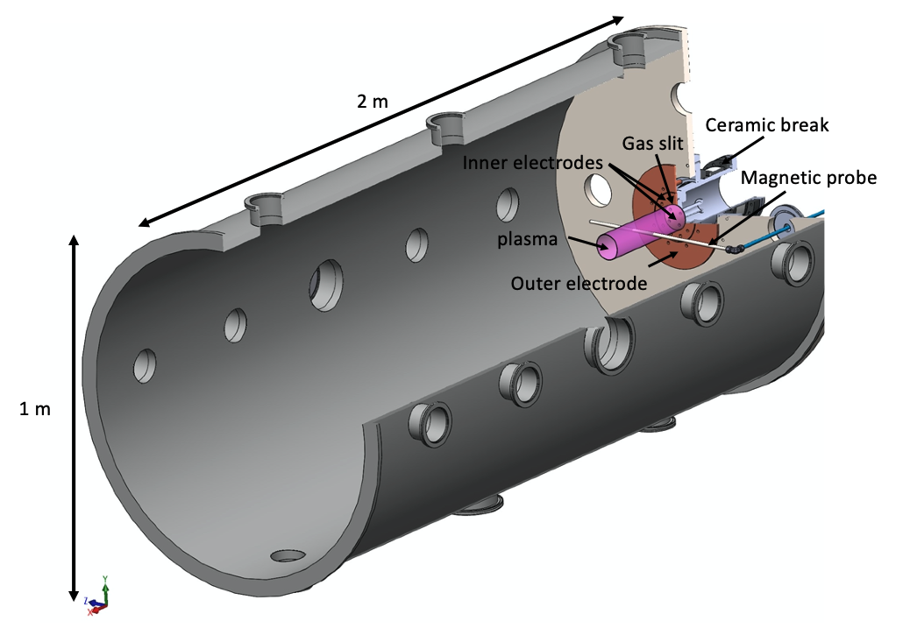
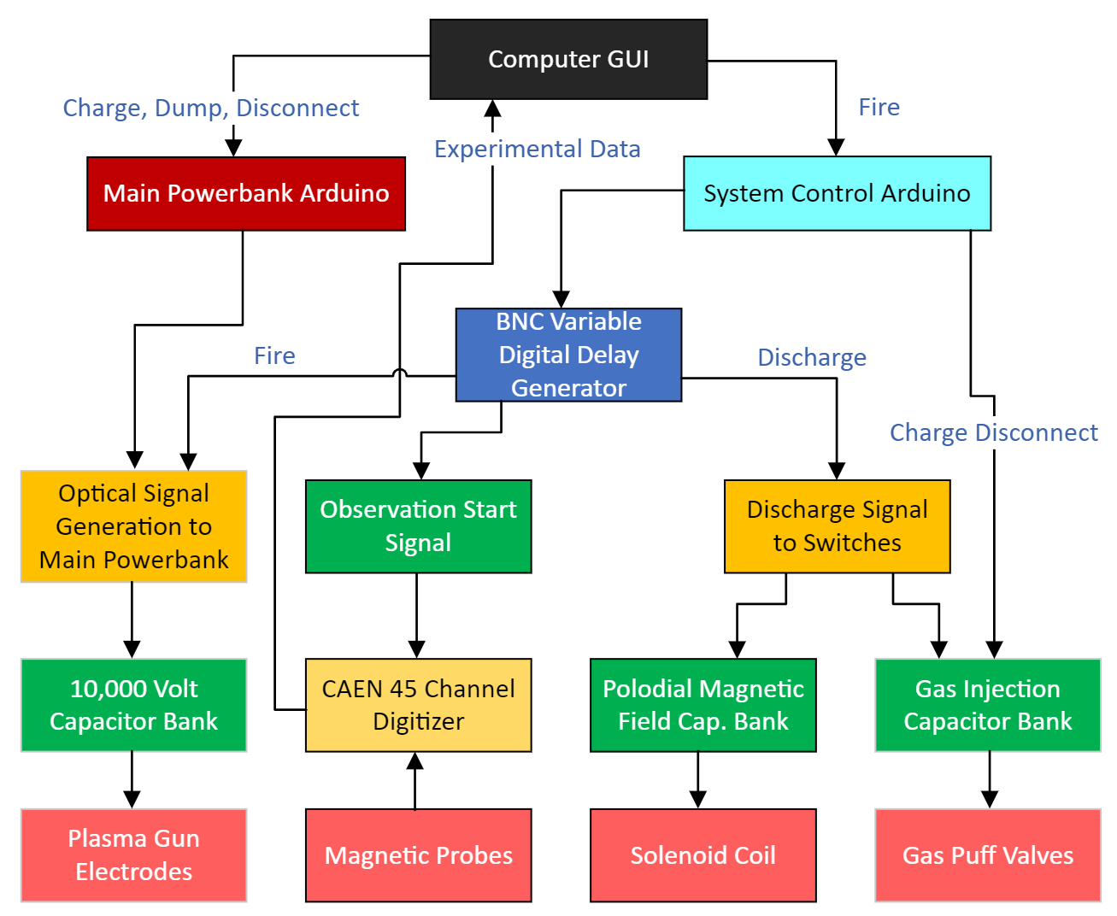
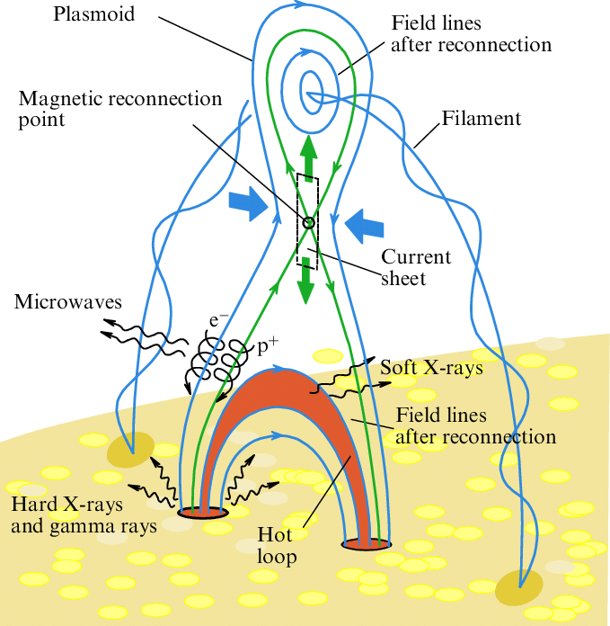
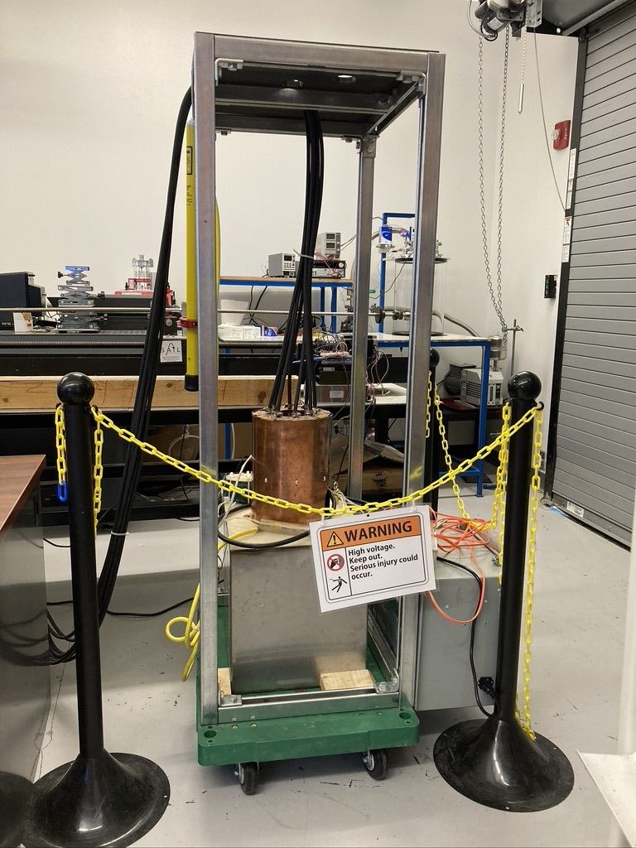
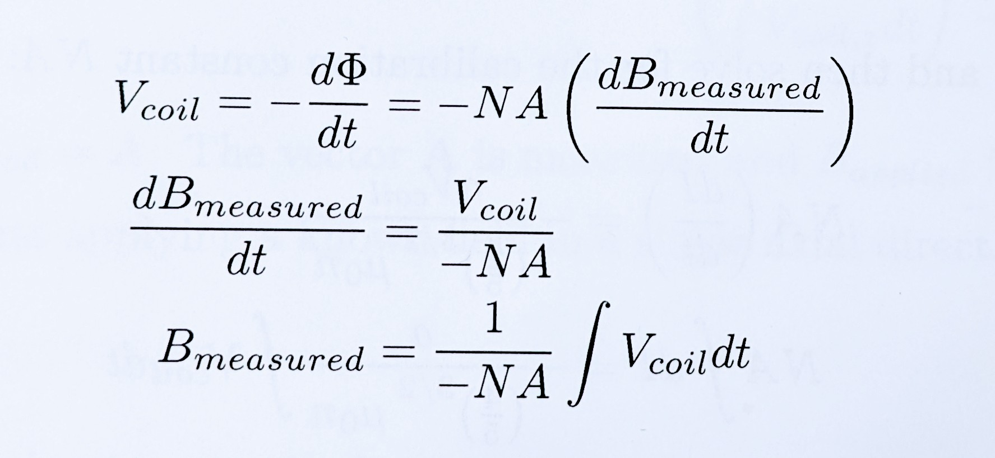
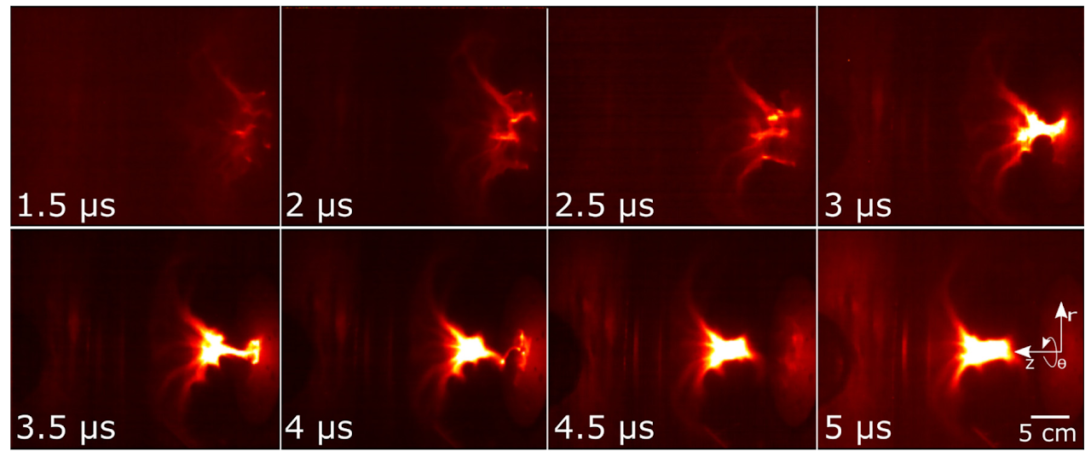
Study of a Supersonic Magnetized Plasma Jet
with a Magnetic Probe Array
Christopher Lamb, Dr. Byonghoon Seo
Embry-Riddle Aeronautical University
Magnetism and Plasma
Experimental Setup
Why measure the magnetic field of a plasma?
Fundamentally, plasma consists of a cloud of charged ions and electrons. Charge moving on along a path will induce a magnetic field. According to Faraday’s Law, this magnetic flux will interact with an inductor. The strength and direction of the changing field can be used to deduce key characteristics of the plasma: electric field characteristics, ion and electron density, velocity, and as a byproduct, temperature.
ERAU’s Magnetic Probe Array
Shown above is the magnetic probe array, housed in a quartz sleeve, with a calibration electromagnet positioned over a set of inductors. The calibration tool must be aligned with system axes, and produces a field two orders of magnitude larger than the earth’s Background field. The data obtained from this process is then used to form a calibration matrix, through which all subsequent data will be processed.
What Instrument is Used to Observe Magnetic Fields?
A inductor is sensitive to changing magnetic fields, which produce an induced voltage across the ends. The magnetic probe array (MPA) being developed at Embry-Riddle’s plasma physics lab has 15 sets of 3-axis orthogonal inductor clusters. These inductors measure changing magnetic fields along each axis. The probe can be rotated and translated, so over many identical short bursts of plasma formation, a 3-D vector space of magnetic fields can be built up of a specific combination of parameters.
Magnetic Reconnection:
A process in which part of the magnetic field energy is converted and released as heat and kinetic energy in a plasma [1]. Reconnection is used to model and understand solar flares and coronal mass ejections. 3 dimensional reconnection is not fully understood, so the main study we’re preparing for is to evaluate the efficacy of energy transfer between the input power and kinetic energy transferred to the plasma. Reconnection can have applications in fusion pre-heating and in-space electric propulsion.
- (Above) Plasma chamber at ERAU [2]
(Right) An experimental system flowchart of ERAU’s new plasma gun.
- (Below) The 10K volt main capacitor bank. This capacitor is discharged in 5*10^-6 seconds.
Faraday’s Law of Induction:
Where N is the number of turns and A is the area of the coil. , so a calibration process is to be conducted. This also corrects for sensor misalignments.
References:
- (Above) A field line view of solar flare magnetic reconnection.
Photo courtesy of reference [3]
- (Far Right) Reconnection in laboratory plasma[2]
[1] Deanconu et al, 31st Plasmadynamics and Lasers Conference.
[2] Dr. Byonghoon’s research website:
sites.google.com/view/byonghoon/home
[3] Lysenko et al, DOI:10.3367/UFNr.2019.06.038757

