Slide 1
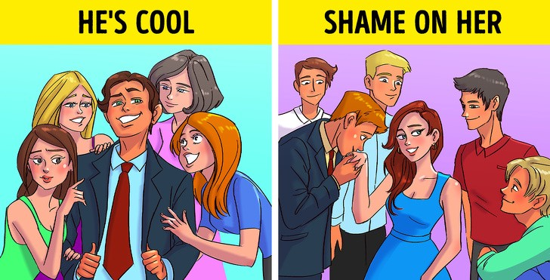
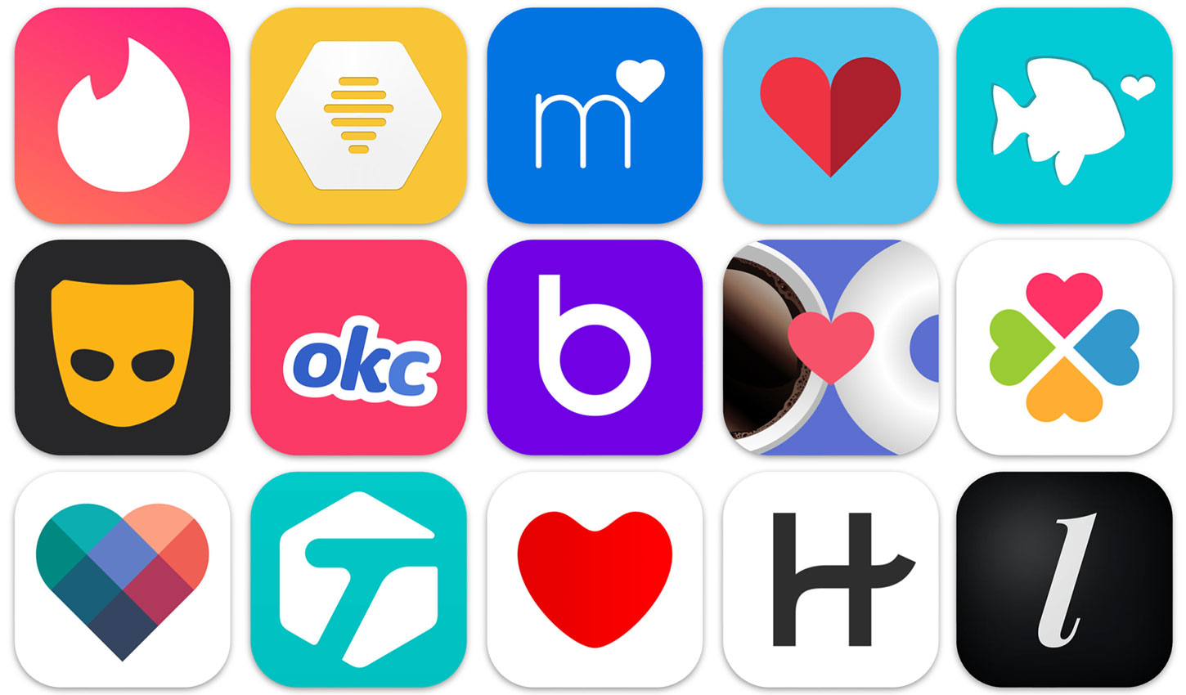
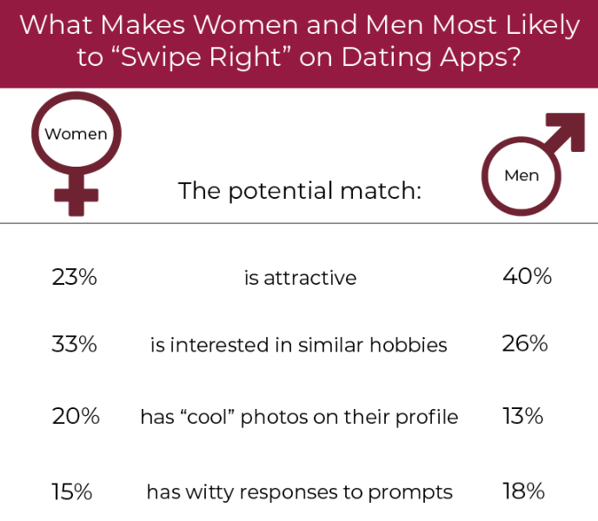
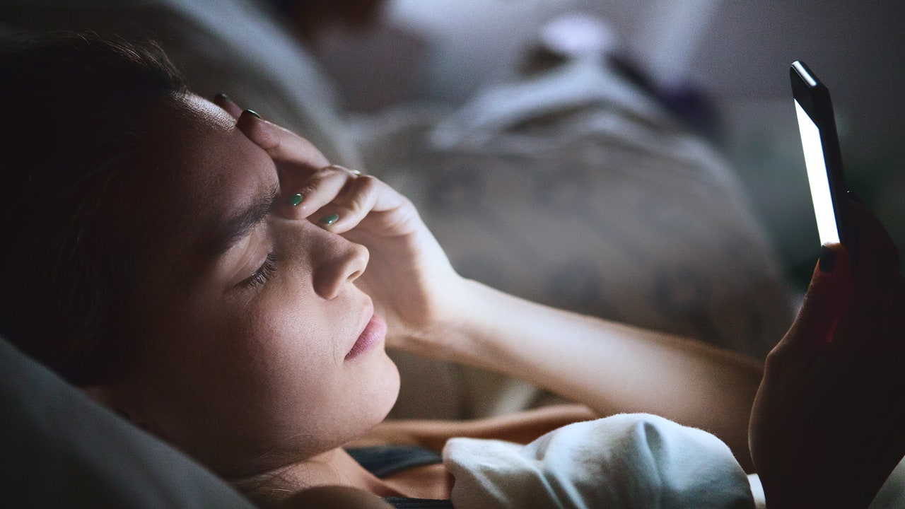
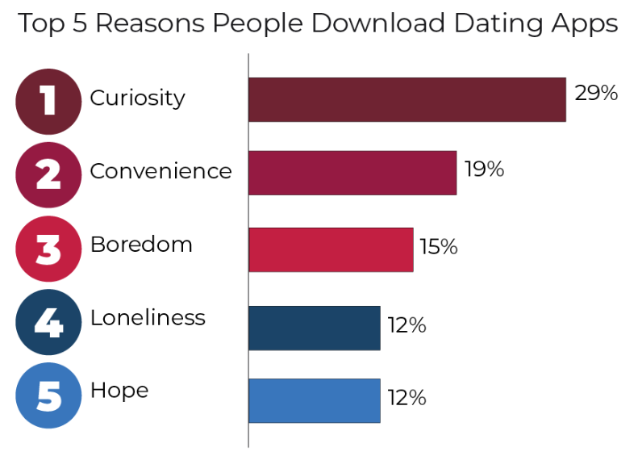
The Great Divide on Vulnerability : Dating Applications vs. Reality
Joseph Adams & Dr. Emily K. Faulconer
Worldwide | Embry-Riddle Aeronautical University
Mechanical Engineering
Abstract
People lose their self-expression skills in the non-digital world.
Dating apps = psychological distress, anxiety, depression, or self-image issues [1].​
Goal = find and resolve differences between intimate expression in an online and real-world setting
The data collection is in progress = needed IRB approval
Cannot change people’s communication customs, but we can close the digital and real-world gap when verbalizing intimate feelings.
Literature Review Findings
No empirical statement on the use of dating applications
Sexual Minorities = use apps more but no specific reason
Applications changed interface = COVID-19 pandemic
Higher sexual disgust = less likely to use dating apps
Dating applications = intensify double gender standards
Methodology
Quantitative analysis = creating a survey to find eligible candidates for interview (inclusive)
Qualitative analysis = conducting interviews for how candidates present themselves on dating sites and motivation of app use
Figure 5: Dating representation on a mobile app
Results & Future Work
Data collection = in progress as a current approval of an IRB for surveys and interviews.
Future = finding manipulation tactics/effects and fear of rejection as the possible answer to dating app usage
Figure 3: Double Gendered Standard
Figure 1: Examples of various dating applications
Problem Statement
Current State = a factual statement behind the targeted audience of dating applications and the purpose of dating application usage
Desired Goal = to improve communication of intimate feelings in the real world.
Figure 2: Mental Disturbances in App Users
Figure 6: Survey of Potential Reasons for Swiping Right
Introduction
Dating applications = easy access to making a connection between various people for fulfilling an intended emotional goal.
Evidence shows dating applications cause mental disturbances in individuals and empowers sexual minorities [2].
Research Question: Why do people use dating applications despite their harmful effects?
References
[1] Barnhardt, K. (2022, February 22). How to sidestep the emotional punishment that can come with dating apps. Novant Health | Healthy Headlines. Retrieved April 6, 2022, from https://www.novanthealth.org/healthy-headlines/surviving-the-swipe-how-dating-apps-can-shatter-your-self-image
[2] Castro, Á., & Barrada, J. R. (2020). Dating apps and their sociodemographic and psychosocial correlates: A systematic review. International Journal of Environmental Research and Public Health, 17(18), 6500. https://doi.org/10.3390/ijerph17186500
Figure 4: 2020 Dating App Survey from The Manifest

