Slide 1
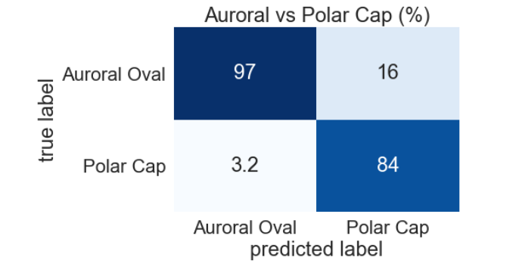
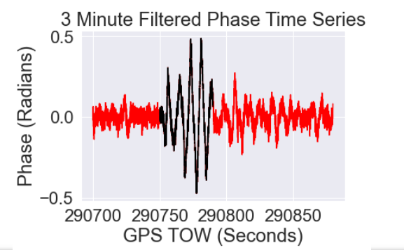
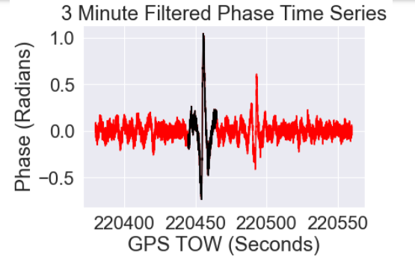
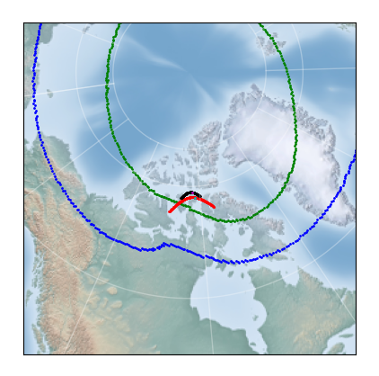
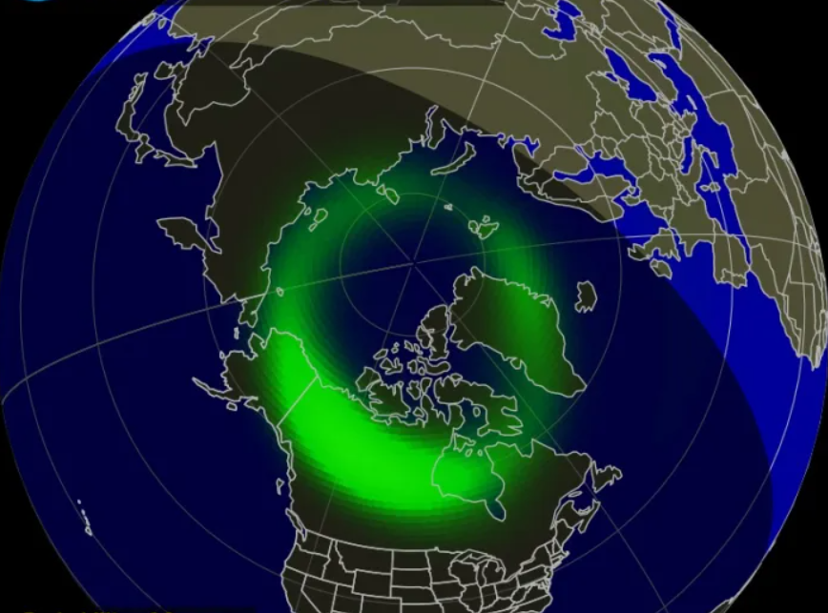
Categorizing Characteristic Regions of Nightside High-Latitude Ionospheric Irregularities Using a Machine Learning Approach
Chintan Thakrar, Nicolas Gachancipa, Marie Bals and Dr. Kshitija Deshpande (deshpank@erau.edu)
Department of Physical Sciences and Center for Space and Atmospheric Research (CSAR), Embry-Riddle Aeronautical University, Daytona Beach, FL, USA
INTRODUCTION
METHODOLOGY
RESULTS
GNSS
Group based GNSS CHAIN stations are used to understand upper-atmospheric plasma irregularities.
RF signals penetrate through these irregularities which cause them to refract or diffraction and are hence observed as signal carrier phase and/or amplitude fluctuations on the ground.
For the purpose of this project, data collected on the Novatel GNSS station 6 receivers were used.
Polar Cap vs Auroral Oval
Polar cap and auroral oval are regions of higher latitudes.
The auroral oval is where the magnetic field lines close in and solar wind, magnetospheric particles precipitate along those fields into upper atmospheric regions (E and F regions).
Particle precipitation is one of the major source of auroral scintillations [Jin et al. 2017].
Particles move from the dayside to night side region (where they are more favorable conditions) along the field of line currents through the polar cap.
Plasma densities drifting horizontally as polar cap patches (or gradient drift instability) are the major causes of observations in the polar region.
Machine Learning and Data Driven Modeling
Machine learning (ML) models use large amounts of data to train i.e., learn characteristics of instances based on the label. ML models have a feedback loop (back propagation) to learn based on the annotations.
Machine learning models can be either supervised (have labeled training data) and un-supervised (unlabeled data) and are used to forecast, predict, categorize and cluster data. For the purpose of this project, we used isolation forest to detect, while Artificial neural networks are used to categorize events.
In this research, we develop a full cycle process to detect, label and finally categorize events based on their observed regions.
GNSS data from the Canadian High Arctic Ionospheric Network (CHAIN) stations were used [Jayachandran et el. 2009]. More specifically the data from Eureka (EUR), Resolute (RES) and Sanikiluaq (SAN) receivers.
The process is divided into 3 major steps i.e. event detection, isolation forest detection and event labeling. This is a preliminary analysis to test our method. We are currently using phase fluctuations but we would like to expand this to include amplitude fluctuations.
Event Detection
The detection process is further split into 2 steps more specifically 60-second sigma phi thresholding and fluctuation detection using isolation forest.
For the three stations, high and low-rate data for the year 2018 was downloaded, processed and filtered at σϕ>0.2. This will yield minutes within which the signal is expected to fluctuate above the noise level.
The dataset was cleaned up to remove disturbances caused by multipath and signal loss of lock. To capture the entire duration of the fluctuating segment, the preceding and succussing minute of each filtered event is included in the analysis. This is done to capture the entire fluctuating instance which might have initiated at the tail of the minute.
Isolation forest Detection
The high rate (50 Hz) data for the instances selected in the above step are run through the isolation forest anomaly detection algorithm (Liu et al. 2008) to isolate the specific seconds within the selected segments of where the signal is fluctuating. The isolation forest model works by assigning an anomaly score to each point based on the vertical distance from the root node.
Using the method described a total of 6683 events are identified, of which 2568 events are polar while 4123 events are Auroral. For the first piece of this research, the power spectral densities (Welch 1987) of each event is computed. A Neural Network model with 5 hidden layers is used to categorize the events. The model yields an accuracy precisely equivalent to the proportion of the inputs data categorize. This implies that the model was unable to find any distinct features between the two categorize.
Later, a subset of the event’s time series were flown through a Neural Network. More specially 133 events from each set were used to train the network. The inputs time series are of length 30 seconds and with a rate of 50 Hz equates to an input layer of 1500 neurons. The model is built with 6 layers (1 input, 1 output and 4 hidden layers) and uses a sigmoid activation function.
The input data set is split into the test and
training set with a 20, 80 split respectively.
Running the test data through the model.
The testing yielded the confusion
matrix below:
Figure 1: Confusion matrix for the time series Neural Network
The above is the confusion matrix showing the accuracy of the model. This model has an overall accuracy of 89%. This means that given an unseen event, the neural Model network is potentially above to correctly categorize the event as Polar or Auroral with an accuracy of up to 89%. It can be observed that the polar events are much likely to m=be classified. This can be explained by the random and different causes of the fluctuations.
CONCLUSIONS & FUTURE WORK
We have proved that there is an observable and categorizable difference between the scintillations observed in the polar cap vs the Auroral Oval. The Neural Network model is able to, with a fairly high level of confidence, distinguish and categorise observed time series to the respective source regions.
The above-described model validates that the physical differences due to the sources of irregularities in the 2 regions can be observed and categorized by the signal received on the ground.
Train and test the time series-based model with significantly more events. Expand to include power.
The current stations selected are Novatel receivers, to test the robustness of the process, it is crucial events are captured from Septentrio and CASES receivers are tested.
Fig 2: RES, 01/03/2018 SVID: 12. Black: Isolation Forest output. Red original input signal. Phase against Time
Fig 3: RES, 01/02/2018 SVID: 16. Black: Isolation Forest output. Red original input signal. Phase against Time
OBJECTIVE
Event Labeling
For each event identified from the above process, the ionospheric pierce point (IPP) is computed at120 Km (bottom E layer height) and 300 Km (bottom F layer height). The IPP location is against the EDR-AURORAL model based on the SUSSI instruments aboard the DMSP satellites (Ding et al. 2007) to determine whether any specific observation is inside the auroral or the polar cap.
For each event, the closest orbit (with respect to time) is used to check the IPP against.
If and only if, the 120 Km IPP and 300 Km IPP region are the same, the event is taken for further analysis.
Gain an understanding of the differences in the overall observed characteristics of irregularities in Polar Cap and Auroral Oval.
Are we able to leverage the underused high rate (50 Hz) GNSS data in a data driven approach to categorize irregularities based on locations of scintillations regions (polar cap Vs auroral oval)?
REFERENCES
Jin, Y.,Moen, J. I., Oksavik, K., Spicher, A., Clausen, L. B. N., &Miloch,W. J. (2017). GPS scintillations associated with cusp dynamics and polar cap patches. Journal of SpaceWeather and Space Climate, 7, A23. https://doi.org/10.1051/swsc/201702
Jayachandran, P. T., R. B. Langley, J. W. MacDougall, S. C. Mushini, D. Pokhotelov, A. M. Hamza, I. R. Mann, D. K. Milling, Z. C. Kale, R. Chadwick, T. Kelly, D. W. Danskin, and C. S. Carrano (2009), The Canadian high arctic ionospheric network (CHAIN), Radio Sci., 44, RS0A03, doi:10.1029/2008RS004046, 2009.
Ding, G.-X., He, F., Zhang, X.-X., and Chen, B., “A new auroral boundary determination algorithm based on observations from TIMED/GUVI and DMSP/SSUSI”, <i>Journal of Geophysical Research (Space Physics)</i>, vol. 122, no. 2, pp. 2162–2173, 2017. doi:10.1002/2016JA023295.
Welch, P.D. (1967). The use of fast Fourier transform for the estimation of power spectra: A method based on time averaging over short, modified periodograms. IEEE Transactions on Audio and Electroacoustics, 15, 70-73.
Liu, F. T., Ting, K. M., & Zhou, Z. H. (2008, December). Isolation forest. In 2008 eighth ieee international conference on data mining (pp. 413-422). IEEE.
Acknowledgements: We would like to acknowledge NSF CAREER grant AGS1848207 for sponsoring this research. Infrastructure funding for CHAIN is provided by the Canada Foundation for Innovation and the New Brunswick Innovation Foundation. CHAIN operation is conducted in collaboration with the Canadian Space Agency. Thanks to JHUAPL for DMSP SUSSI data. DMSP SSJ data can be accessed at the John’s Hopkins website: https://ssusi.jhuapl.edu/
Fig 1: NOAA Space weather prediction centre Aurora Forecast model.
Fig 4: The 120 Km IPP (Black), 300 Km IPP(Red) overplotted with the SUSSI Auroral equatorial and polar boundary.

