Slide 1
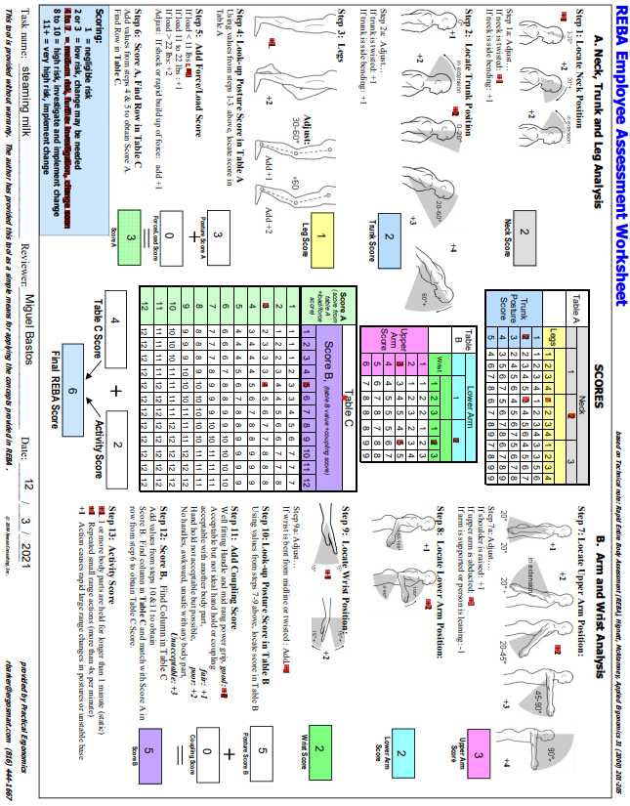
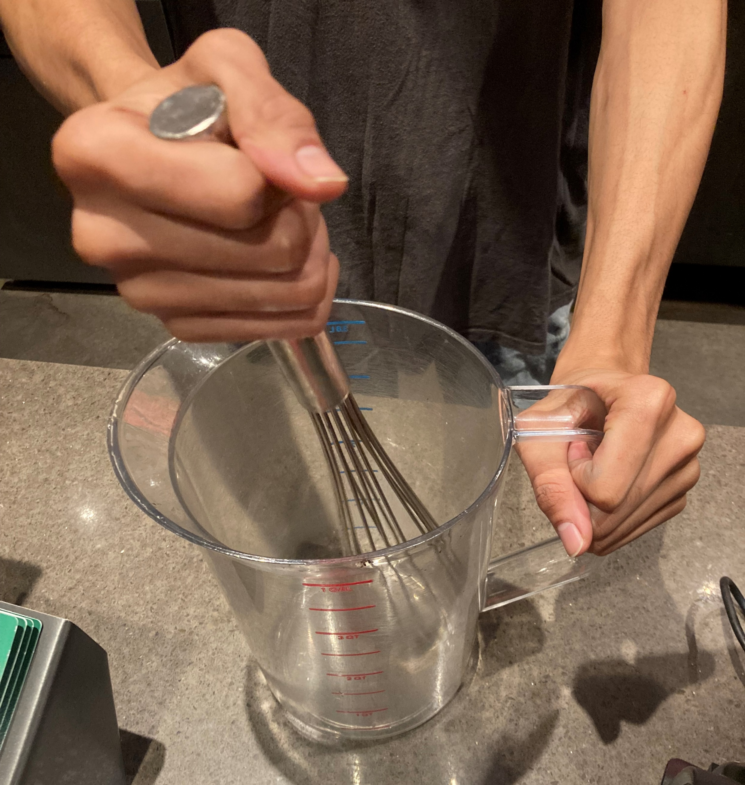
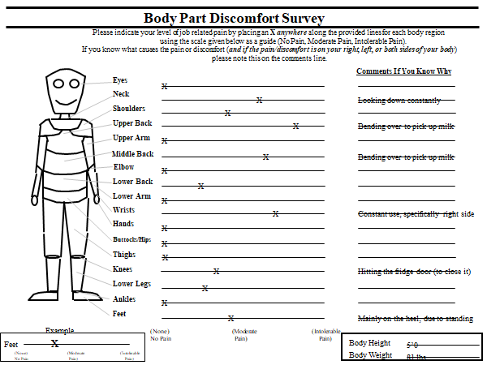
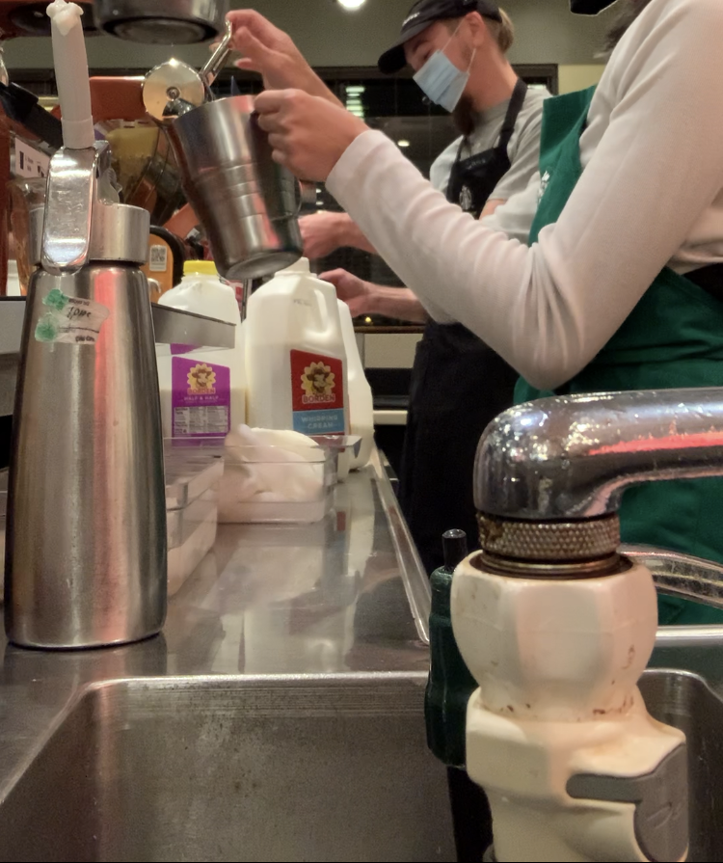
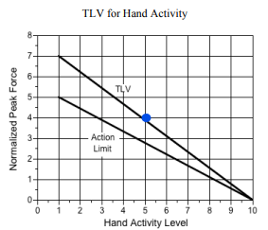
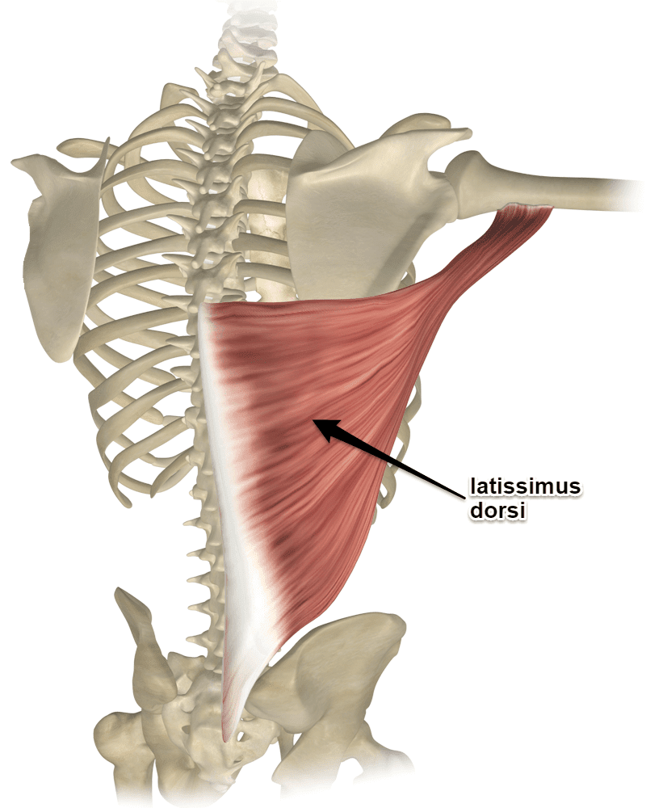
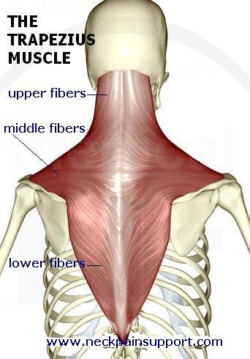
Ergonomic Assessment of a Barista Miguel Bastos, John Kleber Beth Blickensderfer Ph.D. Embry-Riddle Aeronautical University
Abstract
Rapid Entire Body Assessment
Threshold Limit Value for Hand Activity
Body Part Discomfort Survey
Highly repetitive manual tasks such as those performed by a barista can put workers at risk of developing Work-related Musculoskeletal Disorders (WMSDs). These disorders can cause both short-term and long-term pain for workers and come at high financial costs for employers. The purpose of this case study is the evaluation of potential risk associated with tasks performed by baristas and to provide recommendations for limiting the potential development of these disorders. This case study focused on a barista working in Texas. The subject is a 24-year-old female who has worked as a barista for over a year. The Rapid Entire Body Assessment (REBA) and the Threshold Limit Value (TLV) for Hand Activity were used to assess the tasks of milk steaming (REBA) and the whisking of sweet cream (TLV): two activities the barista performs regularly. The ergonomics evaluations showed that the barista scored a six on the REBA and a five on the TLV. Both scores imply that the barista is in the hazardous zone for WMSDs, requiring interventions. Recommendations include wearing a back brace and rotating workstations throughout a shift. Implementing these solutions will reduce the chance of WMSDs.
Figure 5 (top). Demonstration of vanilla sweet cream preparation.
Figure 3: Demonstration of the milk steaming process assessed by the REBA.
Figure 8 shows the part discomfort survey, which was used to determine the subjects’ primary areas of discomfort. As seen below, the main areas are the back, neck, and wrist. This survey helped determine which ergonomic tools would be most effective in identify the WMSD of the subject.
Figure 4. REBA Assessment for steaming of milk.
Figures 6 (left) and 7 (top). The TLV for Hand Activity for the preparation of vanilla sweet cream.
Introduction
Methods and Results
Prominent Areas of Pain
The subject
24-year-old female
Works at Starbucks as a Barista/Shift manager
Weighs 81 lbs. and stands at 5’0
Tasks as a Barista/Shift manager include preparing drinks, warming up food, taking orders, putting away RP orders and doing food pulls, and counting tills.
Musculoskeletal disorder description
The subjects’ musculoskeletal disorder originates from the pain in their upper body and back. They experience pain in their upper back and down their spine towards the right side. The subject feels stiff in the neck and upper back area. A lot of tightness is felt from the base of the head to the shoulder blade.
Ergonomics Tools Used:
Tool #1: Rapid Entire Body Assessment (REBA)
This tool is ideal for someone who is in static positions for long periods of times. The subject is often placed in a station where they must stand for long time in the same place with.
REBA Score and analysis: 6; medium risk, further investigation is needed, and changes need to be implemented soon
Tool #2: The ACGIH Threshold Limit Value for Hand Activity
This tool is ideal for someone who performs a lot of short cycle tasks using their hand and/or wrist. The subject uses both for a plethora of tasks, particularly the whisking of vanilla sweet cream.
Hand TLV Score and analysis: Hand Activity Level – 5; Normalized Peak Force – 4; low risk, changes should be implemented
Results:
Receiving a score of 6 on the REBA and score of 5 on the HAL and 4 on the NPF indicate that the subject is at an elevated risk of Work-related Musculoskeletal Disorders
Interventions are recommended in order to reduce the risk of harm to the subject
The following images show the two areas where most of the subject's pain resides.
Figure 1 (top left) shows the latissimus dorsi. Figure 2 (top right) shows the trapezius muscle.
Discussion
Recommended Solutions
References
In order to reduce the potential of Work-related Musculoskeletal Disorders, interventions are necessary
Some recommendations include implementing a back brace, being more conscious of posture and working at different stations
The subject is still young; corrections can still be made so that they doesn’t have to take their pain into their adult life
If there are not any improvements after the subject has started implementing changes, then we might have to seek consultation from an expert in musculoskeletal disorders to help diagnose the subject and help fix their Musculoskeletal Disorder
Solution | Reasoning | Reduced Risk
Rotating workstations | As a shift manager, the subject can easily pick where they will station themselves throughout the shift. | The subject can station themselves somewhere that is not as physically demanding if they are experiencing pain.
Being more conscious of posture | The subject has stated that they have caught themselves having bad posture and slouching while working. | Constantly reminding themselves to stand up straight and have a good posture could lead to less pain while working.
Wearing a back brace | The subject owns a back brace that they wear occasionally outside of work. | Wearing the back brace more often and at work can help alleviate pain and help fix bad posture.
Millett, A. (2020, December 29). Tight lats? do these stretches & drills. Retrieved October 19, 2021, from https://movestrongphysicaltherapy.com/new-blog/2019/11/18/tight-lats-do-this
My trapezius really hurts..how do I find relief? (n.d.). Retrieved October 19, 2021, from https://www.neckpainsupport.com/2009/07/my-trapezius-really-hurtshow-do-i-find-relief.html
ACGIH TLV for hand activity - USF health. (n.d.). Retrieved December 6, 2021, from https://health.usf.edu/publichealth/tbernard/~/media/096358E538A0473DBD9F7145C175FDAA.ashx
Dainty, R. S., Alcorn, E., Ferguson, C. A., & Gregory, D. E. (2014). Prevalence of occupation-related pain among baristas and an examination of low back and shoulder demand during the preparation of espresso-based beverages. Ergonomics, 57(8), 1192–1200. https://doi.org/10.1080/00140139.2014.914582
Blackwell, T. (2014, May 29). Tough grind in barista job; Study. The Province.
Dainty, R. S., Alcorn, E., Ferguson, C. A., & Gregory, D. E. (2014). Prevalence of occupation-related pain among baristas and an examination of low back and shoulder demand during the preparation of espresso-based beverages. Ergonomics, 57(8), 1192–1200. https://doi.org/10.1080/00140139.2014.914582

