Slide 1


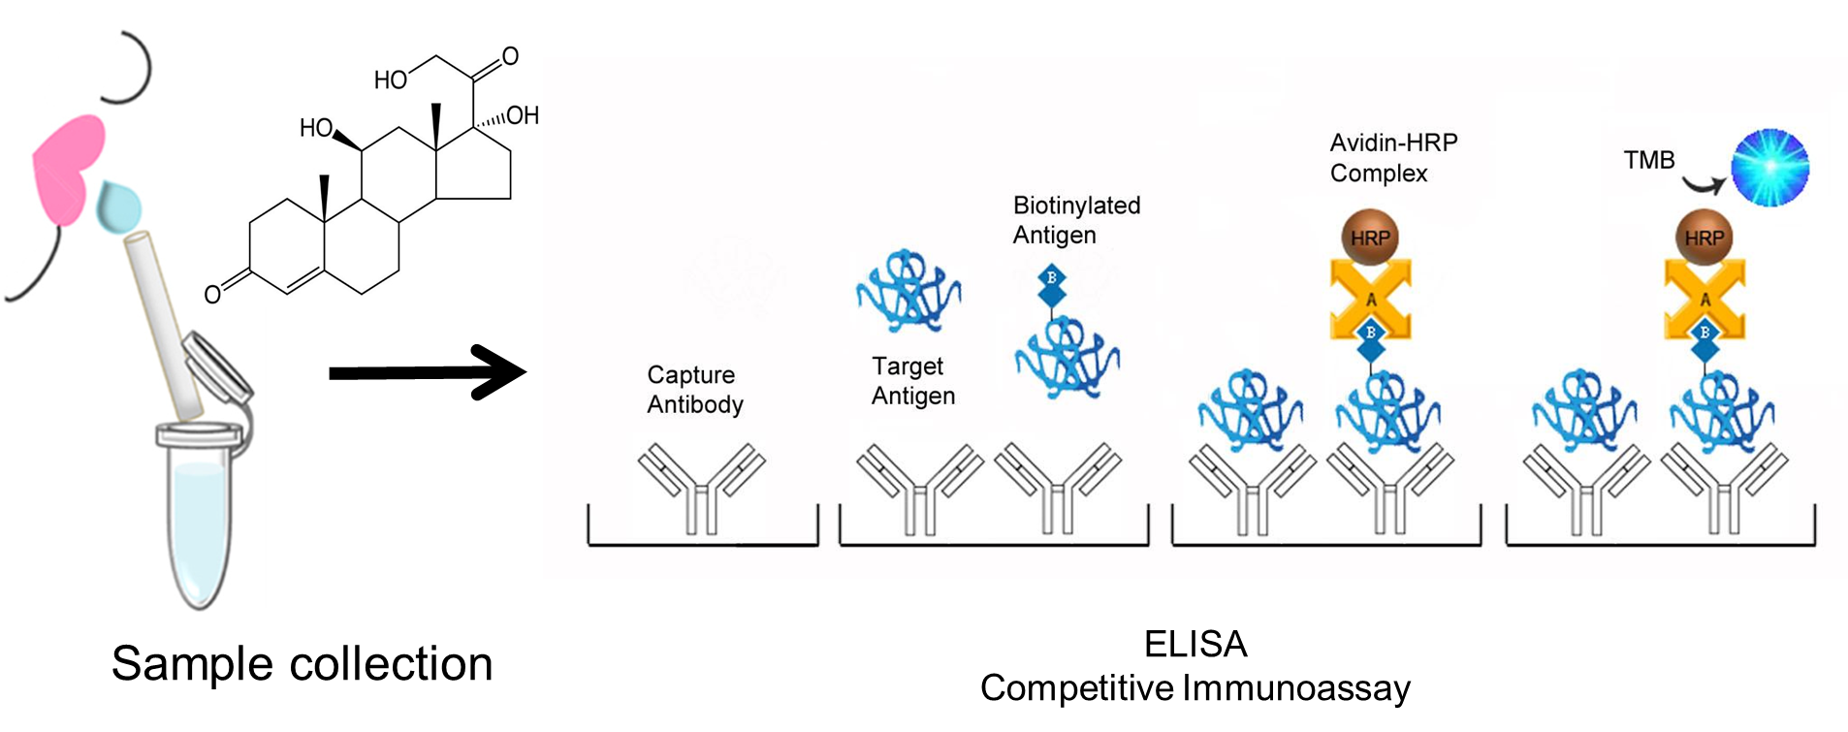
Comparison of Salivary Cortisol and Melatonin Levels in ERAU Students
Brianna Magdaleno and Alba Chavez
Department of Human Factors, Embry-Riddle Aeronautical University, Daytona Beach, FL 32114
Abstract
Test Principle
Discussion/Conclusion
College students tend to have more stress and less sleep than many people. Cortisol and melatonin are stress hormones responding to a physical or emotional stressor. The purpose of the present study was to evaluate these essential hormones in saliva samples from students at ERAU coursing the majors of Aerospace Engineering and Mechanical Engineering. The selected course within this major is EGR 120 with the CATIA computer program. Saliva samples were obtained before and after taking the class. Students were asked to spit into a tube, and samples were analyzed using an Enzyme-Linked Immunoassay (ELISA) procedure to calculate cortisol levels melatonin in the participant's samples and compare these with standards and controls. Results were analyzed by comparison with a curve line using Excel and Prism 9. Our results indicate that the students suffered more stress (directly proportional to elevated cortisol levels) after finishing the class. Additionally, salivary melatonin levels were detected in an overall student population, indicating values below average, related to high-stress levels. Future studies will include a screening of a larger student population size for more accurate screening.
Our results indicate a tendency for elevated cortisol levels after attending the EGR 120 class.
No statistical difference was found, but a larger population is needed to make a statistical difference.
In melatonin levels, a group with lower than usual levels was found, which indicates a high level of stress and not enough rest. These are from 0 to 20 pg/dL.
In melatonin, most students showed an average level of 44 to 100pg/dL.
The third group of melatonin showed very high results, indicating a lack of stress and enough rest.
Figure 1. Enzyme-Linked Immunoassay principle. Salivary Cortisol or Melatonin is detected. Specific antibodies bind the target antigen and detect the presence and quantity of Cortisol or Melatonin.
Introduction
Cortisol is one of the most important hormones secreted by the cortex of the adrenal gland. Cortisol affects the metabolism of carbohydrates, fats, and proteins involved in the stress response. Cortisol follows a circadian rhythm, with levels peaking in the early morning and dropping to the lowest values at night.
Only around 10% of cortisol is in its biologically active form in the blood, and the remaining is bound to serum proteins. Unbound cortisol is also present in saliva (unbound to protein). Salivary cortisol levels can fluctuate and are affected by salivary flow rate and are relatively resistant to degradation from the enzyme. Previous studies have reported an accurate correlation between serum and saliva cortisol (meaning that salivary Cortisol levels estimate with high-reliability serum Cortisol levels).
Many College and University students face novel daily demands in their academic life. These daily stressors have been linked to poor physical and physiological health and amounts of stress-related hormones (including cortisol) can fluctuate according to the general capacity to cope with the challenges of college life. Thus, characteristic college stressors have been linked to changes in cortisol. Yet it is unclear the degree of these changes according to specific majors, which can help describe students' general coping capacity.
Objective: To extend available laboratory evidence, we examined cortisol levels in saliva samples collected from different students and majors at Embry-Riddle Aeronautical University. We expected that elevated saliva cortisol levels would be associated with more demanding majors or with students that report poor academic coping efficacy.
Results
Figure 2. The “Before” column refers to students' stress levels of AE and ME majors before taking the EGR 120 class. The ”After” column refers to the stress levels after finishing the course.
Future Directions
Higher population to reach a stronger conclusion about the relation of cortisol and melatonin levels on Embry-Riddle students. Future studies would include different classes and/or majors.
Figure 3. The salivary melatonin levels were taken in all students regardless of their major. We accounted for the following variables: hours of sleep, breakfast, and exercise.
Acknowledgements: We thank the financial support by the Office of Undergraduate Research at Embry-Riddle Aeronautical University SURF Grant and the Physical Sciences Department at Embry-Riddle Aeronautical University.
References:
1. Koch, G. H., Brongers, M. P. H., Thompson, N. G., Virmani, Y. P., & Payer, J. H. (2001).
“Corrosion Costs and Preventive Strategies in the United States.” Retrieved from http://impact.nace.org/documents/ccsupp.pdf
2. Cho, S. H., White, S. R., & Braun, P. V. (2009). Self‐healing polymer coatings. Advanced Materials, 21(6), 645-649.
3. Imato, K., Nishihara, M., Kanehara, T., Amamoto, Y., Takahara, A., & Otsuka, H. (2012). Self‐healing of chemical gels cross‐linked by diarylbibenzofuranone‐based trigger‐free dynamic covalent bonds at room temperature. Angewandte Chemie, 124(5), 1164-1168.4. Wu, 4. Chen, H., Ma, X., Wu, S., & Tian, H. (2014). A rapidly self‐healing supramolecular polymer hydrogel with photo stimulated room‐temperature phosphorescence responsiveness. Angewandte Chemie, 126(51), 14373-14376.
5. Holten-Andersen, N., Harrington, M. J., Birkedal, H., Lee, B. P., Messersmith, P. B., Lee, K. Y. C., & Waite, J. H. (2011). pH-induced metal-ligand cross-links inspired by mussel yield self-healing polymer networks with near-covalent elastic moduli. Proceedings of the National Academy of Sciences, 108(7), 2651-2655.
6. Silverman, R. B., & Holladay, M. W. (2014). Chapter 3 - Receptors. In R. B. Silverman & M. W. Holladay (Eds.), The Organic Chemistry of Drug Design and Drug Action (Third Edition) (Third Edition, pp. 123–163). Boston: Academic Press. https://doi.org/https://doi.org/10.1016/B978-0-12-382030-3.00003-9
Notes:
Treatment Disadvantages:
-Rare lymphomas of spleen and liver.
-Biological Therapy drugs inhibit TNF which is responsible for inflammation.
Formulation: Polymer Differences
-EPO pH 5, mouth release
-RS100 pH 6, ileum release
-S100 pH 7, colon release
Vial 1: RS 100 PVA
Vial 2: RS 100 P127
Vial 3: EPO with p127

