Slide 1
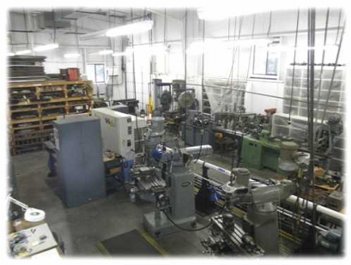
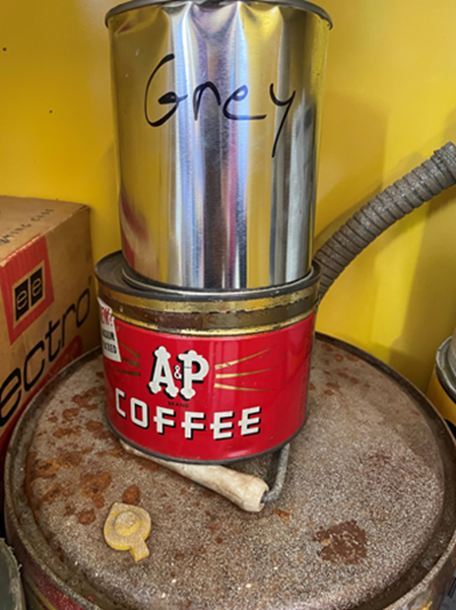
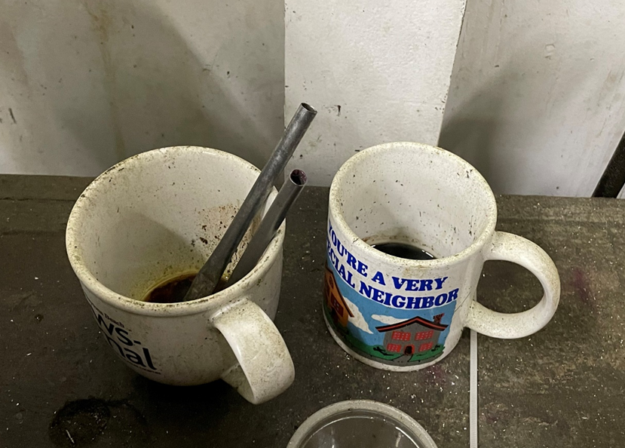
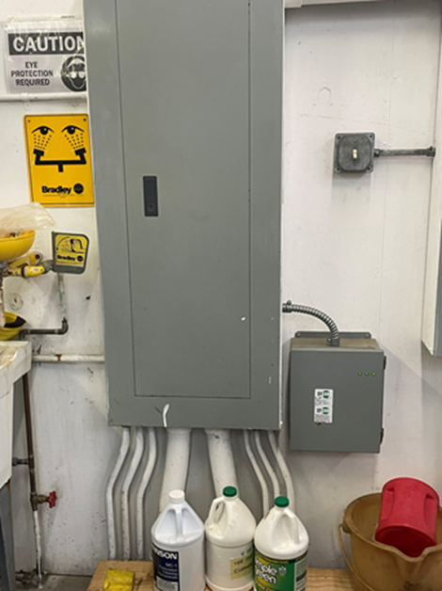
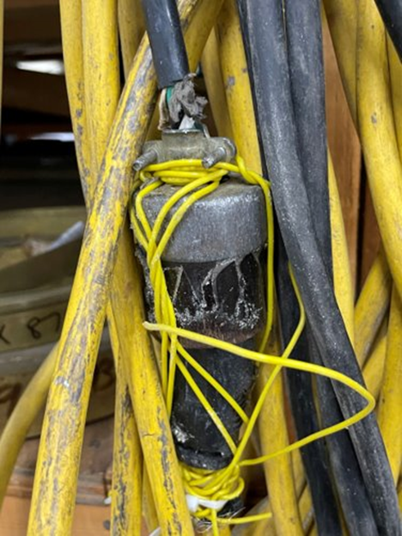
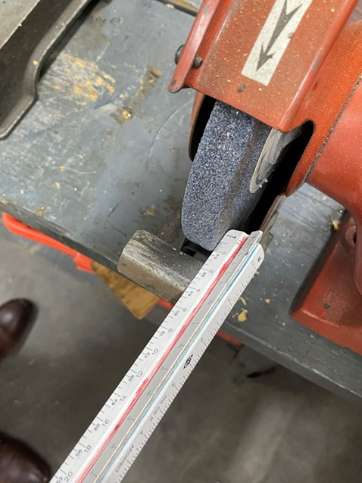
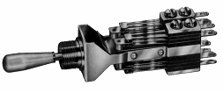
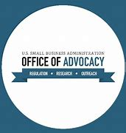
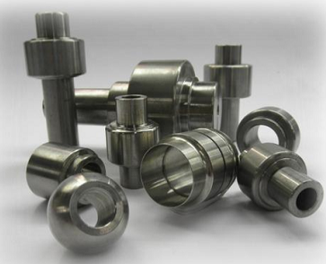
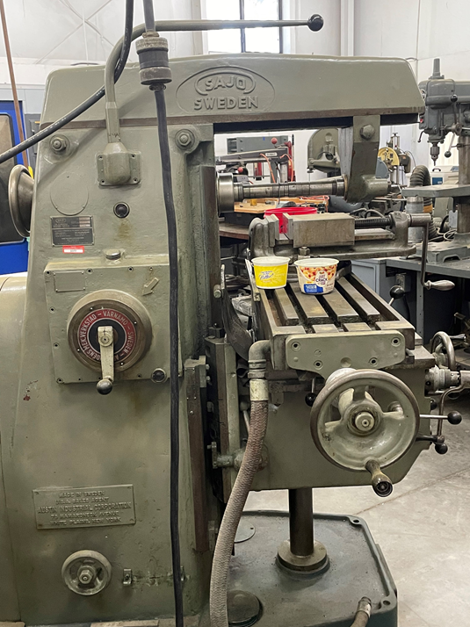
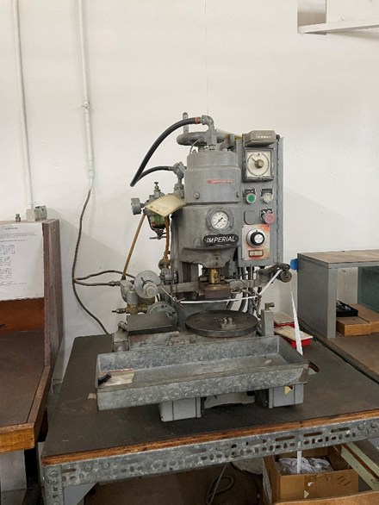
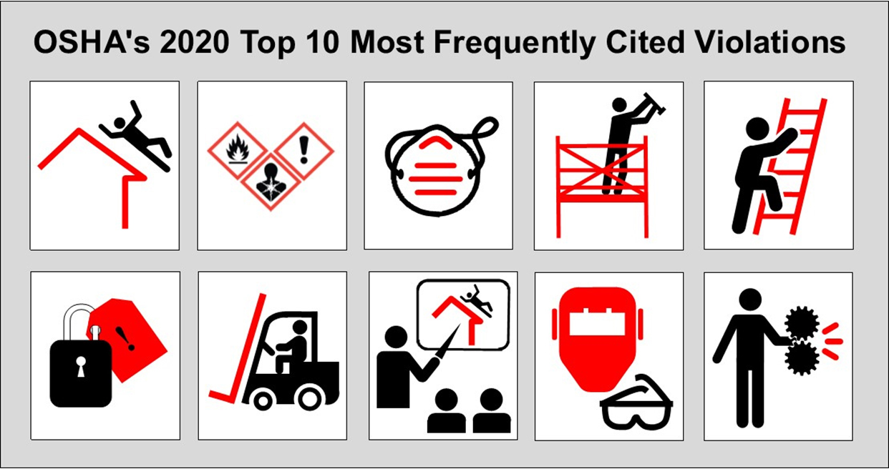
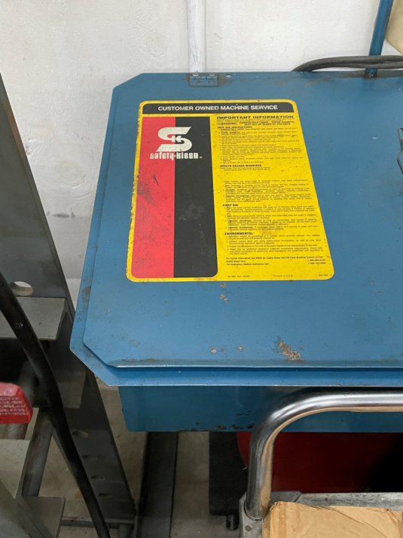
SMALL BUSINESS SAFETY HAZARDS INSPECTION AND RECCOMENDATIONS
Consultation Team: Justin Grillot, Nicole Hester, Priscila Casado, Cameron Pike
Embry-Riddle Aeronautical University, College of Aviation Graduate Studies, Master of Occupational Safety Management
Company Background
Sample Visual Observations
Company volunteered via the Volusia Manufacturing Association
Founded in 1980, moved states and built the current facility in 1991
Approximately 6 employees
Single Shift
Manufactures primarily for the railroad industry
Very Small Quantity Generator of hazardous waste
Small Business Regulatory Enforcement Fairness Act of 1996 (SBREFA)
Example Products
Custom Control Panels
Industrial Switches
Control Units (Interior/Exterior)
Custom Special Parts
Ground Detector Equipment
Purpose and Methods
Federal regulations are too numerous, too complex and too expensive to implement for small businesses.
The intention is to provide small businesses assistance in understanding and complying with current regulations and more of a voice in the development of new regulations.
OSHA produces Small Entity Compliance Guides for some rules.
OSHA is responsive to small business inquiries about compliance with the agency's regulations.
OSHA has a penalty reduction policy for small businesses.
The OSHA On-Site Consultation Program provides a no-cost and confidential health and safety services to small and medium sized businesses.
Primary Goal: Learn how to conduct an inspection and convey the inspection results in an understandable report
Secondary Goal: Provide useful health & safety recommendations to the host company
Methods: Interview employees to understand the equipment and the observed processes. Take pictures of possible identified hazards. Research possible identified hazards to include in the inspection report.
Manufacturing Equipment
Recommendations to Company
Multi-axis milling machines
CNC multi axis router
Drill Press
Lead tinning
Punches
Table Grinders and Band Saws
Contact Welders
Belt Sanders
Metal Stock Lathe
Advantages & Limitations
Reach out to the OSHA On-site Consultation Program for free safety assistance.
Start to provide all required, site-specific safety training through an OSHA Authorized Instructor or by paying for training through a private company.
Conduct a risk assessment on the findings of the report and develop a corrective action plan.
Reach out to the District and Business Support Program (DBSP) at Florida Department of Environmental Protection (FDEP) for small business assistance with Hazardous Waste.
Shop Supervisor answered all questions to the best of his ability
Owner seemed motivated to improve safety/quality
Taking pictures was allowed
Unable to review any documentation
Training Records, Safety Policies/Programs, Hazardous Waste Records, Accident Reports/Logs
No industrial hygiene equipment/survey conducted
Hazardous Waste
Inspection Results: Major Program Deficiencies
Conclusions
Definition of Solid
Waste
Hazardous Wastes
Waste
Generation
Waste
Management
Implementation
Municipal Solid Wastes
Industrial Solid Wastes
There were 41 safety and/or environmental hazards identified where the hazards ranged from severe (very likely an injury or environmental release could happen) to minor (injury or environmental release not likely to occur).
The team acquired a new appreciation for the regulatory struggles that a small business can have when it comes to occupational safety and environmental compliance.
A lack of accidents is not an indicator of a safe working environment.
7 Safety Recommendations:
Lock-Out / Tag-Out
Hazard Communication
Eye and Face Protection
Respiratory Protection
Safe Use of Ladders
Machine Guarding
https://www.osha.gov/top10citedstandards
Creation of a hazardous waste plan
Incident and accident reporting program
Training program development
Creation of standard operating procedures
Creation of an inspection program
Creation of an emergency action plan
Improvements to the ventilation system to control airborne hazards

