Slide 1
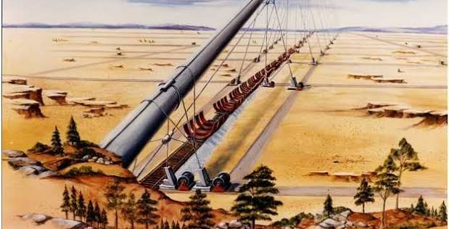
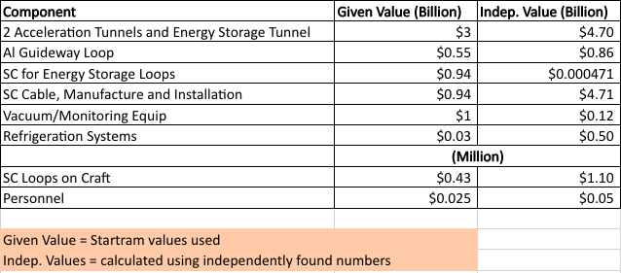
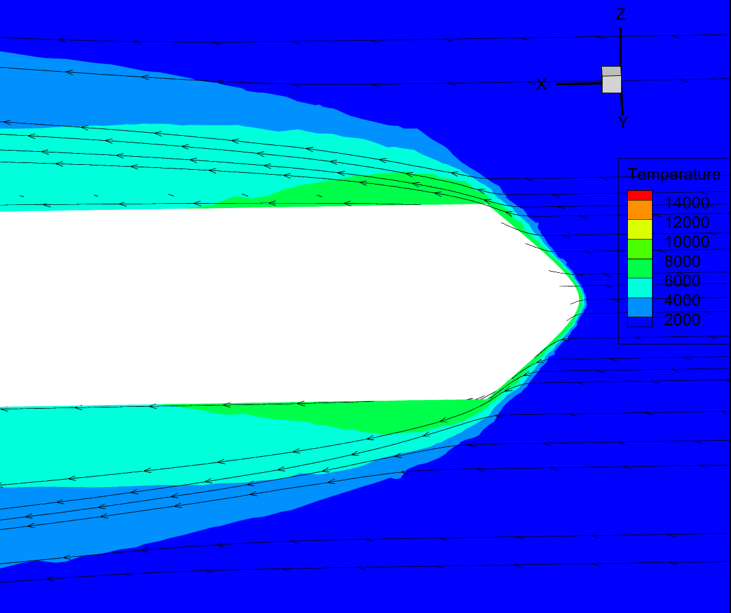
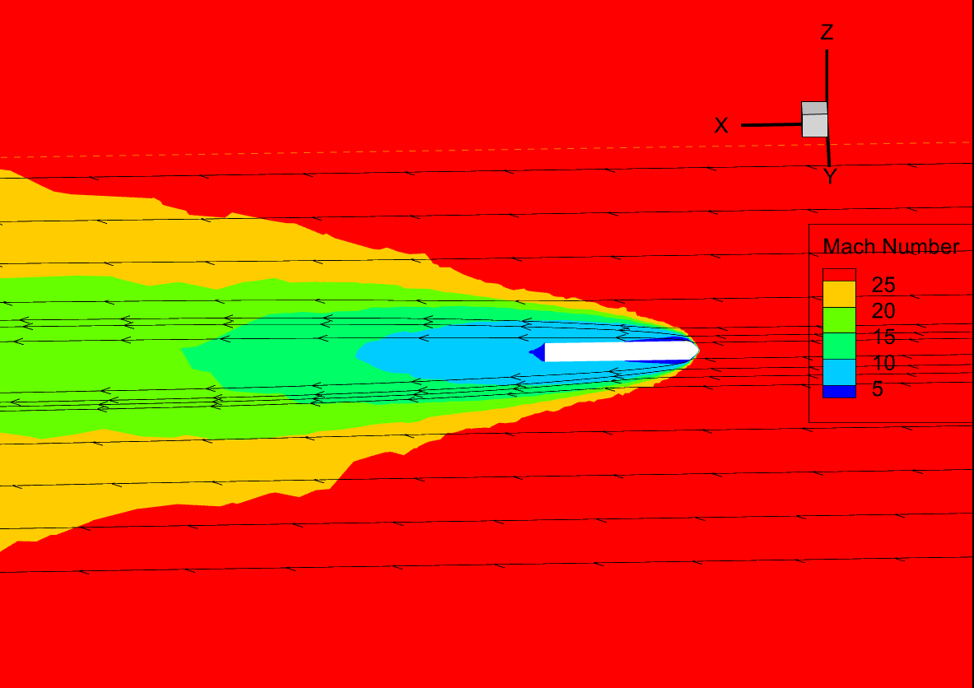
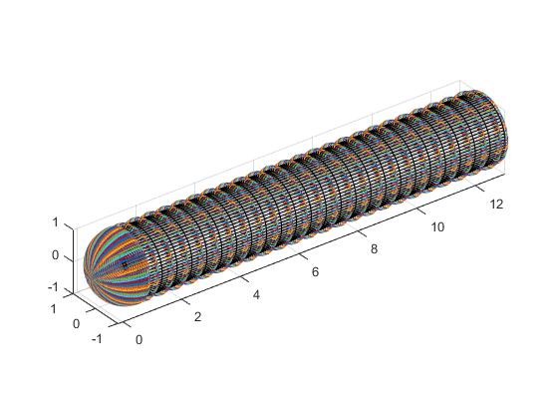
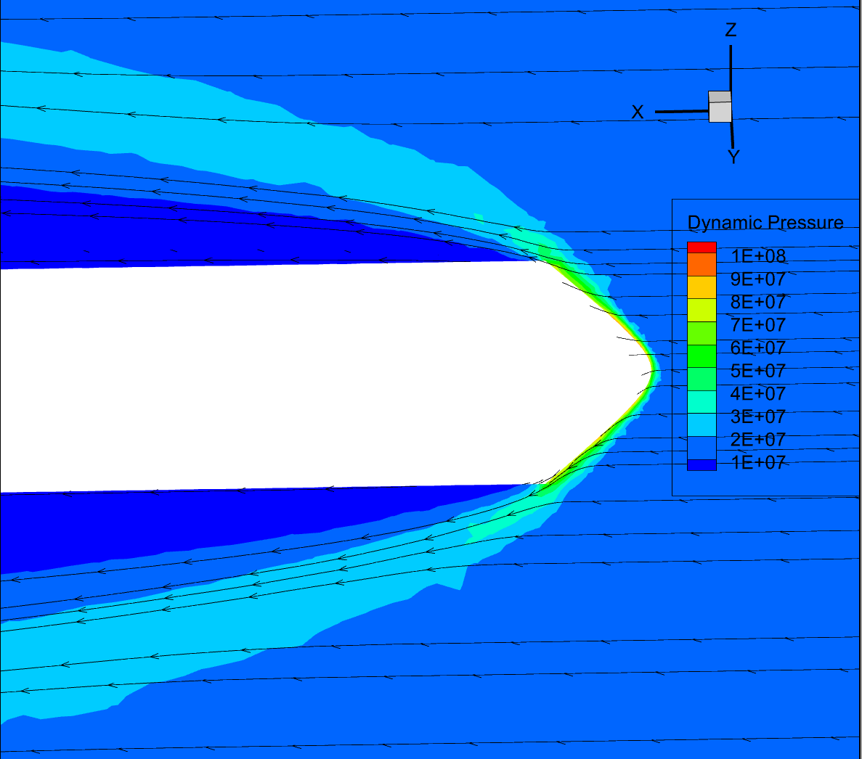
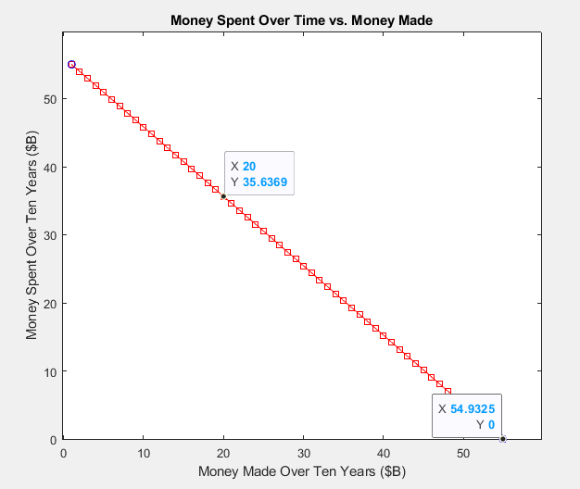
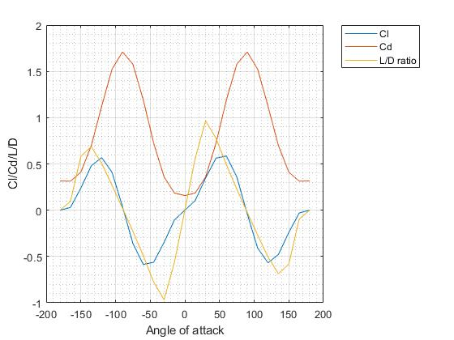
Magnetically Accelerated Launch Systems for More Affordable Space Travel
Nicola-Isabella Ruiz, Adrian Moraga, Praneeth Kasani, Lihuen Munoz
Abstract
Fig.1: Early Startram Design
The price to send a payload into space has decreased significantly since the beginning of the commercial space era, with the current lowest being $1,400/kg on SpaceX Falcon Heavy. Several unique alternatives have been introduced to reduce the price, SpaceX being the most successful by introducing reusable rockets. James Powell, co-inventor of Magnetic Levitation technology, proposed the idea of Startram- a magnetically accelerated launch vehicle that is accelerated on Earth and launched from a vacuum-sealed tube. This project further studies the possibilities of Maglev technologies and potential benefits of the technology for space launch. This investigation analyzes the feasibility and cost-effectiveness of the Startram method through validation of the original Startram calculations along with its interpolation to modern technologies and cost models.
Current Findings
Conclusion
In this project, the group analyzed the feasibility of Startram and its potential impact on the space-launch industry. Evidently, the original Startram construction component and launch cost calculations were permissive compared to the independently calculated values. Computations regarding the realistic physics behind the Startram’s mission design were also formulated and displayed in graphic exhibitions. These showed the physical behavior of the proposed launch vehicle. Research for the evaluations of cost and operation was completed to portray that Startram would take 10 years to break-even in profits. This demonstrates that a long process and commitment is required to make this system profitable. In conclusion, validation efforts prove that although the enterprise is physically possible, the feasibility of Startram is dependent upon the extensive amount of funding and time required.
Background
Startram is a proposed space launch system that uses maglev (magnetic levitation) technology to propel spacecraft into orbit. Maglev technology involves the use of magnetic fields to levitate and propel objects along a track, without any physical contact or friction. The spacecraft would be placed on the track and accelerated to high speeds using magnetic fields. By using magnetic acceleration instead of conventional rocket propulsion, the system could drastically reduce the amount of fuel required for launch, and therefore lower the overall cost.
Fig. 2:Temperature Analysis
Fig.3: Mach Number Analysis
Fig.4: Capsule with Nodes
Methodology
References
This project aims to analyze feasibility of the Startram proposal for low-cost launch solutions. This was done by recalculating the projected cost from the construction and launch parameters. The proposed capsule for delivering cargo to lower earth orbit was re-created in CATIA and Pointwise, thermal and pressure analyses were then run in Ansys Fluent. The capsule was also recreated in MATLAB and a script was run to determine the coefficient of lift/drag on the body at all angles of attack. Literature research was done on maglev technology and the required LEO launch parameters to compare with the Star-Tram cost estimations. A MATLAB plot shows that it would take ten years to make back the cost.
Fig.5: Dynamic Pressure Analysis
[1] College of Engineering. (2020). Coefficient of Pressure Code. Capsule.m.
[2] Grant, P. M., &amp; Sheahen, T. P. (2015, December). Cost Projections for High Temperature Superconductors . AXRIV. Retrieved April 2, 2023
[3] Green, M. A. (2015, December). The cost of coolers for cooling superconducting devices at temperatures at 4.2 K, 20 K, 40 K and 77 K. IOP Science. Retrieved April 2, 2023
[4] Powell, J., Maise, G., & amp; Rather, J. (2010, February 2). Maglev Launch: Ultra-low Cost, Ultra-high Volume Access to Space for Cargo and Humans. AIP Conference Proceedings. Retrieved April 2, 2023, from https://doi.org/10.1063/1.3326240
[5] Rote, D. M. (1998, July 1). Comparison of high-speed rail and maglev system costs. U.S. Department of Energy Office of Scientific and Technical Information. Retrieved April 2, 2023, from https://www.osti.gov/biblio/656864
[6] Tesla, I. (2016). Hyperloop Alpha. Tesla. Retrieved April 2, 2023
Fig.6: CL,CD at Variating AOA

