Slide 1
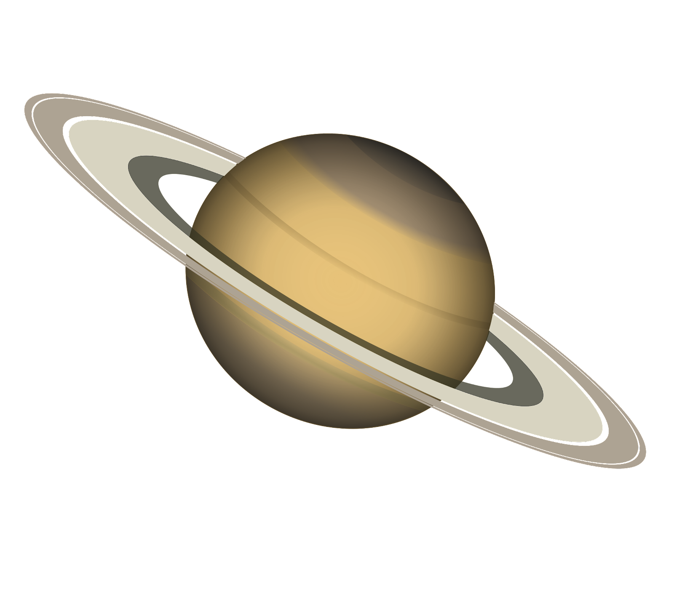
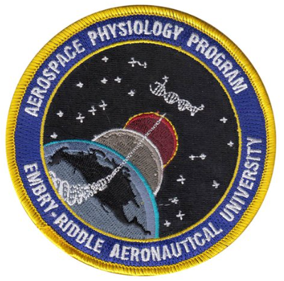
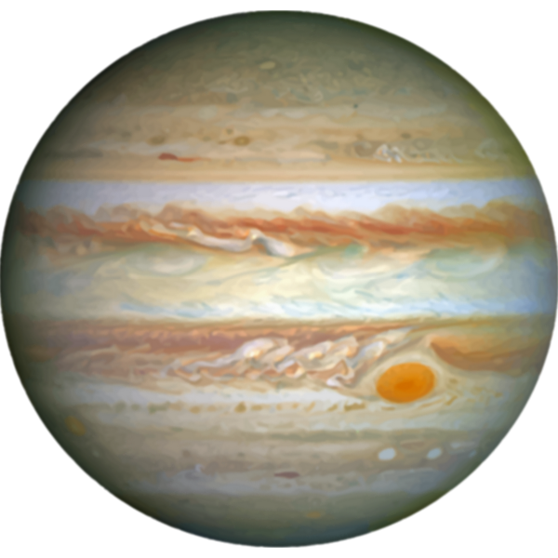
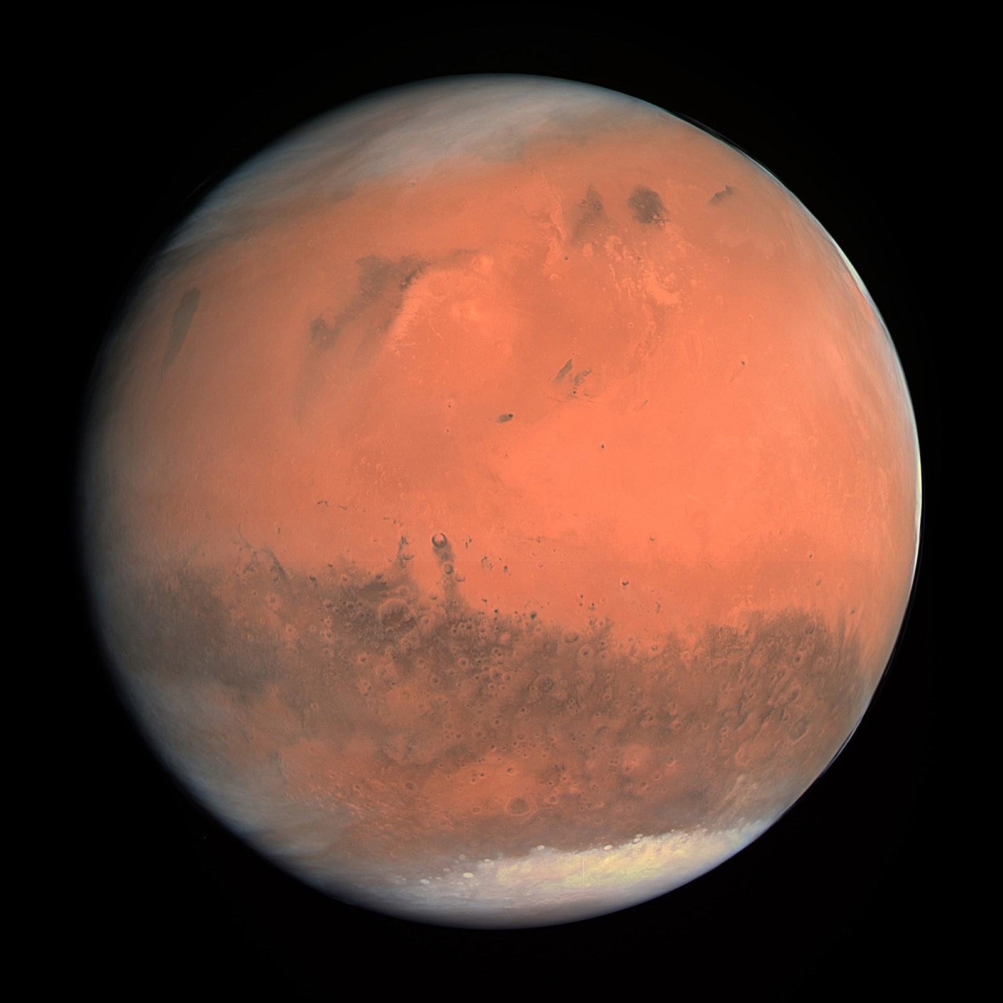
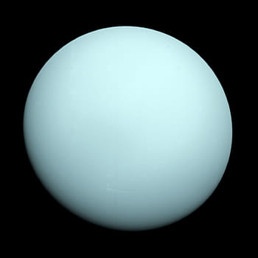
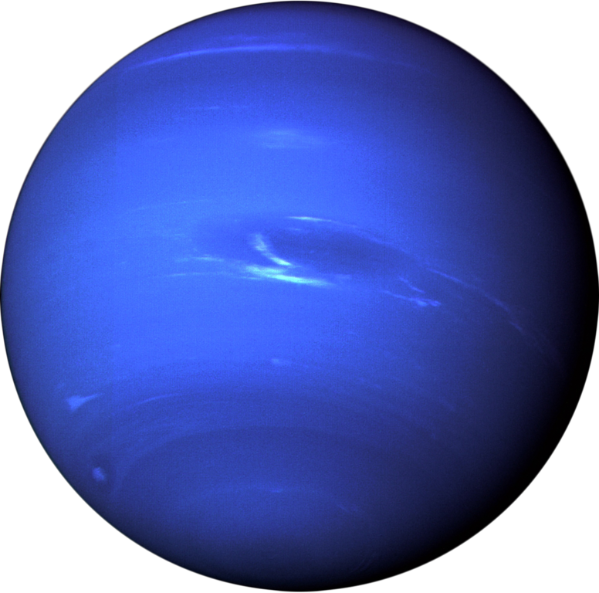
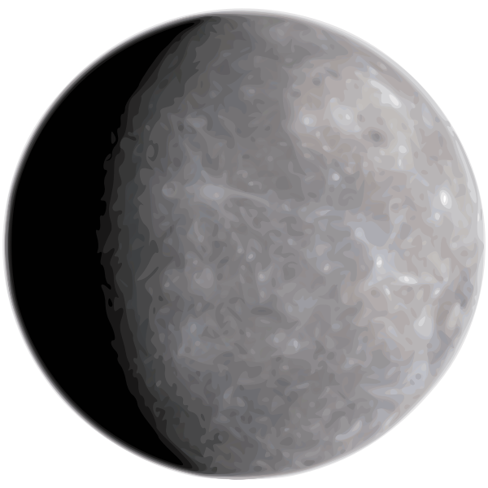
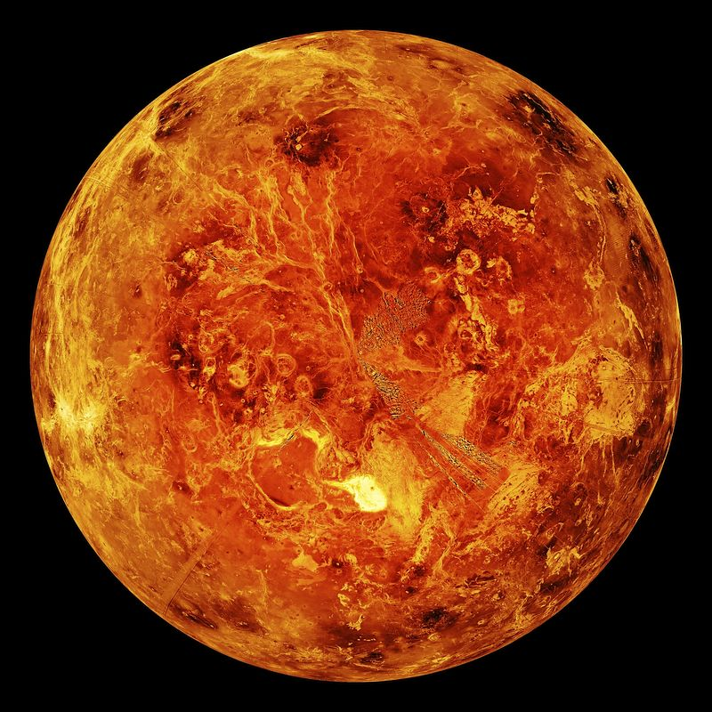
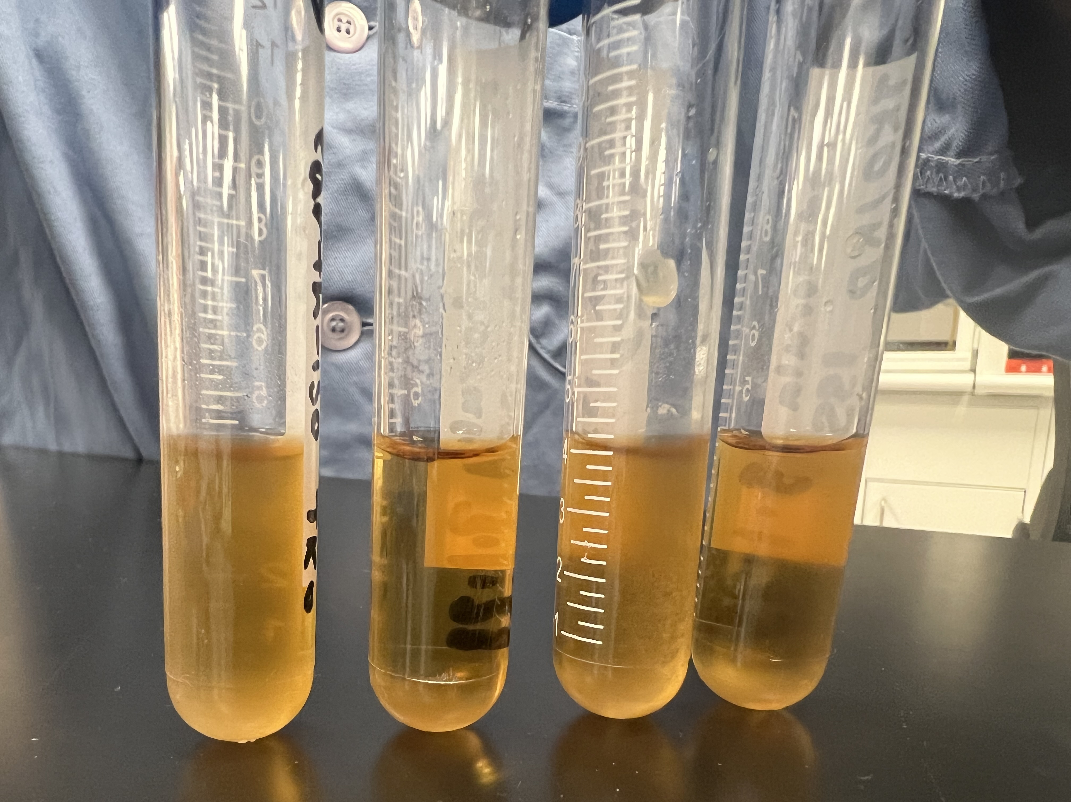
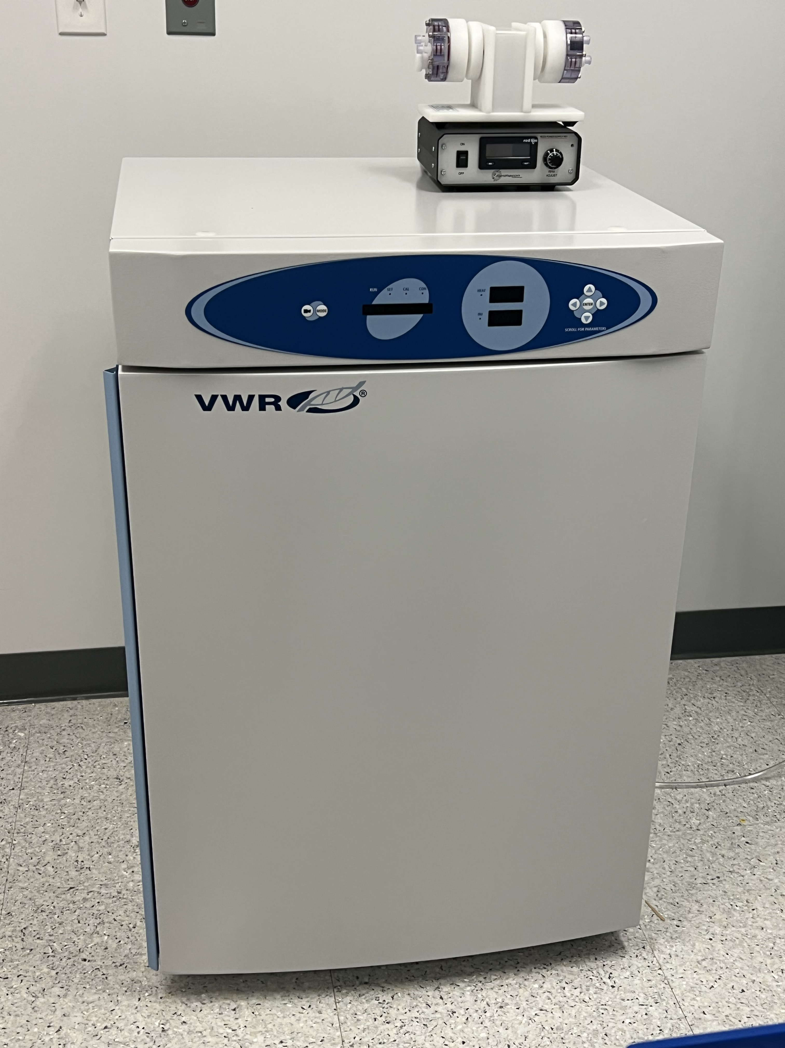
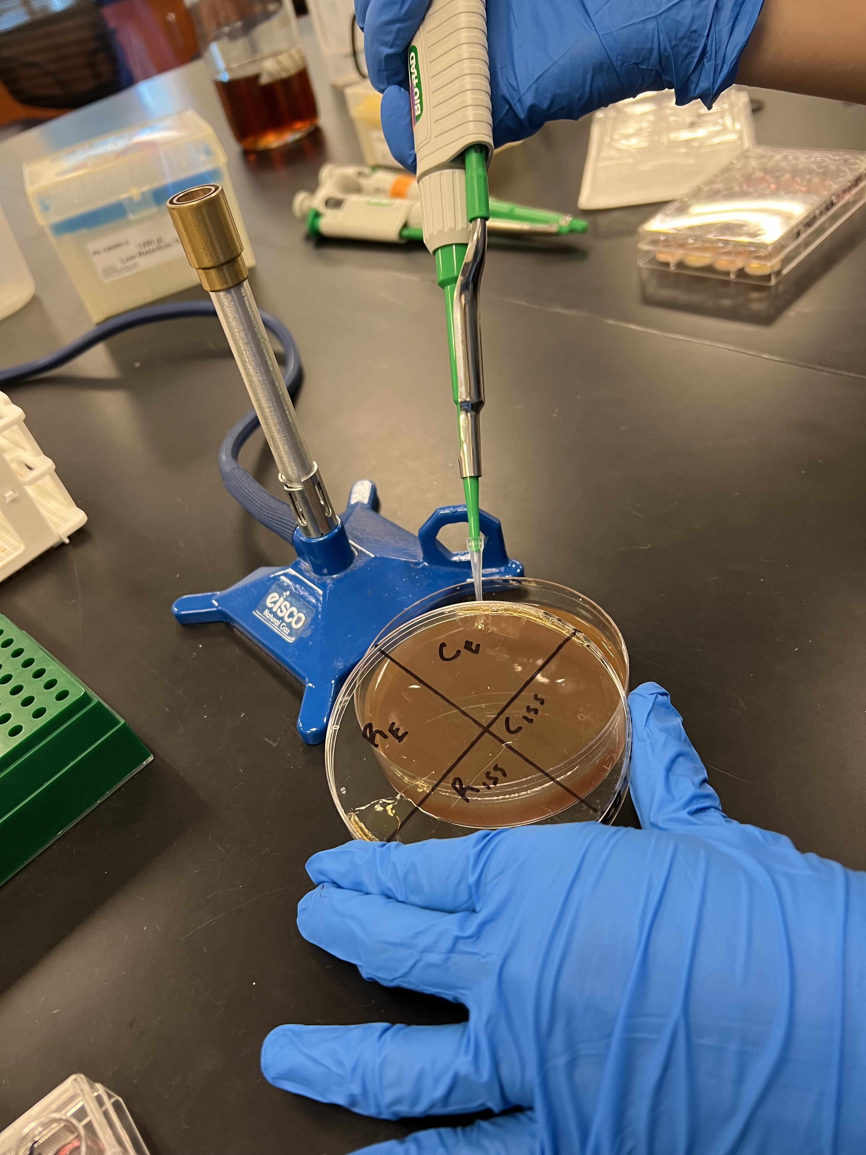
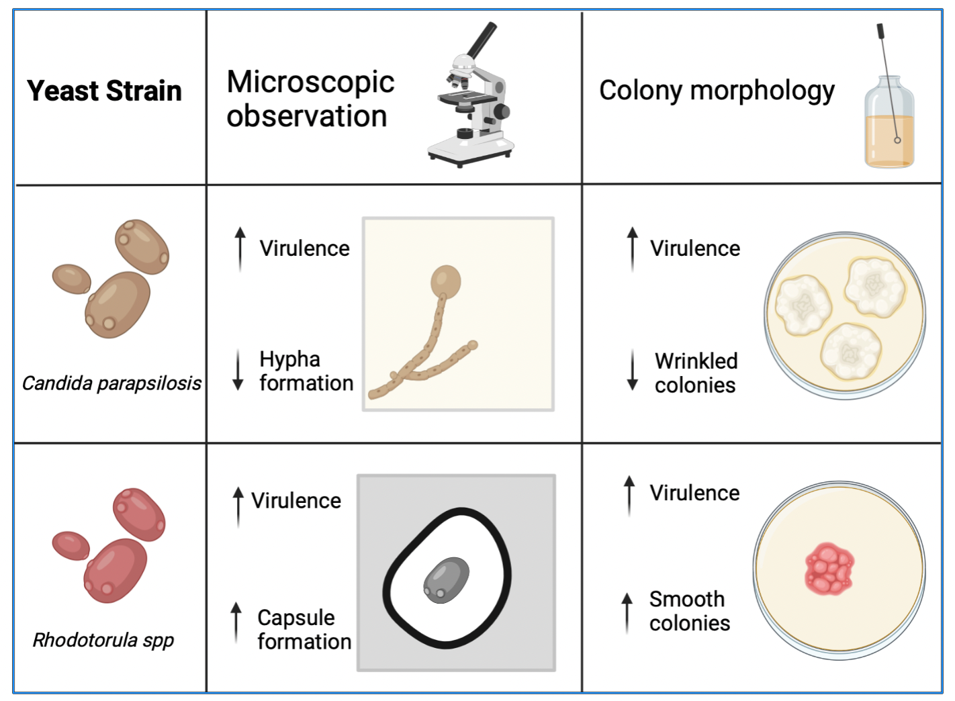
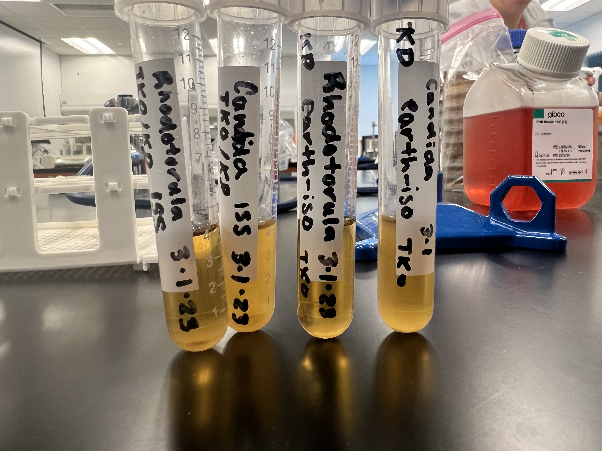
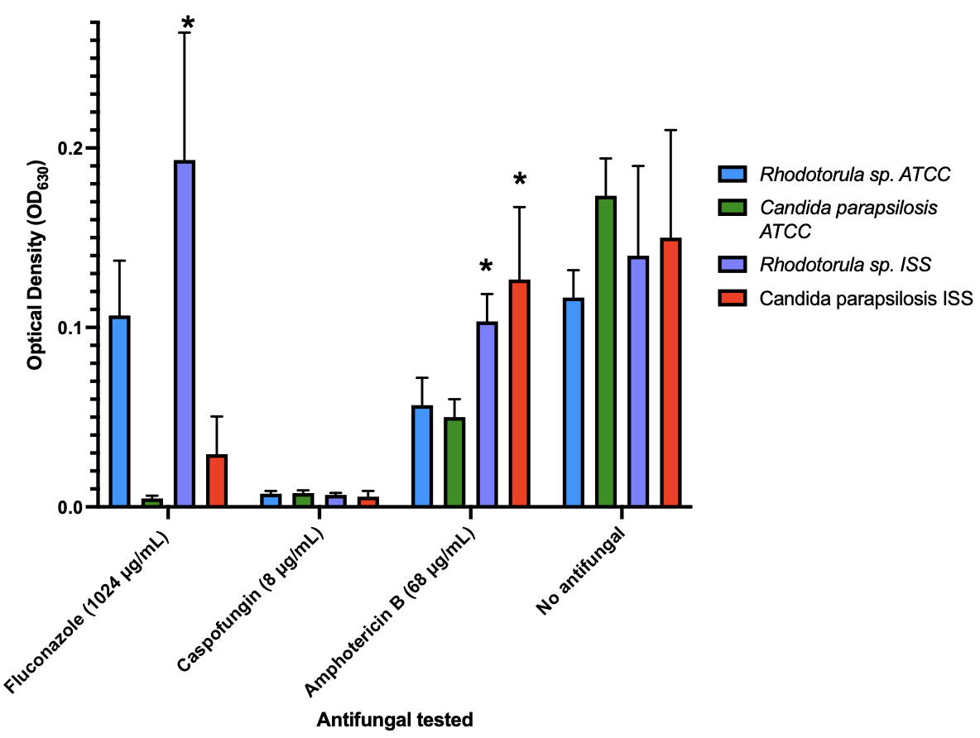
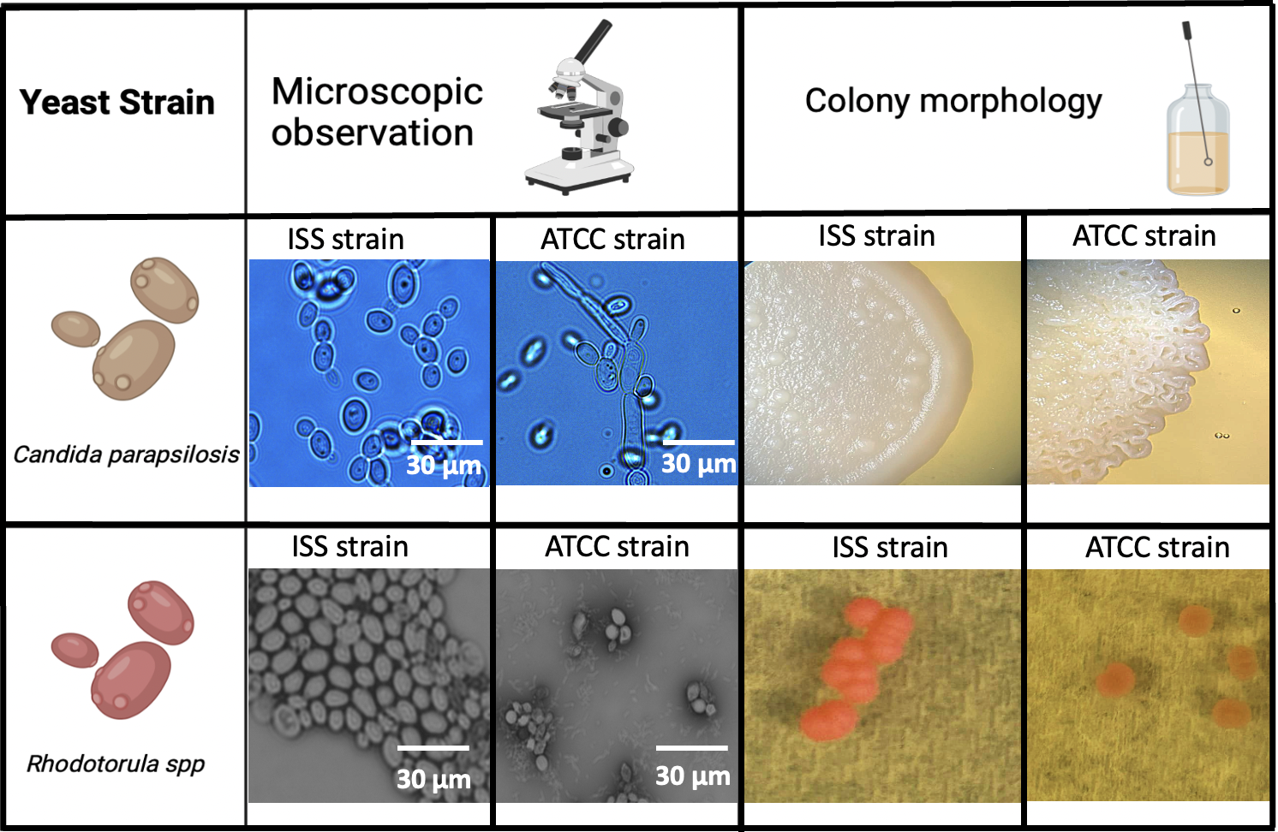
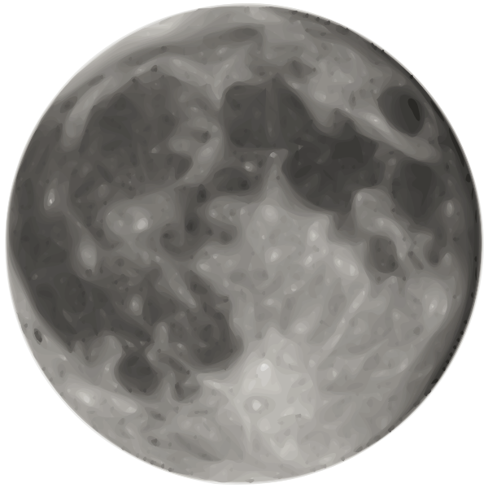
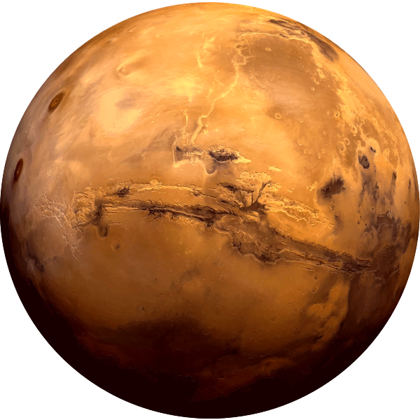
Observing Pathogenic Affinity of Candida and Rhodotorula under Simulated Moon and Martian Atmospheres
Takara O'Brien, Kaitlyn Nielsen, and Alba Chavez (PhD)
ABSTRACT/HYPOTHESIS
FUTURE DIRECTIONS
Due to increased interest in long-term space exploration, the acquisition of how microgravity will affect the growth and adaptability of microorganisms is prevalent. This investigation was designed to assess the virulence and phenotypic expression of yeast isolates Candida parapsilosis and Rhodotorula mucilaginosa.
Consequently, commercial terrestrial controls, Candida and Rhodotorula isolates from the ISS will show a rise in biofilm, antifungal resistance, and filamentation when exposed to different gaseous environments simulating extraterrestrial atmospheres. The experiment's findings will ultimately show whether any of the tested strains show a greater predisposition for pathogenic adaptation when compared to the earth-controls.
Incubator Set-Up/Machine Use Training with Dr. Paul and Dr. Walcker
Second Control Study
Continuation of Research in accordance with SURF project completion timeline
Publication and future deliverables
Final findings will be presented at Discovery Day 2024
EXPERIMENTAL DESIGN
PRELIMINARY RESULTS
Atmospheric % Composition
33% Ne
33% H₂
33% He
95% CO₂
2.6% N₂
1.9% Ar
VS.
MOON
MARS
Notes:
Treatment Disadvantages:
-Rare lymphomas of spleen and liver.
-Biological Therapy drugs inhibit TNF which is responsible for inflammation.
Formulation: Polymer Differences
-EPO pH 5, mouth release
-RS100 pH 6, ileum release
-S100 pH 7, colon release
Vial 1: RS 100 PVA
Vial 2: RS 100 P127
Vial 3: EPO with p127

