Slide 1
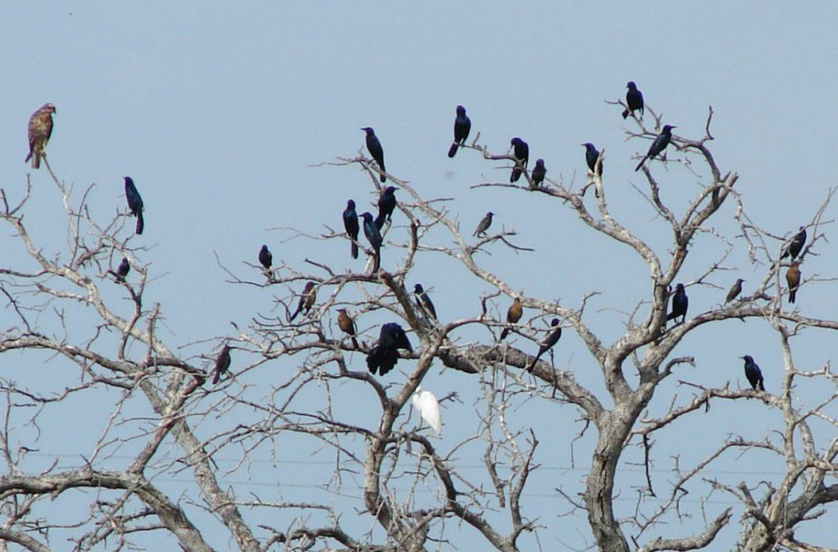
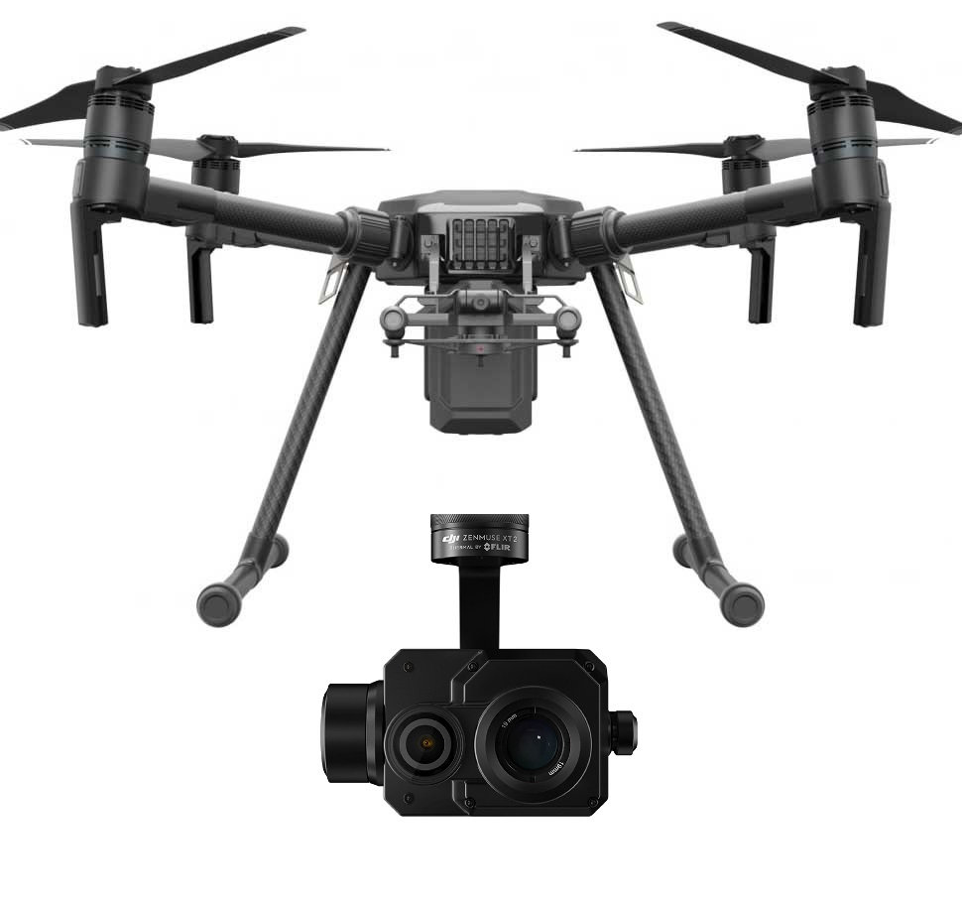
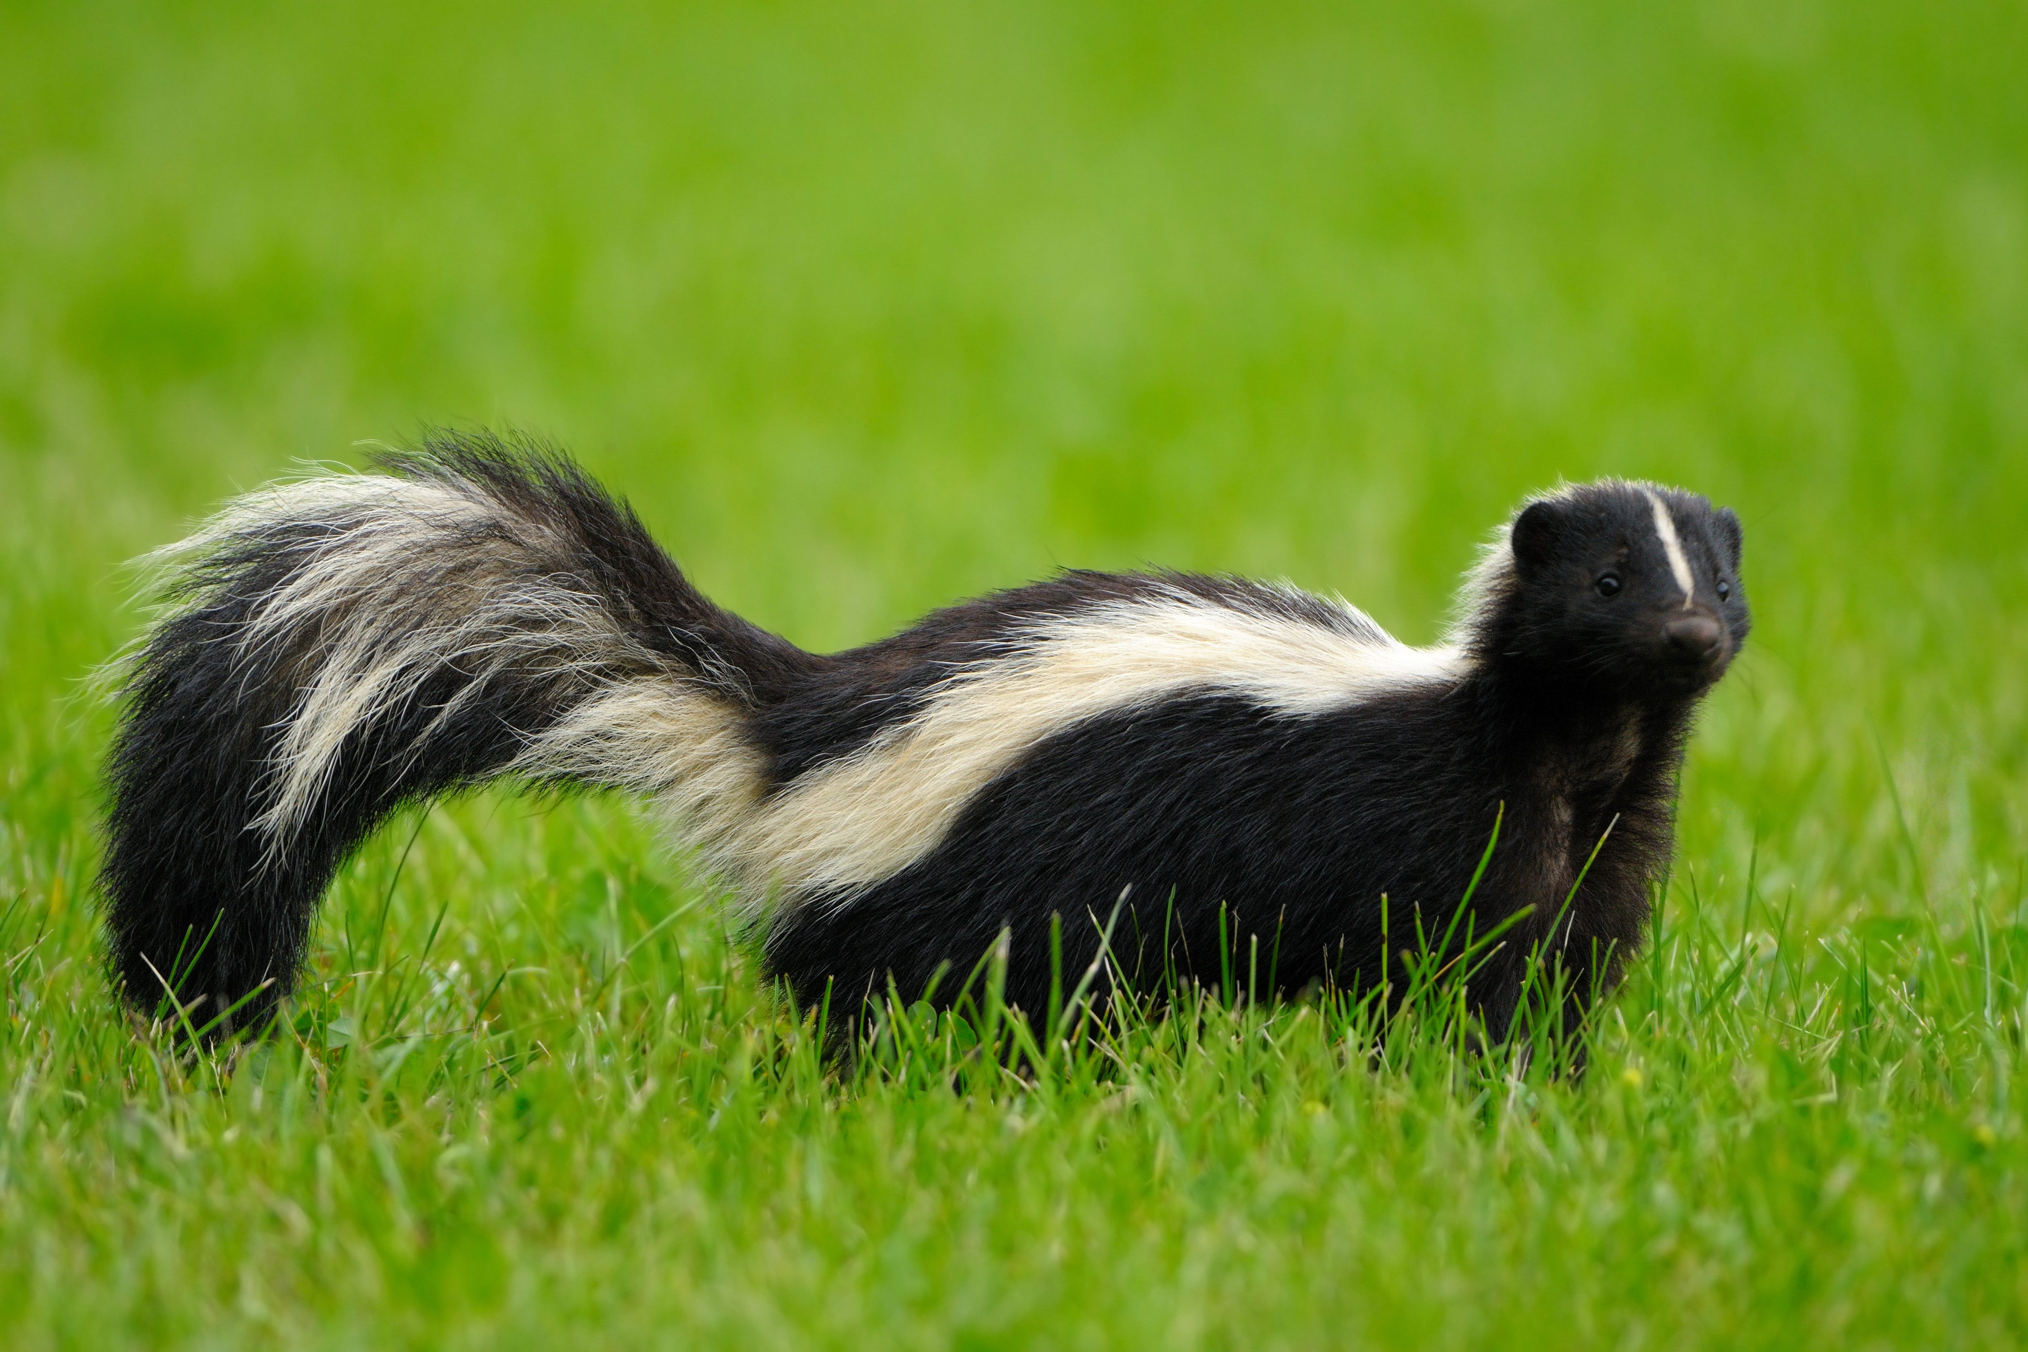
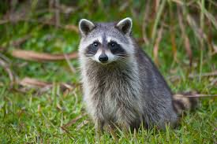
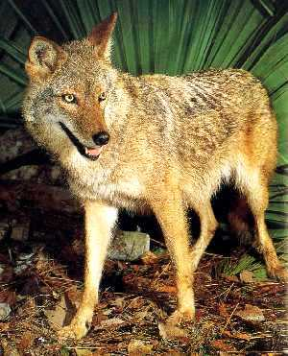
Unmanned Aircraft Systems for Wildlife Hazard Assessment During Nightfall
Student Author: Janelle Drennan – Undergraduate Student and Researcher (drennaj1@my.erau.edu)
Faculty Advisor: Flavio A. C. Mendonca, Ph.D. – MBA (coimbraf@erau.edu)
Abstract
Concept of Operations
Significance of the Study
Part 139 airport operators are required to conduct a wildlife hazard assessment (WHA) whenever a wildlife strike occurs on or near the airport. The WHA is a formal assessment conducted by a qualified airport wildlife biologist (QAWB) to observe and identify wildlife species, their numbers, and behaviors; and to identify locations around the airport that could attract wildlife. The current approach, however, has several limitations that could be mitigated with innovative applications of unmanned aircraft systems (UAS). The researcher will explore the use of UAS technologies at night to support data collection during a WHA. The researcher will use a DJI Mavic 2 Enterprise Dual with both visual and thermal cameras, a spotlight and a Matrice 210 with a Zenmuse-XT2 thermal camera to collect data. Data will be collected in a farmland area located two nautical miles south of Daytona Beach International Airport. Our team will apply multiple strategies to mitigate the risks associated with UAS operations in an airport environment. Findings are expected to suggest that UAS technologies can streamline the WHA process during periods of darkness. Additionally, the researcher is expecting to develop benchmark safety protocols that can facilitate the effective integration of UAS into the airport environment.
The researcher will lead a small team of undergraduate students to assist with data capture, visual observing, flight operations, and data analysis during the hours of twilight leading into nightfall. This study will employ a DJI Matrice 210 with an XT-2 thermal camera to achieve the thermal imaging requirement. The team will use a dedicated trailer to house the necessary equipment to ensure optimal research procedures, such as an Automatic Dependent Surveillance – Broadcast (ADS-B) flight box, in concert with ForeFlight to monitor manned air traffic; and two television monitors, one to display ForeFlight information, and the other, connected to the drone’s controller via an HDMI cable, to mirror the drone’s screen.
Historically, ground-based exploration (often with the assistance of binoculars) does not offer a bird’s-eye view of wildlife, nor are the locations conducive to reach by vehicle or on foot (e.g., wetlands, marshes, etc.) [1]. Furthermore, these assessments fail to capture the nocturnal nature or congregations of large-massed animals that have emerged as more dangerous to aviation. Moreover, traditional WHA conducted at night use trapping and animal marking techniques are highly invasive [3]. Other methods call for night vision equipment that does not adequately penetrate the landscape, or vehicle-mounted spotlights that potentially pose a hazard to aircraft, other vehicles, or airport towers if pointed inappropriately [3]. Hence, the use of UAS technology is a less intrusive means to assist with wildlife surveys, and from an aerial perspective that extends beyond conventional practices.
Safety Risk Management Strategies
The team will adopt SRM procedures to help mitigate the possibility of conflicts between manned aircraft operations and UAS during the data collection process, including geofencing, a visual observer (VO) [5, 6, 7], and UAS flights being conducted below 200 feet above ground level (AGL). Noteworthy to mention that at least one member of the team will stay inside the trailer during the entire data collection process monitoring the live traffic feed and communicating (e.g., walkie-talkies) with the drone’s pilot and the visual observer.
Introduction
Studies have identified a positive relationship between the body mass of an animal and the likelihood of a damaging strike [4, 8]. Similarly, there is evidence that supports a higher risk of strikes with terrestrial mammals at night [2, 4]. This stands to reason considering most terrestrial animals listed in the FAA’s Wildlife Strike Database of the fifty most hazardous wildlife species tend to be crepuscular (most active before sunrise and after sunset) or solely nocturnal. Herein lies an opportunity to enhance current WHA during periods of darkness. Through UAS innovation technologies, there is a potential to extend the range, perspective, and penetrate locations previously inaccessible to qualified airport wildlife biologists.
Data Collection and Analyses
To obtain the best possible outcomes, the test flights will use both automated and manual flight modes. The first mode will provide a baseline of the area and thermal signatures of resting objects (e.g., presence and location of mammals). The second mode of flight will then shift to manual operations whereby the pilot-in-command (PIC) will observe and loiter over areas of interest. Quantitative and qualitative analyses will help identify:
The workflows and best practices for applying UAS technologies during a WHA at night;
Whether UAS thermal imaging is effective in detection of wildlife during periods of darkness; and
Whether UAS thermal imaging is effective in identifying the land uses and habitats at the data collection area that are attracting hazardous wildlife to the airport environment.
References
[1] Cabrera*, J., Chimino*, A., Woolf*, N., Schwarz*, M., & Mendonca, F. A. C. (2021). Applying UAS for wildlife hazard management at airports. FAA challenge: Smart airport student competition. Retrieved from http://faachallenge.nianet.org/wp-content/uploads/FAA_ 2021_TechnicalPaper_EmbryRiddleAeronauticalUniversity.pdf.
[2] Dolbeer, R. A., Begier, M. J., Miller, P. R., Weller, J. R., & Anderson, A. L. (2022). Wildlife strikes to civil aircraft in the United States: 1990-2021 (Serial Report Number 28). https://www.faa.gov/sites/faa.gov/files/2022-07/Wildlife-Strike-Report-1990-2021.pdf
[3] Federal Aviation Administration (FAA). (2018). Protocol for the conduct and review of wildlife hazard site visits, wildlife hazard assessments, and wildlife hazard management plans (AC 150/5200-38). FAA. https://www.faa.gov/documentLibrary/media/Advisory_Circular/150-5200-38.pdf
[4] Federal Aviation Administration (FAA). (2022). Wildlife strikes to civil aircraft in the United States, 1990-2021. FAA. https://www.faa.gov/sites/faa.gov/files/2022-07/Wildlife-Strike-Report-1990-2021.pdf
[5] Hamilton, B. A. (2020a). Airports and unmanned aircraft systems Volume 1: Managing and engaging stakeholders on UAS in the vicinity of airports (ACRP Research Report No. 212, volume 1). Transportation Research Board on the National Academies. https://www.nap.edu/ catalog/25607/airports-and-unmanned-aircraft-systems-volume-3-potential-use-of-uas-by-airport-operators
[6] Hamilton, B. A. (2020b). Airports and unmanned aircraft systems Volume 3: Potential use of UAS by airport operators (ACRP Research Report No. 212, volume 3). Transportation Research Board on the National Academies. https://www.nap.edu/ catalog/25607/airports-and-unmanned-aircraft-systems-volume-3-potential-use-of-uas-by-airport-operators
[7] Hamilton, B. A. (2020c). Airports and unmanned aircraft systems Volume 2: Incorporating UAS into airport infrastructure planning guidebook (ACRP Research Report No. 212, volume 2). Transportation Research Board on the National Academies. https://www.nap.edu/ catalog/25607/airports-and-unmanned-aircraft-ystems-volume-3-potential-use-of-uas-by-airport-operators
[8] Pfeiffer, M. B., Blackwell, B. F., & DeVault, T. L. (2018). Quantification of avian hazards to military aircraft and implications for wildlife management. PloS one, 13(11), e0206599. https://doi.org/10.1371/journal.pone.0206599

