Slide 1
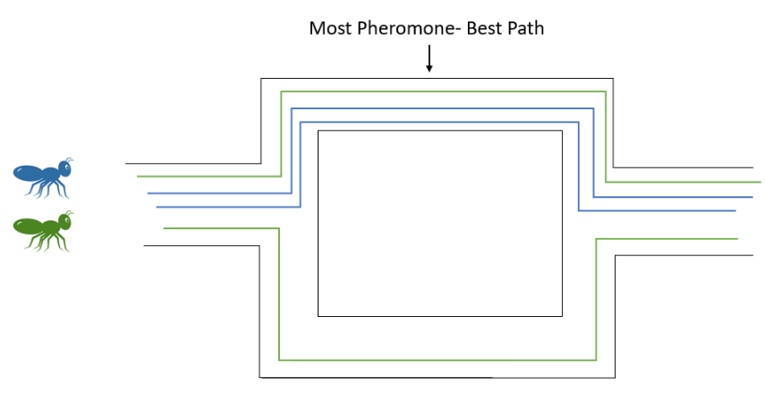
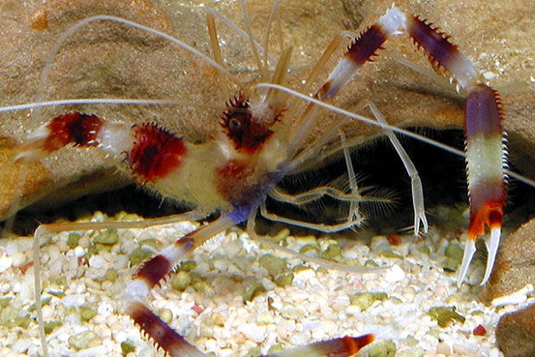
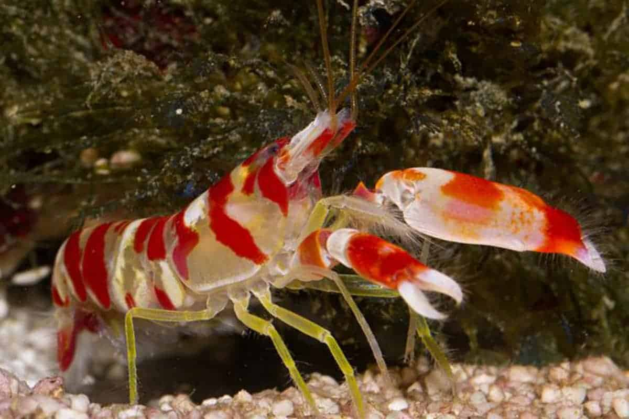
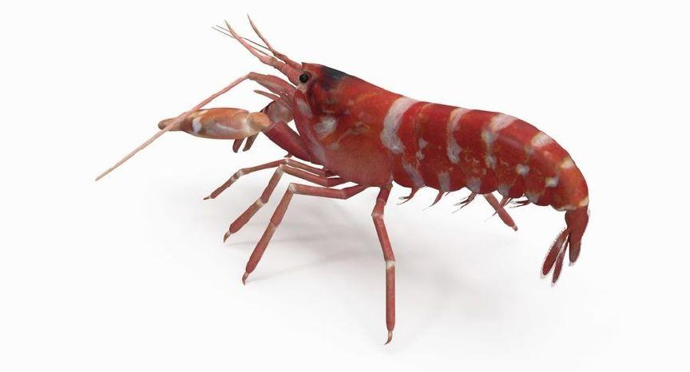
Developing an Optimization Algorithm for Snapping Shrimp Communication
Julia Gorthey and Dr. Bryan Watson
College of Engineering
BACKGROUND INFORMATION:
All societies depend on resources for their communities, but population growth can overwhelm the resources needed for sustainability. When proposing solutions to challenging problems, we can turn to nature for inspiration. Swarm intelligence in ants has been used to design optimization algorithms. Optimization approaches allow the management of resources. Ant Colony Optimization uses computer simulated pheromone trails by ants to find the most optimal path (Figure 1). However, Ant Colony Optimization is best suited for a select probabilistic pathfinding approach . Due to the success in this area, it would be wise to investigate other methods of achieving efficient pathfinding.
Figure 1: Ant Colony Optimization Phenomenon Trails
The colored ants follow their coordinating color path. Over time one ant's random decision to choose a different path will result in a stronger phenome path
SPECIFIC TASKS:
Specific Aim One: Interpret sponge dwelling shrimp literature.
Read literature.
The literature will be filtered by related topics and key words “Group response”, “Underwater swarm intelligence”, “Snapping Shrimp” etc.
Synthesis literature into understandable notes and process
Specific aim two: Develop a biological model.
Conceptual biological model (flowchart of biological process)
The model will use the first aim findings to put together a biological concept of how shrimp communicate.
Executing biological model
CURRENT FINDINGS AND PIVOTING:
In the preliminary literature review we found more potential for research with a different bread of shrimp, the snapping shrimp. This species lives a colony and whose structure resembles more closely with bees. We are beginning to focus the research on the unison snapping the species does with intruders to the colony and how eusociality works with the shrimp.
The pivot was caused by the fact that coral shrimp do not scavenge for food as we had predicted. We found that snapping shrimp have a more compatible colony structure for the research (Figure 2) $.^{1}$ We are finding other areas for potential with colony communication and signaling that we think we provide similar contributions and new areas of research unexplored.
Figure 3: Coral shrimp (right) vs Snapping Shrimp (left)
The current findings show that snapping shrimp colonies have coordinated snapping during an intruder event. Intruder response is an area of interest because the small shrimp typically live in colonies on sponges for generations $.^{2}$
The coordinated snapping events cause intruders to retreat faster than individual snapping. Not all events trigger community response at all and some events do not trigger the fully colony involvement$.^{2}$ From these literature findings, I will be able to create a biological model to simulate how individuals can signal for help and get others to coordinate response with them.
ABSTRACT:
Swarm intelligence in animals have been used to design previous optimization methods. One optimization method, Ant Colony Optimization uses computer simulated pheromone trails formed by ants to find the most optimal path. Scholars have not applied underwater swarm intelligence behavior for optimization algorithms. My key research question is how can underwater swarm activity inspire an optimization or consensus algorithm? Since beginning work, the topic has pivoting from food pathfinding to colony intruder response using snapping shrimp. The behavior of the colony is will be used to create and test a biological model and lead to development of an algorithm for individual triggered group response. The work can be applicable to a variety of real-world system with individual systems trigger a group response for help.
APPLICATION TO REAL WORLD PROBLEMS:
The group communication found in snapping shrimp colonies is applicable to more areas of swarm communication. The goal is to develop a model that individuals within the swarm can signal for waves of help to the group without a central monitoring device. Communication within shrimp can be applicable to real world problems through biological inspired design.
An example of how we can use group communication in various real-world problems such as if an individual taxis can signal for help to other surrounding taxis to receive support in busy areas during demand spikes.
Figure 2: Snapping shrimp individual trigger response
Event End
Event begin
Works Cited
Chak, S. T. C., & Rubenstein, D. R. (2019). Social transitions in sponge-dwelling snapping shrimp. Current Opinion in Insect Science, 34, 33–39. https://doi.org/10.1016/j.cois.2019.02.006
Tóth, E., & Duffy, J. E. (2005, March 22). Coordinated Group response to nest intruders in social shrimp. Biology letters. Retrieved April 3, 2023, from https://www.ncbi.nlm.nih.gov/pmc/articles/PMC1629045/
Contact: Julia Gorthey
gortheyj@my.erau.edu

