Slide 1
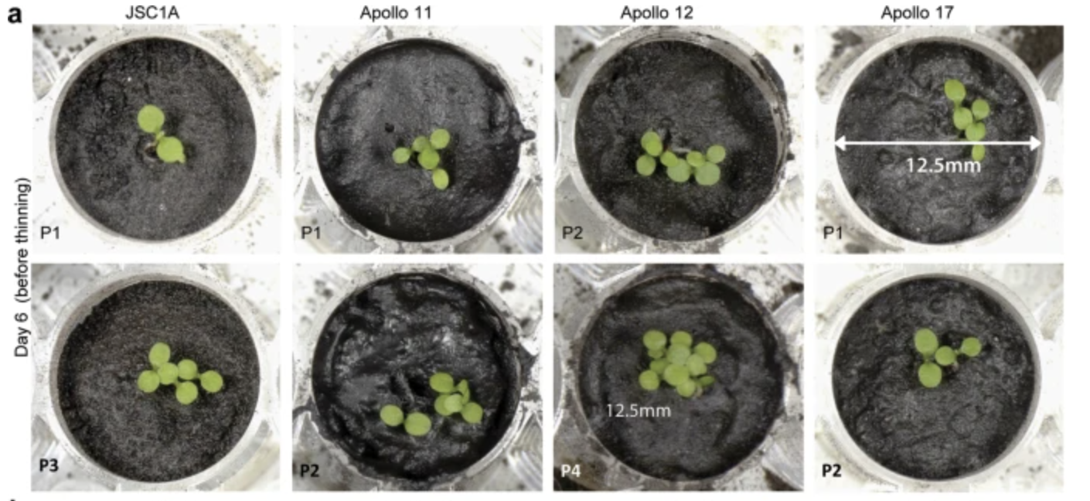
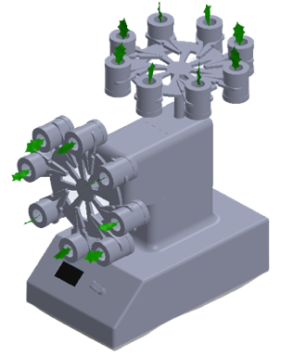
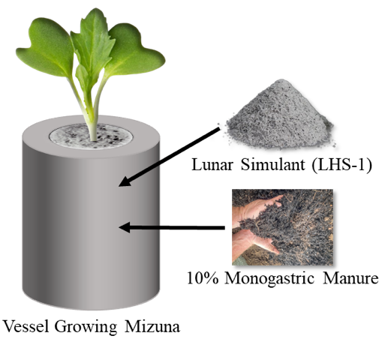
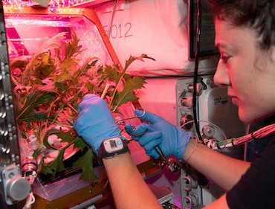
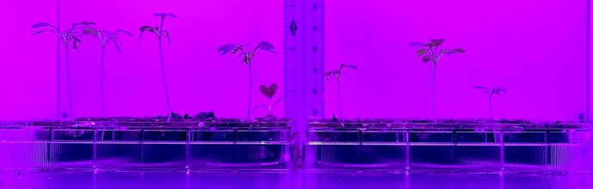
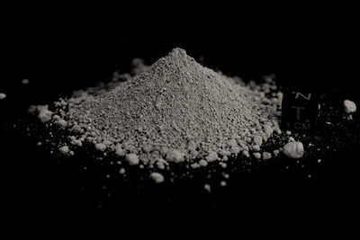
Towards the formation of Moon soil: Mizuna mustard developmental impacts in simulated lunar conditions and compost supplementation.
Collin Topolski, Mitchell Villafania, Paulina Slick, Ella Rowe, Parker Mann & Hugo Castillo, Ph.D.
Department of Mechanical Engineering & Human Factors and Behavioral Neurobiology, Embry-Riddle Aeronautical University, Daytona Beach FL 32114
Introduction
Monogastric Horse Manure
Proxy for human waste
Will be available to use
Think ‘The Martian’
Provides nitrogen and a microbial community
Experiment 2: Developing Moon Soil
Up to 40 days per cycle
Initially mix simulant and manure
Measure all endpoints
Remove edible portions and mix in remainder
Sow new seeds and repeat
Plant Seeds
Measure Germination
Measure Mature Growth
Remove Inedible Portions
Grind Leftover Biomass Into Substrate
NASA’s Artemis program aims to establish a permanent base on the Moon.
Many challenges are present such as mission costs due to high masses and maintaining astronaut health.
Unlike the ISS, the Moon has many useful resources in-situ.
Growing plants on Mars using human waste. (Image credited to The Martian)
Artist render of a lunar base (Image credited to the ESA).
Simulated Microgravity
Modifying the EagleStat to support plant-based studies
2D clinostats can provide initial insight
Custom vessels will be printed to hold the substrate while allowing a simple hydration option.
Crops can utilize the regolith as a growth substrate and nutrient source.
UF Gainesville used authentic Moon regolith and obtained 100% germination and highly stressed plants.
Experiment Endpoints: | Physical | Chemical | Biological
Plants |  |  | N/A
Manure/ Substrate
Height Leaf count | Dry masses Leaf Area
Chlorophyll Content Total Nitrogen
First plants grown in authentic lunar regolith (Paul et al., 2022)
Elemental Analysis Water holding capacity
Total & microbial biomass (N & C) pH level
Microbiome succession using DNA sequencing qPCR differential gene expression
Gaps in literature:
Few studies mix manure or compost with regolith simulant, but don’t analyze microbial community changes
No studies are reincorporating biomass for successive growth cycles
Preliminary Work
Mizuna mustard was initially grown to begin assessing potential issues during growth cycles.
Invited to submit a NASA Step 2 proposal for this work.
Model Selections
A modified EagleStat (left) for plant-based simulated microgravity studies along with custom vessels (right) in development.
Mizuna has many good qualities:
Grown as a microgreen
High nutritional profile
Studied multiple times on the ISS
Can provide high biomass compared to seed mass
Experimental Process
Experiment 1: Simulated Microgravity
Complete six experiments to view direct impact of microbes on plant growth in simulated microgravity.
Treatments | Gravity | Simulated Microgravity
R = Regolith M = Manure W = Water A = Abiotic | R + W (Control) | R + W
 | R + M | R + M
 | R + A (Abiotic Control) | R + A
Mizuna mustard grown in the Space Microbiology Lab for the first time. The progress after day 7 (top) and 15 (bottom) are shown.
Mizuna mustard grown in the VEGGIE module on the ISS (Image credited to NASA).
15 days for Microgreens
Mix up to 10% of manure
References
Using Exolith Lab’s LHS-1 simulant based on NASA landing site.
Entirely absent of nitrogen unlike authentic Moon regolith.
Caporale, A. G., Amato, M., Duri, L. G., Bochicchio, R., De Pascale, S., Simeone, G. D. R., ... & Adamo, P. (2022). Can Lunar and Martian Soils support food plant production? Effects of horse/swine monogastric manure fertilization on regolith simulants enzymatic activity, nutrient bioavailability, and lettuce growth. Plants, 11(23), 3345. ​
Caporale, A. G., Palladino, M., De Pascale, S., Duri, L. G., Rouphael, Y., & Adamo, P. (2023). How to make the Lunar and Martian soils suitable for food production-assessing the changes after manure addition and implications for plant growth. Journal of Environmental Management, 325, 116455. ​
Duri, Luigi Giuseppe, et al. "The potential for lunar and martian regolith simulants to sustain plant growth: a multidisciplinary overview." Frontiers in Astronomy and Space Sciences (2022): 233. ​
Paul, A. L., Elardo, S. M., & Ferl, R. (2022). Plants grown in Apollo lunar regolith present stress-associated transcriptomes that inform prospects for lunar exploration. Communications biology, 5(1), 382. ​
Rivera, C. M., Battistelli, A., Moscatello, S., Proietti, S., Rouphael, Y., Cardarelli, M., & Colla, G. (2006). Influence of simulated µG on growth, yield, and quality of leafy vegetables: Lettuce and rocket. European Journal of Horticultural Science, 71(1), 45. ​
Wamelink, G. W., Frissel, J. Y., Krijnen, W. H., Verwoert, M. R., & Goedhart, P. W. (2014). Can plants grow on Mars and the moon: a growth experiment on Mars and moon soil simulants. PLoS One, 9(8), e103138. ​
Measure all plant, microbe, and substrate endpoints.
Growing plants on Mars using human waste. (Credit to The Martian)

