Slide 1
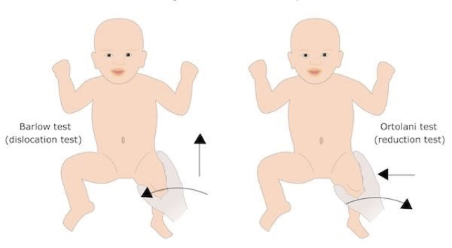
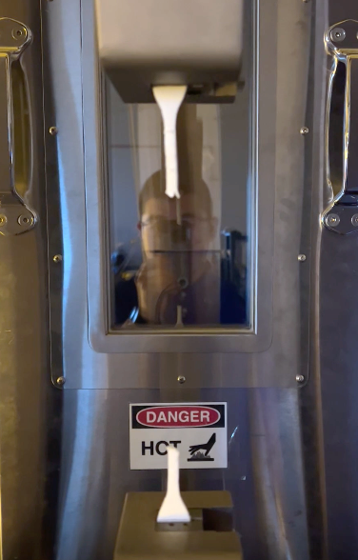
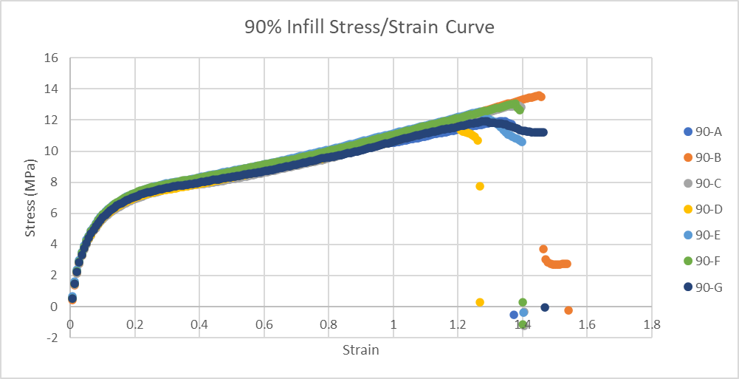
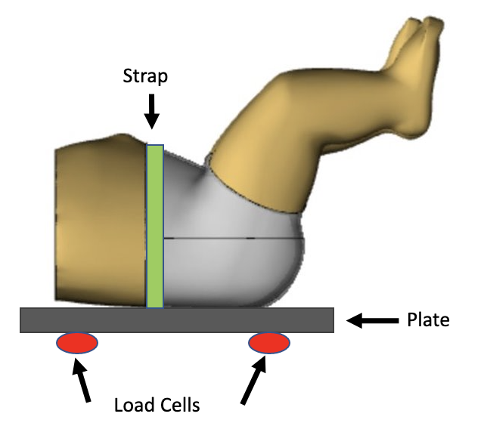
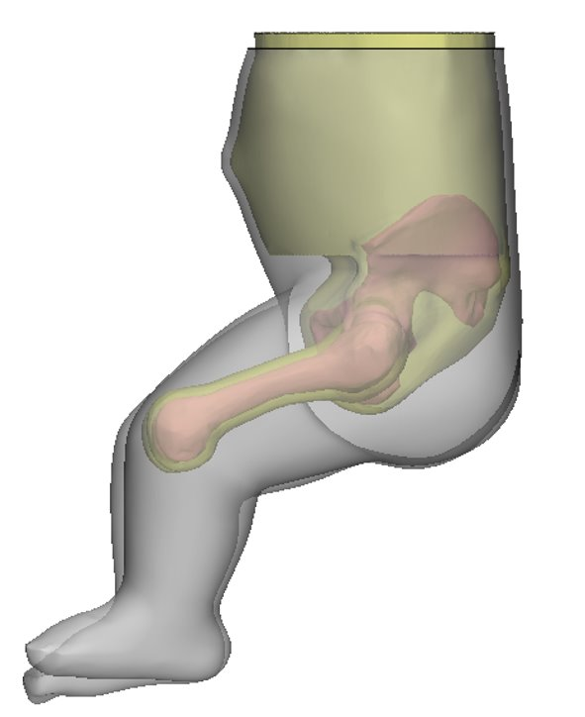
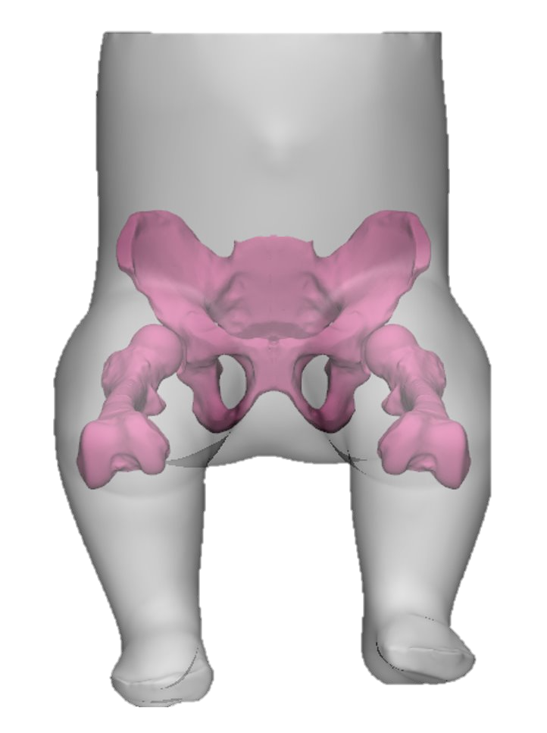
Developmental Dysplasia of the Hip JOEE Medical Trainer
Mechanical Engineering
Discovery Day Poster Session
BACKGROUND
Developmental dysplasia of the hip (DDH) is a common condition affecting 1 in every 1000 children [3]. The cause of DDH is unknown however, the leading identifiers are being female, family genetics, the infant presenting breech, being the first born, or restricted in the womb. The most common case seen is when the acetabulum is formed incorrectly resulting in a shallow socket, allowing for dislocation of the infant’s hip.
Figure 1: Barlow and Ortolani Test [2]
To detect DDH, a physical examination is performed on newborns at the hospital and at each doctor's appointment until three months of age. The Ortolani and Barlow maneuvers, as seen above in Figure 1, are two dynamic tests performed on the infant to study the movement of the femoral head in the acetabulum. A healthy hip will experience full range of motion with no dislocation.
METHODOLOGY
The proposed design uses Clear Flex 30, a water-clear urethane rubber, to surround the bones while providing optimal transparency. The acetabulum and both femurs have been printed in Ultimaker 95A TPU at 100% infill. Two molds were created to complete one prototype. The first was of the existing Hippy Baby and the second was an internal mold placed inside the first mold while the Clear Flex 30 cured. The internal mold was 3D printed out of PLA.
Figure 2: JOEE Medical Trainer Final Model
In Figure 2, the grey section of the model represents the area made from Clear Flex 30, the yellow section is hollow, and the pink section are the bones. The internal and external molds were made by mixing equal parts water and alginate in a large container. A small amount was used to fill the 3D printed internal mold. The remaining amount was used for the external mold of the Hippy Baby. Each mold was allowed to cure for eight minutes before the Hippy Baby was carefully removed from the container, and the 3D printed pieces removed from around the internal mold. The Clear Flex 30 was then mixed and poured about halfway into the larger external mold. The smaller internal mold was then positioned into the rubber-filled external mold and the remaining Clear Flex 30 was poured on top. The rubber was allowed to cure for 48 hours before the molds were removed.
Emma Fontz, Olivia Burkowski,
James Palmer, Emily Scott
Department of Mechanical Engineering,
Embry-Riddle Aeronautical University
fontze@my.erau.edu
TENSILE TESTING
Tensile testing of the TPU 95A material was performed for varying infill percentages ranging from 10-100% infill with increments of 10%. Pictures of one of the tests are shown below in Figure 4.
A stress-strain curve was generated from the 90% infill test results and is shown above in Figure 5. The Young’s Modulus was then calculated for each data set and averaged. The average Young’s Modulus for 100% infill was 88.36 MPa, which is a 225.4% increase from the previously assumed 27.15 MPa. These results show that the TPU 95A material is suitable for withstanding the estimated loads of the Barlow and Ortolani procedures.
LOAD CELL TESTING
Figure 6: Load Cell Testing Set Up .
DISCUSSION
The prototype will be filled with glycerin in the pelvic region and sealed with foam. Then, it will be tested using load cells and compared against the JOEE medical trainer. Using these results, the prototype will be re-evaluated, and any necessary changes will be made. The final JOEE medical will then be constructed using the techniques discussed in the plans for improvement so that no air bubbles will be created, and the model is completely water-clear.
REFERENCES
[1] Chow, Y. W., Turner, I., Kernohan, W. G., & Mollan, R. A. (1994). Measurement of the Forces and Movements Involved In Neonatal Hip Testing. International Society For Low Power Laser Applications In Medicine.
[2] Stanford Medicine. (n.d.). Barlow and Ortalani Manuevers. Retrieved from Stanford Medicine:https://med.stanford.edu/newborns/clinicalrotations/residents/residents-newborn-exam/barlow-and-ortalani-manuevers .html
[3] Storer, S., & Skaggs, D. L. (2006). Developmental Dysplasia of the Hip. American Family Physician, 1310-1316.
ACKNOWLEDGEMENTS
Dr. Victor Huayamave, Assistant Professor, Department of Mechanical Engineering
Dr. Charles Price, MD, FAAP, Director of International Hip Dysplasia Institute
Sheridan Perry, B.S. Mechanical Engineering ‘22
ABSTRACT
Developmental Dysplasia of the Hip (DDH) is a condition that causes an infant’s hip to be easily dislocated from the acetabulum. An improperly formed acetabulum is the most common cause of DDH and can cause the femoral head to displace from the socket with ease. The Barlow and Ortolani maneuvers are used to detect DDH by dislocating and relocating the femoral head relative to the acetabulum. Improper training when performing these two procedures can decrease the chances of detecting DDH, resulting in long-term harm to the individual. The current medical trainer, Laerdal Medical’s Hippy Baby, is commonly used to teach the Barlow and Ortolani maneuvers to physicians. The Hippy Baby is not favored because it is stiff and opaque. The new medical trainer has been given the name JOEE, an acronym that incorporates the first letter of each team member’s name. To improve the Hippy Baby, the JOEE medical trainer will be made from a transparent urethane rubber to allow the students to observe the dislocation and reduction. In addition, the bones will be 3D printed in 95A TPU. JOEE will be instrumented using load cells and a force plate to evaluate the forces applied during the Barlow Maneuver.
Figure 4: TPU Sample During Testing | Figure 5: 95A TPU Stress/Strain Graph
The team will be using load cells to obtain the force required to dislocate the hip. This testing will be conducted on Laderal Medical’s Hippy Baby, as well as the JOEE Medical Trainer. The the load cells will be connected to a wooden board, which the medical trainers will be attached to. In addition to the load cell, the team is working to use a force plate simultaneously with the load cell to verify the results. The goal is to compare the force required to dislocate the hip with peer reviewed data.
CURRENT STATUS
The most recent prototype has been completed using the methods previously mentioned in the methodology. This prototype experienced some unforeseen issues throughout the curing process. The main issue is that a large amount of air bubbles are inhibiting the clarity of the material seen below in Figure 3. Clear Flex 30 is supposed to be water-clear without air bubbles and since clarity is the main requirement, this issue needs to be resolved.
Figure 3: Current JOEE Prototype
In addition, with the water-based alginate mold, the resin takes a significantly longer time to cure, this needs to be accounted for.
Plans for Improvement
Pour the mold in sections
Use the heat gun to release air bubbles while pouring the resin
Expand the internal mold to allow for a greater pocket inside
ME Biomedical Systems
Notes:
A stress-strain curve was generated from the 90% infill test results and is shown above in Figure #. The Young’s Modulus was then calculated for each data set and averaged. The average Young’s Modulus for 100% infill is 88.36 MPa which is a 225.4% increase from the previously assumed 27.15 MPa. These results show that the TPU 95A material is suitable for withstanding the estimated loads of the Barlow and Ortolani procedures.

