Slide 1
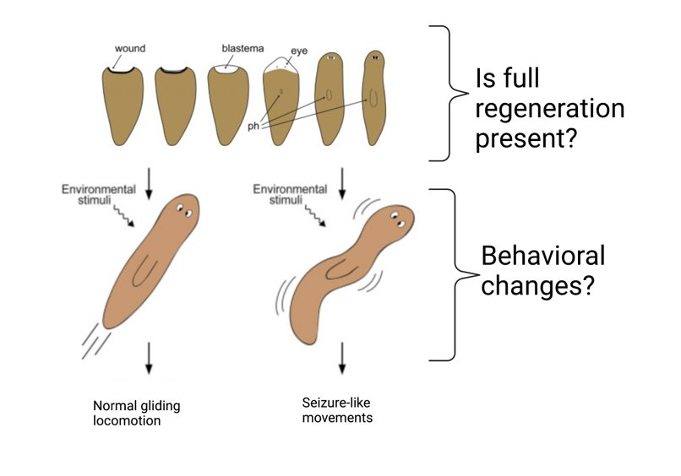
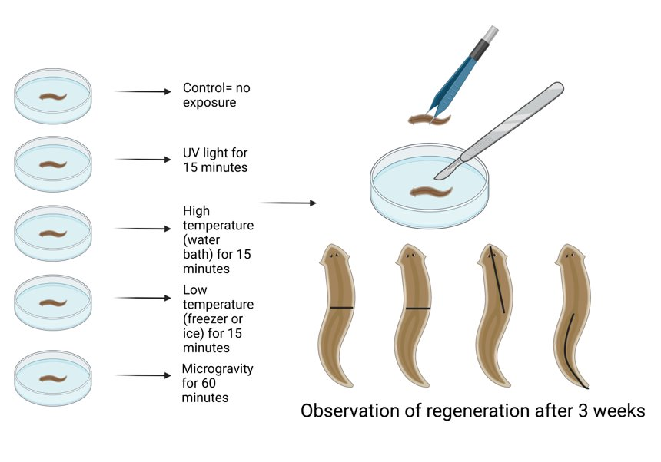
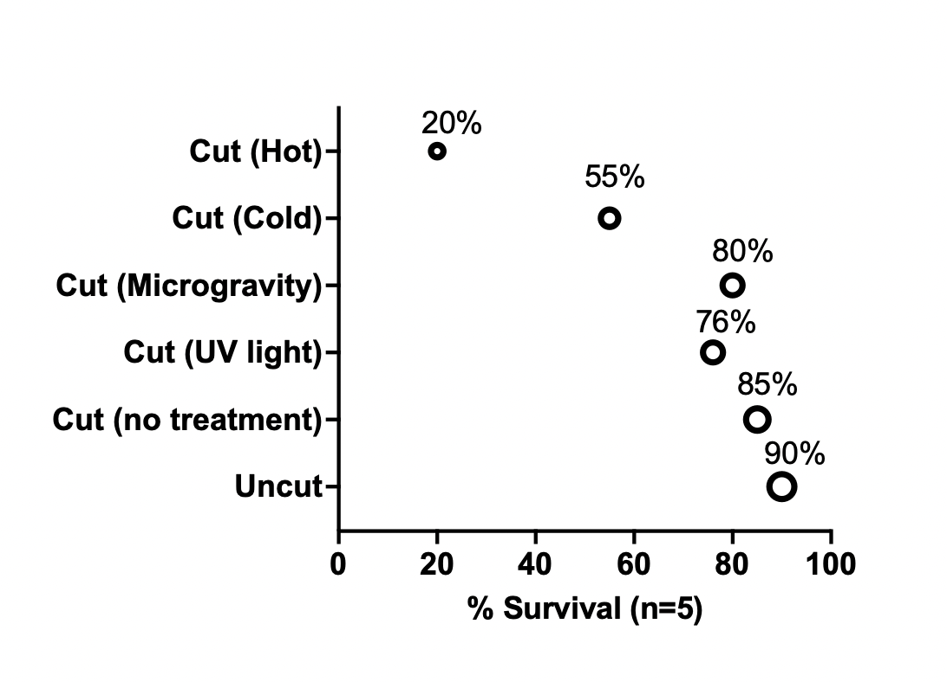
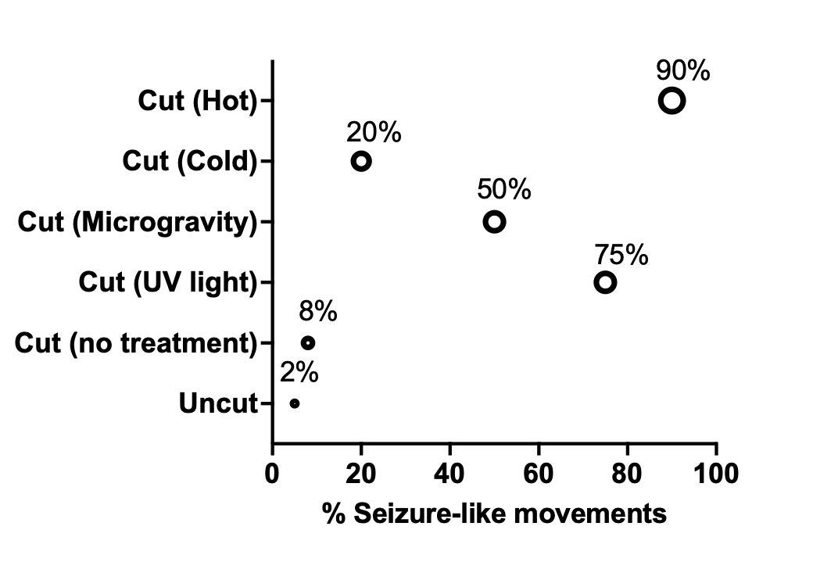
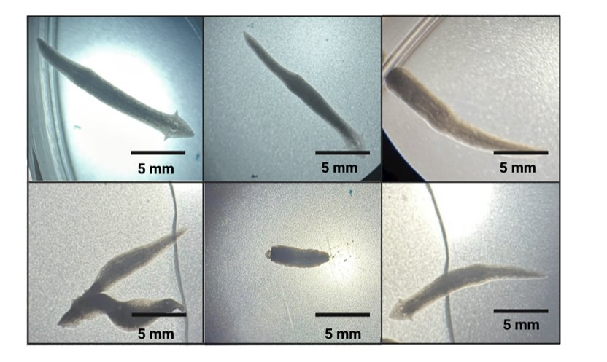
Regenerating Planaria.
Effects of Environmental Factors on Cell Regeneration
Ja'Hann Hannor and Alba Chavez. Aerospace Physiology, Embry- Aeronautical University
Abstract
Hypothesis
Results
Aerospace physiology observes many different aspects of cell reproduction and how they can be used for medical purposes. Planarian has attracted increased attention in the regeneration field for its usefulness as an important organism due to its regeneration ability and it has become increasingly useful to use as a model system to study the effects of environmental factors on cell regeneration. In the present study we subjected planarian worms to different factors including UV light, extreme temperatures and microgravity to observe the rate of regeneration. This experiment has been successfully applied in a classroom setting to demonstrate the importance of environment in organism. In addition, the findings will benefit the medical industry in their research to understand how human cells might be able to replicate planaria stem cells to fight off diseases and cancer cells. This study will be a step in the right direction in understanding cell regeneration in humans.
Extreme environmental factors will inhibit the ability of planarian worms to regenerate.
Experimental design
Introduction
Is regeneration possible in humans under extreme environments?
Planaria share 123 regenerative genes with mice and humans (Figure 1)
Observing phenotypic changes in mice and planaria would shed light into human regeneration.
Results
A
B
C
D
E
F
Future perspectives
To take this project to the next step we will continue our study to understand why that after the three-week regeneration process that the regenerated planaria will show behavioral changes, and how we can stop the planaria from experiencing the stimuli changes.
Results: A) Planarian worm after treatment. B) Control produced full regeneration. C) Microgravity and D) UV light produced slow regeneration and mutated heads. E) Hot temperature showed the most severe effect and F) Cold temperature produced full regeneration.
Acknowledgements
We would like to thank the Bio 121L students for their participation (Spring 2022 and 2023).
Notes:
Name for group/project????
Introduction key points??
pH results – data and graphs?

