Slide 1
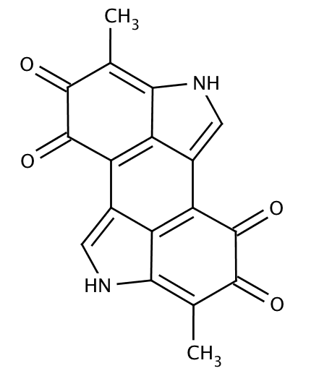
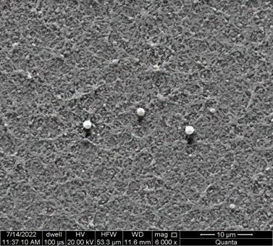
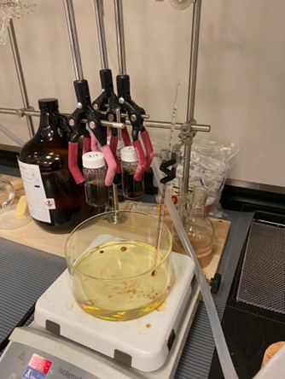
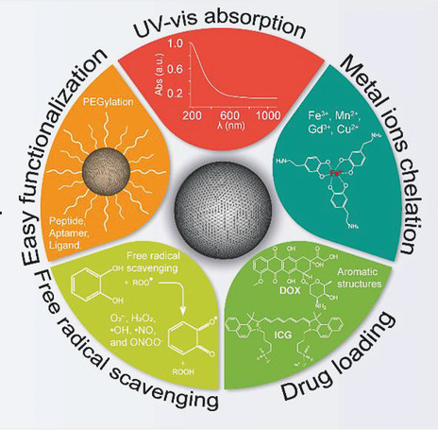
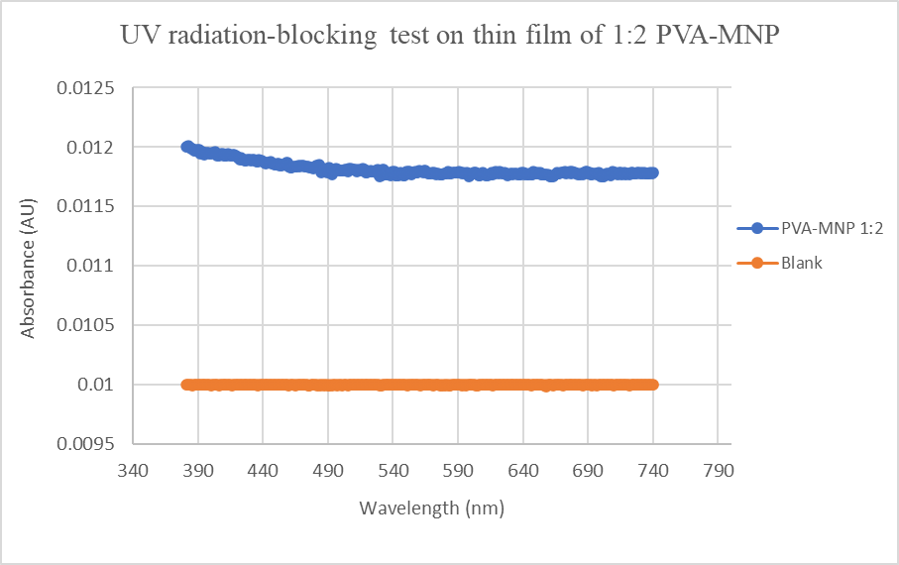
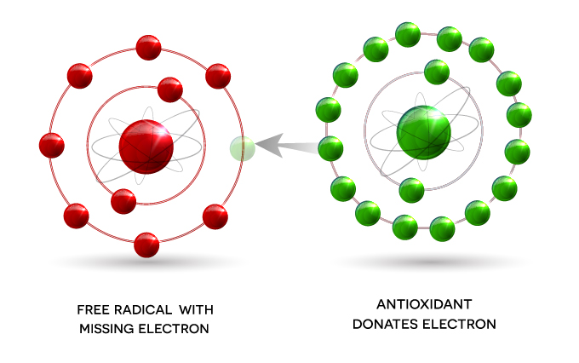
Investigating Antioxidant Properties of Melanin Nanoparticles for Drug Delivery and Countering Cytotoxic Effects of Free Radicals
Giulia Stewart*, Luke Paget*, and Foram Madiyar
*Department of Aerospace Physiology and Neurobiology, Department of Physical Science, Embry Riddle Aeronautical University, Daytona Beach, FL
I. Introduction
III. Previous Results
Characterization Methods of Nanoparticles
- FTIR analysis
SEM images with Energy Dispersive X-­Ray
Melanin, an organic dark pigment naturally produced in most mammals’ skin tissues, is known to neutralize reactive oxygen (ROS) and reactive nitrogen species (RNS). This project’s objective is to produce a synthetic melanin nanoparticle (MNP)-based drug delivery system, capable of neutralizing ROS and RNS in affected tissues.
Quantification of Antioxidant Potential
- Antioxidant assays
- DPPH assays
IV. Future Applications
RADIATION-INDUCED ROS and RNS in mice cells:
Question: Can PEG-MNP treatment of cells prior/post exposure to UV rays decrease ROS/RNS?
Fig 1: Structure of eumelanin
Fig 4: SEM of gold-coated 3% PVA-MNPs
Fig 5: Schematic image of the experimental setup for the synthesis of eumelanin nanoparticles
II. Melanin: Biomedical applications
Drug loading and delivery system
Antioxidant properties for anti-inflammatory therapies and free radical scavenging
Goal: combination of both for novel treatments and multi-purpose drug delivery
Fig 6: UV-radiation-blocking test performed on thin film of 1:2 PVA-MNP (bottom left)
IV. Materials and Methods
Question: Can PEG-MNPs deliver drugs and amplify their antioxidant potential?
Objective: synthesis of MNP-based drug delivery system + replication of natural melanin's antioxidant properties
1. Synthesis of PEG-MNP solutions
2. Loading of PEG-MNPs with DOx (doxorubicin)
3. Quantification of antioxidant potential of:
- DOx (control)
- PEG-MNPs
- DOx-PEG-MNPs
4. Controlled drug-release studies on DOx-PEG-MNPs
Fig 7: Schematic image of PEG-MNP treatments for the investigation of melanin's role in preventing/neutralizing ROS and RNS.
Fig 2: Summary of potential biomedical applications of synthetic melanin nanoparticles.
V. References
Fig. 3: Summary of mechanism of action of PEG-MNP acting as an antioxidant and neutralizing high-energy, unstable free radicals.
(1) Tran-Ly, A. N.; Reyes, C.; Schwarze, F. W. M. R.; Ribera, J. Microbial Production of Melanin and Its Various Applications. World J. Microbiol. Biotechnol. 2020, 36 (11), 170. https://doi.org/10.1007/s11274-020-02941-z.
(2) Michalak, M.; Pierzak, M.; Kręcisz, B.; Suliga, E. Bioactive Compounds for Skin Health: A Review. Nutrients 2021, 13 (1), 203. https://doi.org/10.3390/nu13010203.
(3) Vasileiou, T.; Summerer, L. A Biomimetic Approach to Shielding from Ionizing Radiation: The Case of Melanized Fungi. PLoS ONE 2020, 15 (4), e0229921. https://doi.org/10.1371/journal.pone.0229921.
Antioxidant assays and DPPH assays
Free Radicals (ROS and RNS)
PEG-MNPs

