Slide 1
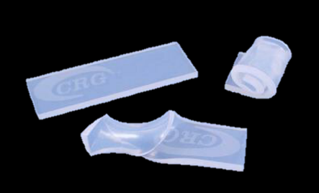
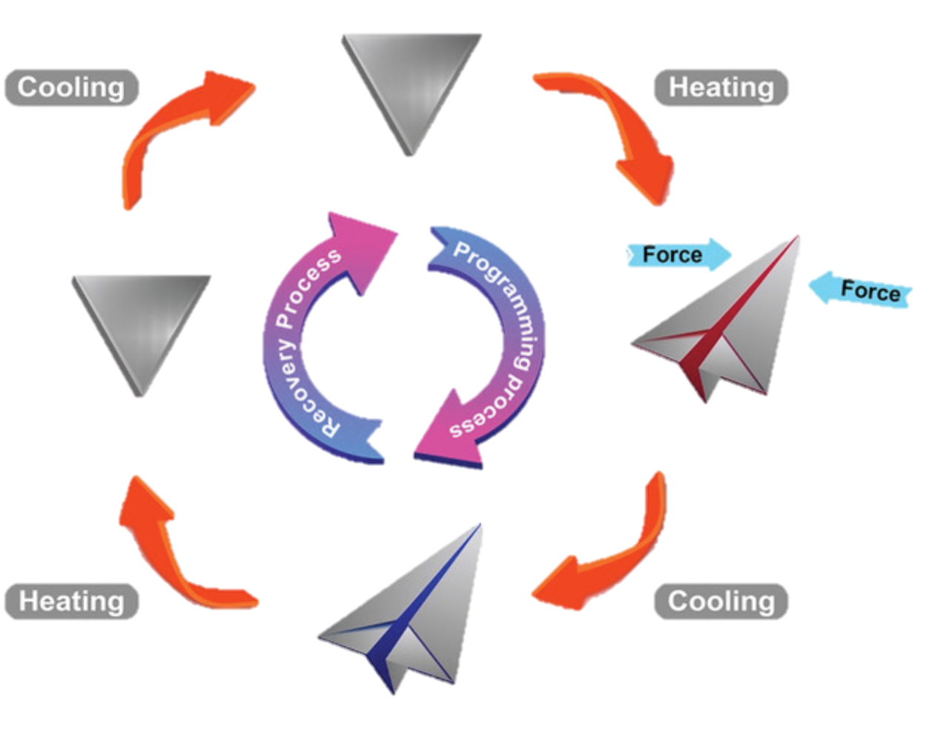
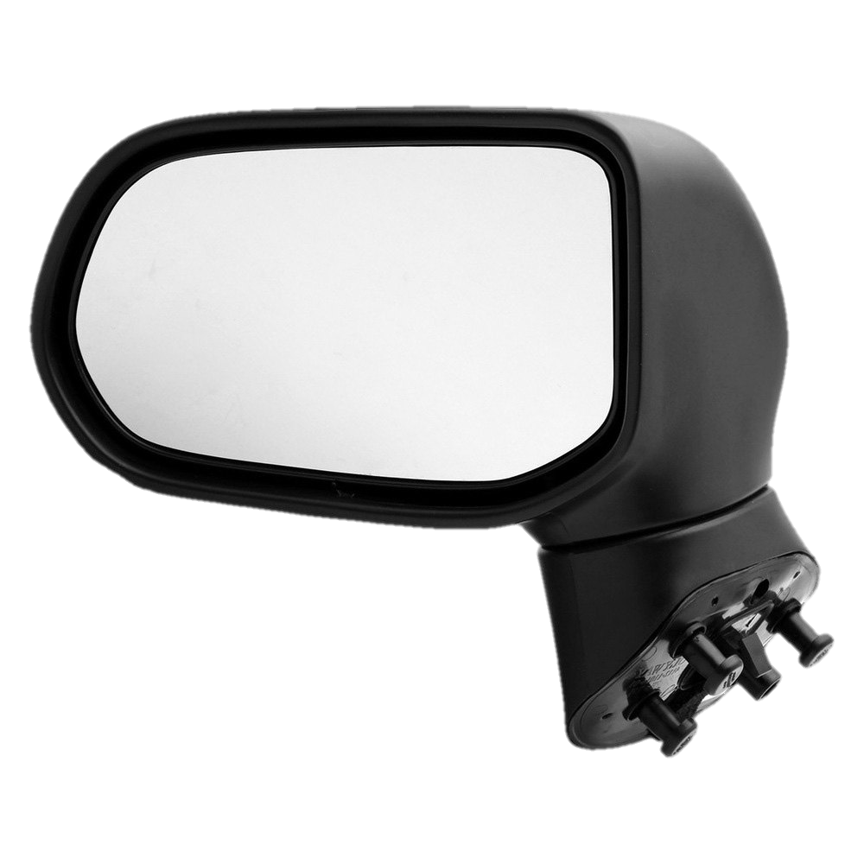
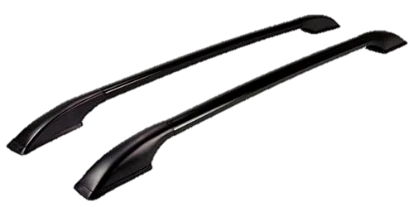
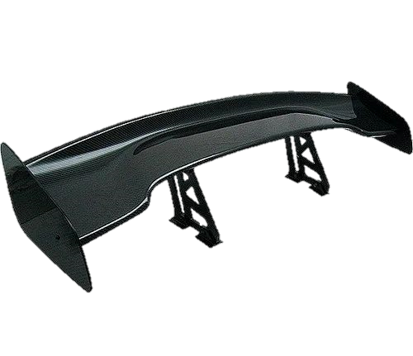
Study of Shape Memory Polymers for Automotive Application Sophia Maldonado, Victoria Melendez and Birce Dikici (Advisor) Mechanical engineering Department, Embry Riddle Aeronautical University
OBJECTIVE:
In the US, 77% of people who drive cars get into a car accident at least once in their lifetime. This translates to car repairs being very common amongst car owners. In this research, we explored the benefits of using shape memory polymers in the automotive industry. Particularly we explored the possibility of a “self-repairable” car part.
INTRODUCTION:
Shape-memory polymers are a type of polymer that can programed to remember a particular shape. this “programming” can be done by adding outside stimuli. This stimuli could be heat or light. There are several methods, however we focused on using temperature changes.
RESTORATION:
For a polymer to be considered a shape memory polymer (SMP) it must have to go through a process in order to program said polymer to remember a fixed shape to which it will morph under certain conditions. Shape deforming is the first step in this process and is done with external stress and heat. The heat increases the entropy of the polymer and therefore makes it easier to manipulate it to the desired fixed shape. Once the polymer is in said fixed shape the temperature will be decreased while the external stress is maintained. The polymer will be programmed to a fixed shape using heat and then low temperatures. The theory is that if the shape deforms in any way heat may be applied to revert the shape back to its original programmed form.
BENEFITS:
One of the reasons SMPs have gained attention from the automotive industry is because, in comparison to metals, they have low cost, biocompatibility, and easy manufacturing and programming. Currently, steel makes up a little over half of the total composite of the average car. Additionally, various types of SMPs can be “programmed” for different functions and increase productivity of aspects such as biodegradability. With the detail of being programmable SMPs are extremely attractive to car manufacturers who wish to further custom vehicle parts. With current science working towards changing this majority of metal parts to be made of SMP, car productions may in turn become faster, easier, and more cost-efficient.
FIGURE 5 : DEFORMATION
CONCLUSION:
Although information and studies on SMPs are limited, it shows promise for applications in different industries such as biomedical, aerospace, and automotive. For the automotive industry, SMPs will be used for parts with the purpose of easier and more efficient process of car repair after an accident. By moving towards SMPs rather than metal for car parts, car repairs may in turn become more efficient seeing as a part can be manipulated to morph back to a programmed shape rather than having to replace the part in its entirety. SMPs also make the car manufacturing process easier because of their low cost, light weight and easy programming.
FIGURE 1 : SHAPE MEMORY POLYMER
FIGURE 3 : SHAPE MEMORY CYCLE
MATERIAL STATE:
There are two types of polymers: amorphous and crystalline. Amorphous polymers do not have ordered and periodic structures, while crystalline structures do have ordered and periodic structures. However, shape memory polymers are neither. Shape memory polymers are semi crystalline.
USE OF POLYMERS IN THE AUTOMOTIVE INDUSTRY:
Side View Mirror
Roof Rails
References:
Xia, Y., He, Y., Zhang, F., Liu, Y., & Leng, J. (2020, September 23). A Review of Shape Memory Polymers and Composites: Mechanisms, Materials, and Applications. Wiley Online Library. Retrieved April 5, 2023, from https://onlinelibrary.wiley.com/doi/full/10.1002/adma.202000713
Qian , Z., Qi, H. J., & Tao , X. (2015, April 11). Recent progress in shape memory polymer: New behavior, enabling materials, and mechanistic understanding. Science Direct. Retrieved April 4, 2023, from https://www.sciencedirect.com/science/article/pii/S0079670015000477
Crystalline
Semi-Crystalline
Amorphous
FIGURE 2 : STRUCTURE
Spoilers
FIGURE 4 : CAR PARTS

