Slide 1
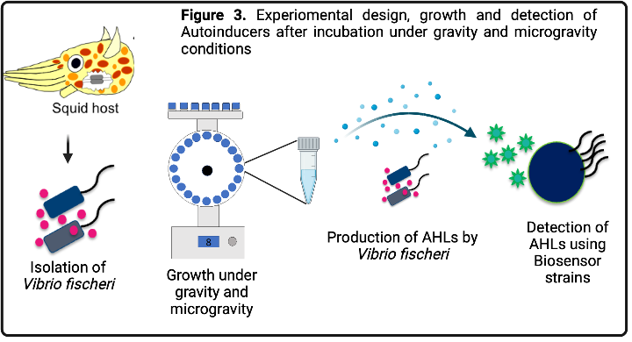
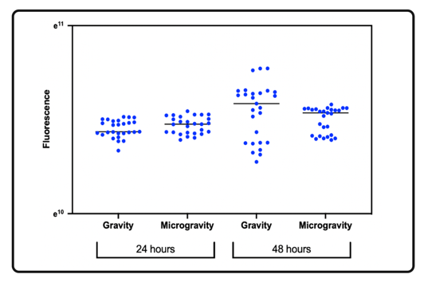
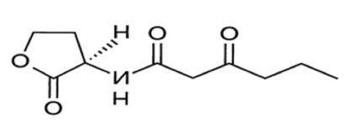
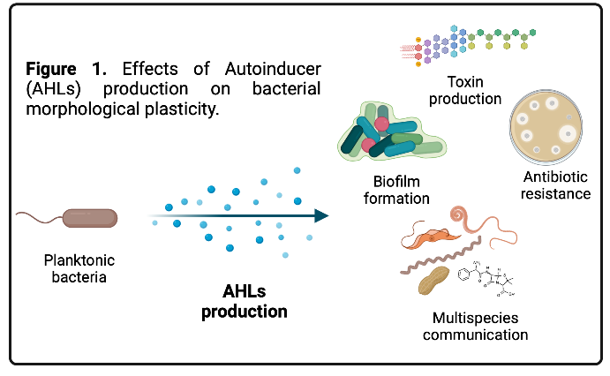
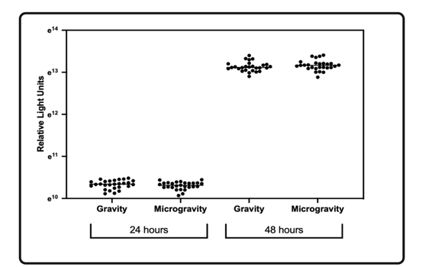
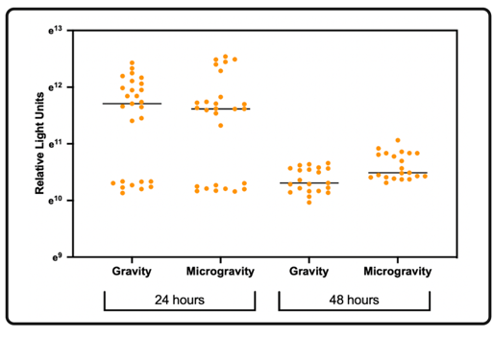
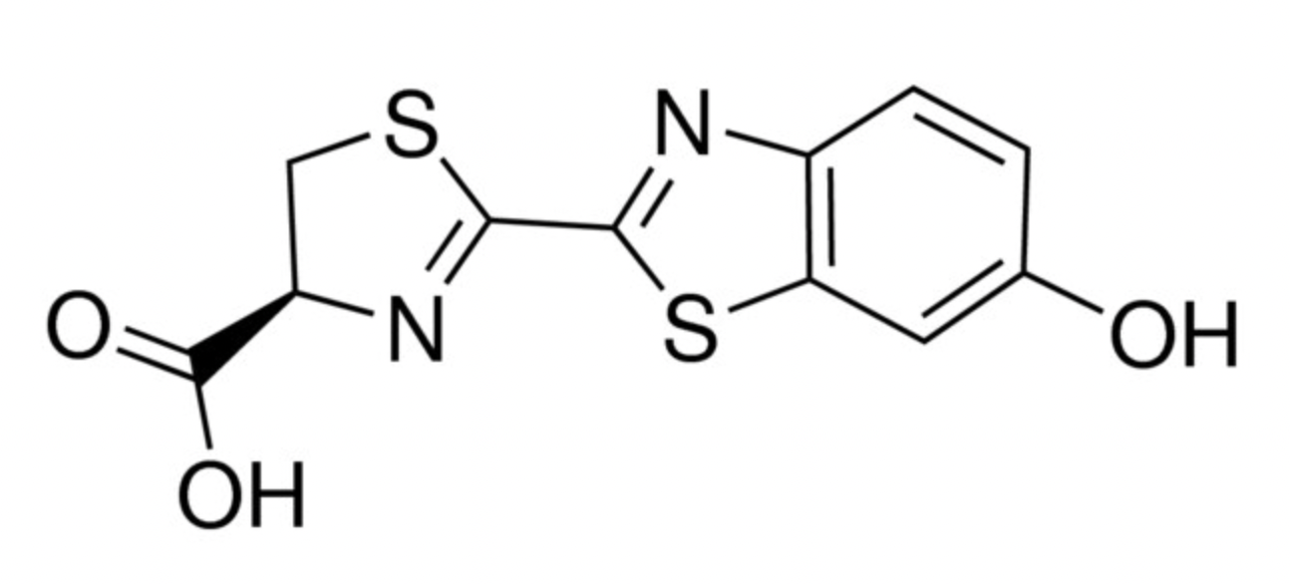
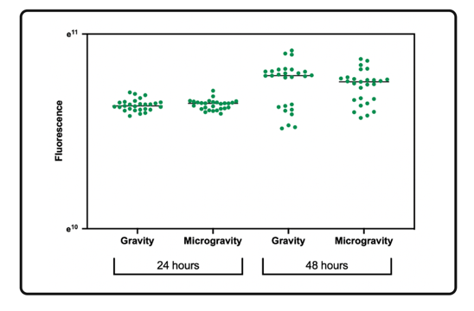
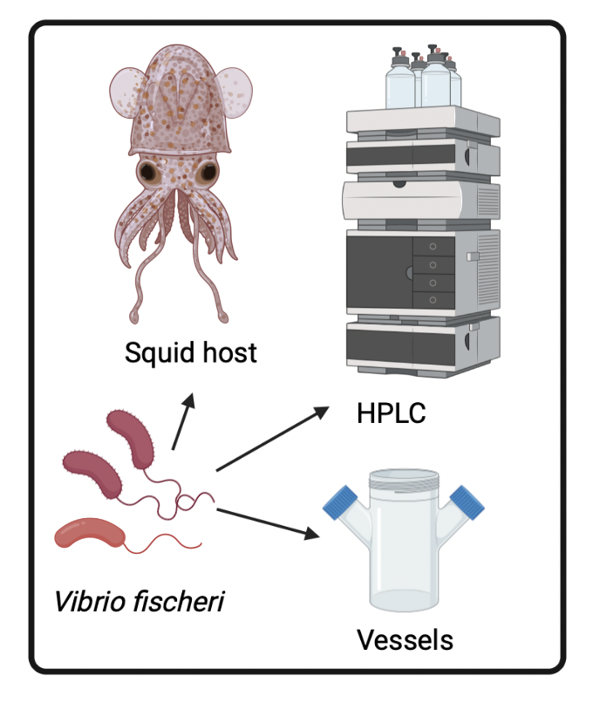
Assessing Bacterial Quorum Sensing Through Measuring Bioluminescence with Vibrio fischeri Exposed to Simulated Microgravity
Paulina Slick, Maria Tobarra, Alba Chavez, Hugo Castillo
Department of Human Factors and Behavioral Neurobiology, Embry-Riddle Aeronautical University, Daytona Beach FL 32114
Introduction
Figure 2. Experimental design, growth and detection of Autoinducers after incubation under gravity and microgravity conditions.
Interbacterial communication takes place through a process known as Quorum Sensing or cell-cell communication, accomplished through the activation of small signaling molecules known as Autoinducers (acyl-homoserine lactones or AHLs).
Quorum sensing controls many phenotypical aspects, including antibiotic resistance, biofilm formation and toxin production (Figure 1).
Stressors (e.g., microgravity) have been proven to alter cell-cell communication.
This study used Vibrio fischeri, a marine mutualistic bacterium, that infects Sepiloid squids and monocentrid fishes and has been studied for its capacity to synthesize long and short chain AHLs and alter bacterial behavior and host colonization.
Figure 5. Fluorescence measurements using Pseudomonas putida modified with gfp (Green Fluorescent Protein) operon promoter for detection of short chain (6 C) Autoinducer.
Results
Figure 3. Relative Light Units measurements using Vibrio harveii modified with lux (luciferin) operon promoter for detection of long chain (12 C) Autoinducer.
Figure 6. Relative Light Units measurements via luminescence for detection of Luciferin.
Methodology
Future Work
Hypothesis: Simulated microgravity will change AHLs production in Vibrio fischeri bacteria.
Host infection experiments.
Chemical detection of Autoinducers using High Performance Liquid Chromatography analysis.
Perform experiment using aerated vessels.
V. fischeri was grown under simulated microgravity and gravity conditions using the EagleStat, a 2D clinostat device (Figure 2).
The experiment consisted in incubating V. fischeri for 24 and 48 hours under gravity and microgravity.
Autoinducer production was detected by measuring Luminescence and Fluorescence after activation of Biosensors in order to find effects on simulated microgravity on gene expression.
References
Figure 4. Fluorescence measurements using Escherichia coli modified with gfp (Green Fluorescent Protein) operon promoter for detection of medium chain (8 C)Autoinducer.
Baudart, J., Blanchet, E., Girard, L., Intertaglia, L., Lami, R., Lebaron, P., Stein, D., Suzuki, M. (2017). Characterization of N-Acyl homoserine lactones in Vibrio tasmaniensis LGP32 by a biosensor-based UHPLC-HRMS/MS method. Sensors. 17(4):906.
Batailler, N., Blanchet, E., Escargueil, A., Ferandin, Y., Intertaglia, L., Prado, S., Lami, R., Oliveira da Silva, J., Stein, D. (2017). Quorum sensing and quorum quenching in the Mediterranean seagrass Posidonia oceanic microbiota. Front. Mar. Sci. 21(2):1110.
Greenberg, P., Lupp, C., Ruby, E and Urbanowski, M. (2003). The Vibrio fischeri quorum-sensing system ain and lux sequentially induce luminescence gene expression and are important for persistence in the squid host. Mol. Microbiol. 50(1):319-331.
Notes:
Name for group/project????
Introduction key points??
pH results – data and graphs?

