Slide 1
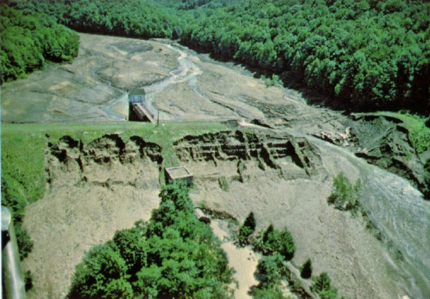
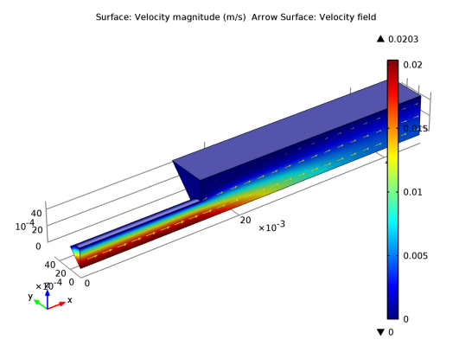
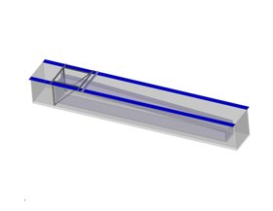
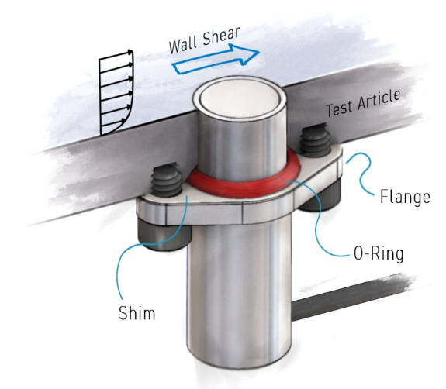
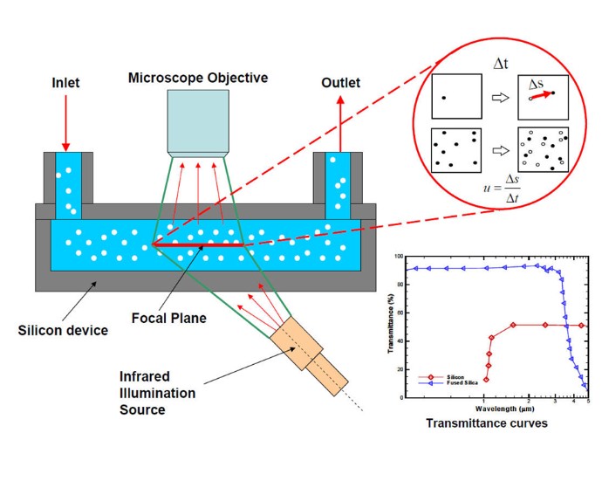
Flume Experiment to Evaluate Shear Stresses Under Variable Flowing Conditions
Student Researchers: Angie Castillo, Steven Insignares
Faculty Mentors: Dr. Ghada Ellithy (PI), Dr. Andrei Ludu
Introduction
Experiment Design
It is reported that approximately 34% of failures (breach) in water-retaining structures, like levees and dams, are caused by overtopping.
One important application of shear stress measurement is the evaluation of soil erosion and sediment transport in water bodies. Due to climate change, extreme rainfall events are occurring with more frequency and intensity, causing structures like dams and levees to overflow and fail.
The difficulty of this experiment comes from the different variables that affect the experiment outcomes. These variables include flow rate, surface roughness and slope, scour hole configuration which in turn affect the water turbulence, shear stress and velocity. It is impossible to physically test each scenario of interest, therefore, the approach is to test these variables via Computational Fluid Dynamics (CFD) simulations using COMSOL Multiphysics. CFD simulations will be calibrated to the experiment results, and then more scenarios could be modeled.
CFD Simulation
Flume
Figure No.1: Laurel Run Dam (PA, USA) after breach on 7/20/1977 showing scour marks (A.T. Rose, 2013 ASDSO Annual Conference).
COMSOL Multiphysics has the capability to simulate the experiment conditions under different modeling scenarios.
Laminar flow modeling fluids with constant density and viscosity.
Low-Reynold-number treatment resolves the flow of water going down a smooth surface.
Multi-surface flow separates the different speeds of the water is flowing on a surface and able to track particles.
With these simulations, many assumptions and failed experimentation can be minimized.
Embry-Riddle Aeronautical University’s Nonlinear Waves Laboratory houses a 4,000-gallon tank measuring 30 feet in length, 4 feet in width, and 2-inch-thick acrylic walls that stand 3 feet from the ground and are 4 feet high.
The flume is made of thick acrylic walls and 10 series steel. Measuring 2 feet wide, 25 ft in length and starting at a height of 36 inches after the first 6 inches with a 3-degree decline.
The tank is composed of 6 water pumps that will fill a sealed of area created by an acrylic wall. This will allow for the water to create up to a 4-inch gravitational flow.
Due to quickly changing conditions, it is difficult, almost impossible during an ongoing breach event, to measure in-situ variables including erosion rate, flow velocity and shear stress. The behavior of the boundary layer in gravitational flow on shallow water is rarely studied and often modeled using laminar flow on flat surfaces. Whereas, in the real world flat surfaces not found in nature.
The importance of this experiment is to simulate the grades of the slope of a natural water flow structure without the erodible conditions of a natural surface
Future Research
The next step for this research is to obtain trackable and sustainable analysis of water on smooth surfaces to then test the shear force of water against textured surfaces simulating coarse –grained soils, and curved surfaces simulating a progression in a scour hole.
The final goal for this experiment is to analyze the data collected from the flume test with a textured controlled surface and correlate to soil erosion data at similar conditions. Also, to calibrate CFD simulations to experimental data.
Figure No.2: Example of COMSOL simulation for a cube pipe (tank)
Figure No.3: Rendered drawing of the flume inside the water tank.
Acknowledgements
Wall Shear Sensors
MicroPIV
Ahmic Aerospace LLC, for their technical support and leasing of the wall shear sensors for this project
The Embry-Riddle Aeronautical University Office of Undergraduate Research and the Civil Eng. Department for providing grant funding
Mr. Bill Russo for his machining expertise and design of the flume
On the 20 ft marker, the flume will have a working envelope where a plate with 4 wall shear sensors from Ahmic Aerospace LLC will be installed.
These sensors can measure shear from 25-500 Pa with a resolution of <1 Pa
Data collected from these sensors will help to establish ranges for shear stress and correlated flow velocity at specified flow rates
A MicroPIV system consisting of microscopic fluorescent seed particles and a laser will be used to measure the flow velocity.
The data from the MicroPIV will be captured by an AOS high-speed camera shooting at 2,000 frames per second. Within the flow, fluorescent microbeads from Cospheric with a density equal to that of water will be used to track and model the multiphase-flow of the water into particle data sets.
What Is COMSOL Multiphysics? (n.d.). COMSOL Multiphysics. https://www.comsol.com/blogs/what-is-comsol-multiphysics/
‌
References
Figure (AHMIC NUMBER) and “Wall Shear Sensors” section specifications courtesy of Ahmic Aerospace, www.ahmicaerospace.com/sensors
What Is COMSOL Multiphysics? (n.d.). COMSOL Multiphysics. https://www.comsol.com/blogs/what-is-comsol-multiphysics/
Department of Mechanical Engineering - University of Houston. (n.d.). Www2.Egr.uh.edu. Retrieved February 9, 2023, from http://www2.egr.uh.edu/~dli9/research.htm
Solved with COMSOL Multiphysics 4.3 © 2 0 1 2 C O M S O L. (n.d.). Retrieved February 9, 2023, from https://www.egr.msu.edu/classes/ce321/lishug/HW/models.cfd.backstep.pdf
‌
‌
‌
Figure No.4: AHMIC "Wall Shear Sensors"
Figure No. 5: This illustration shows how the MicroPIV works

