Slide 1
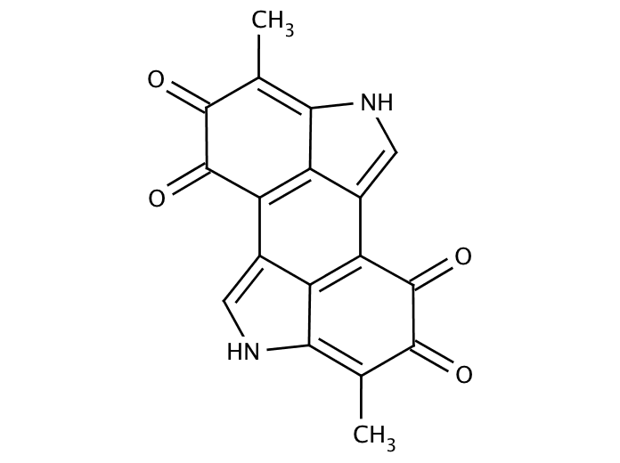
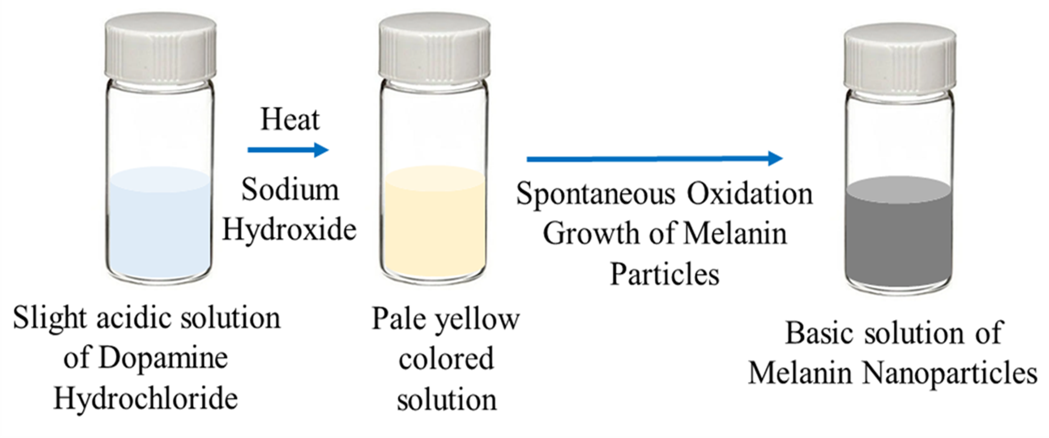
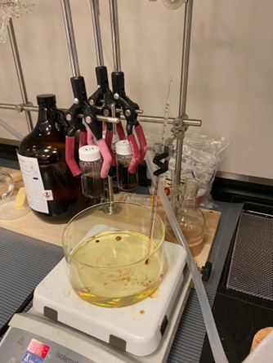
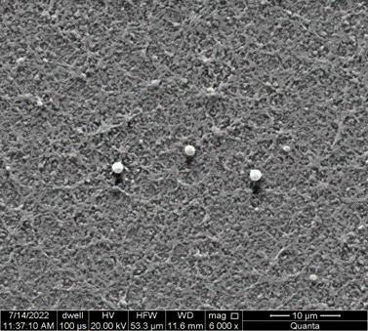
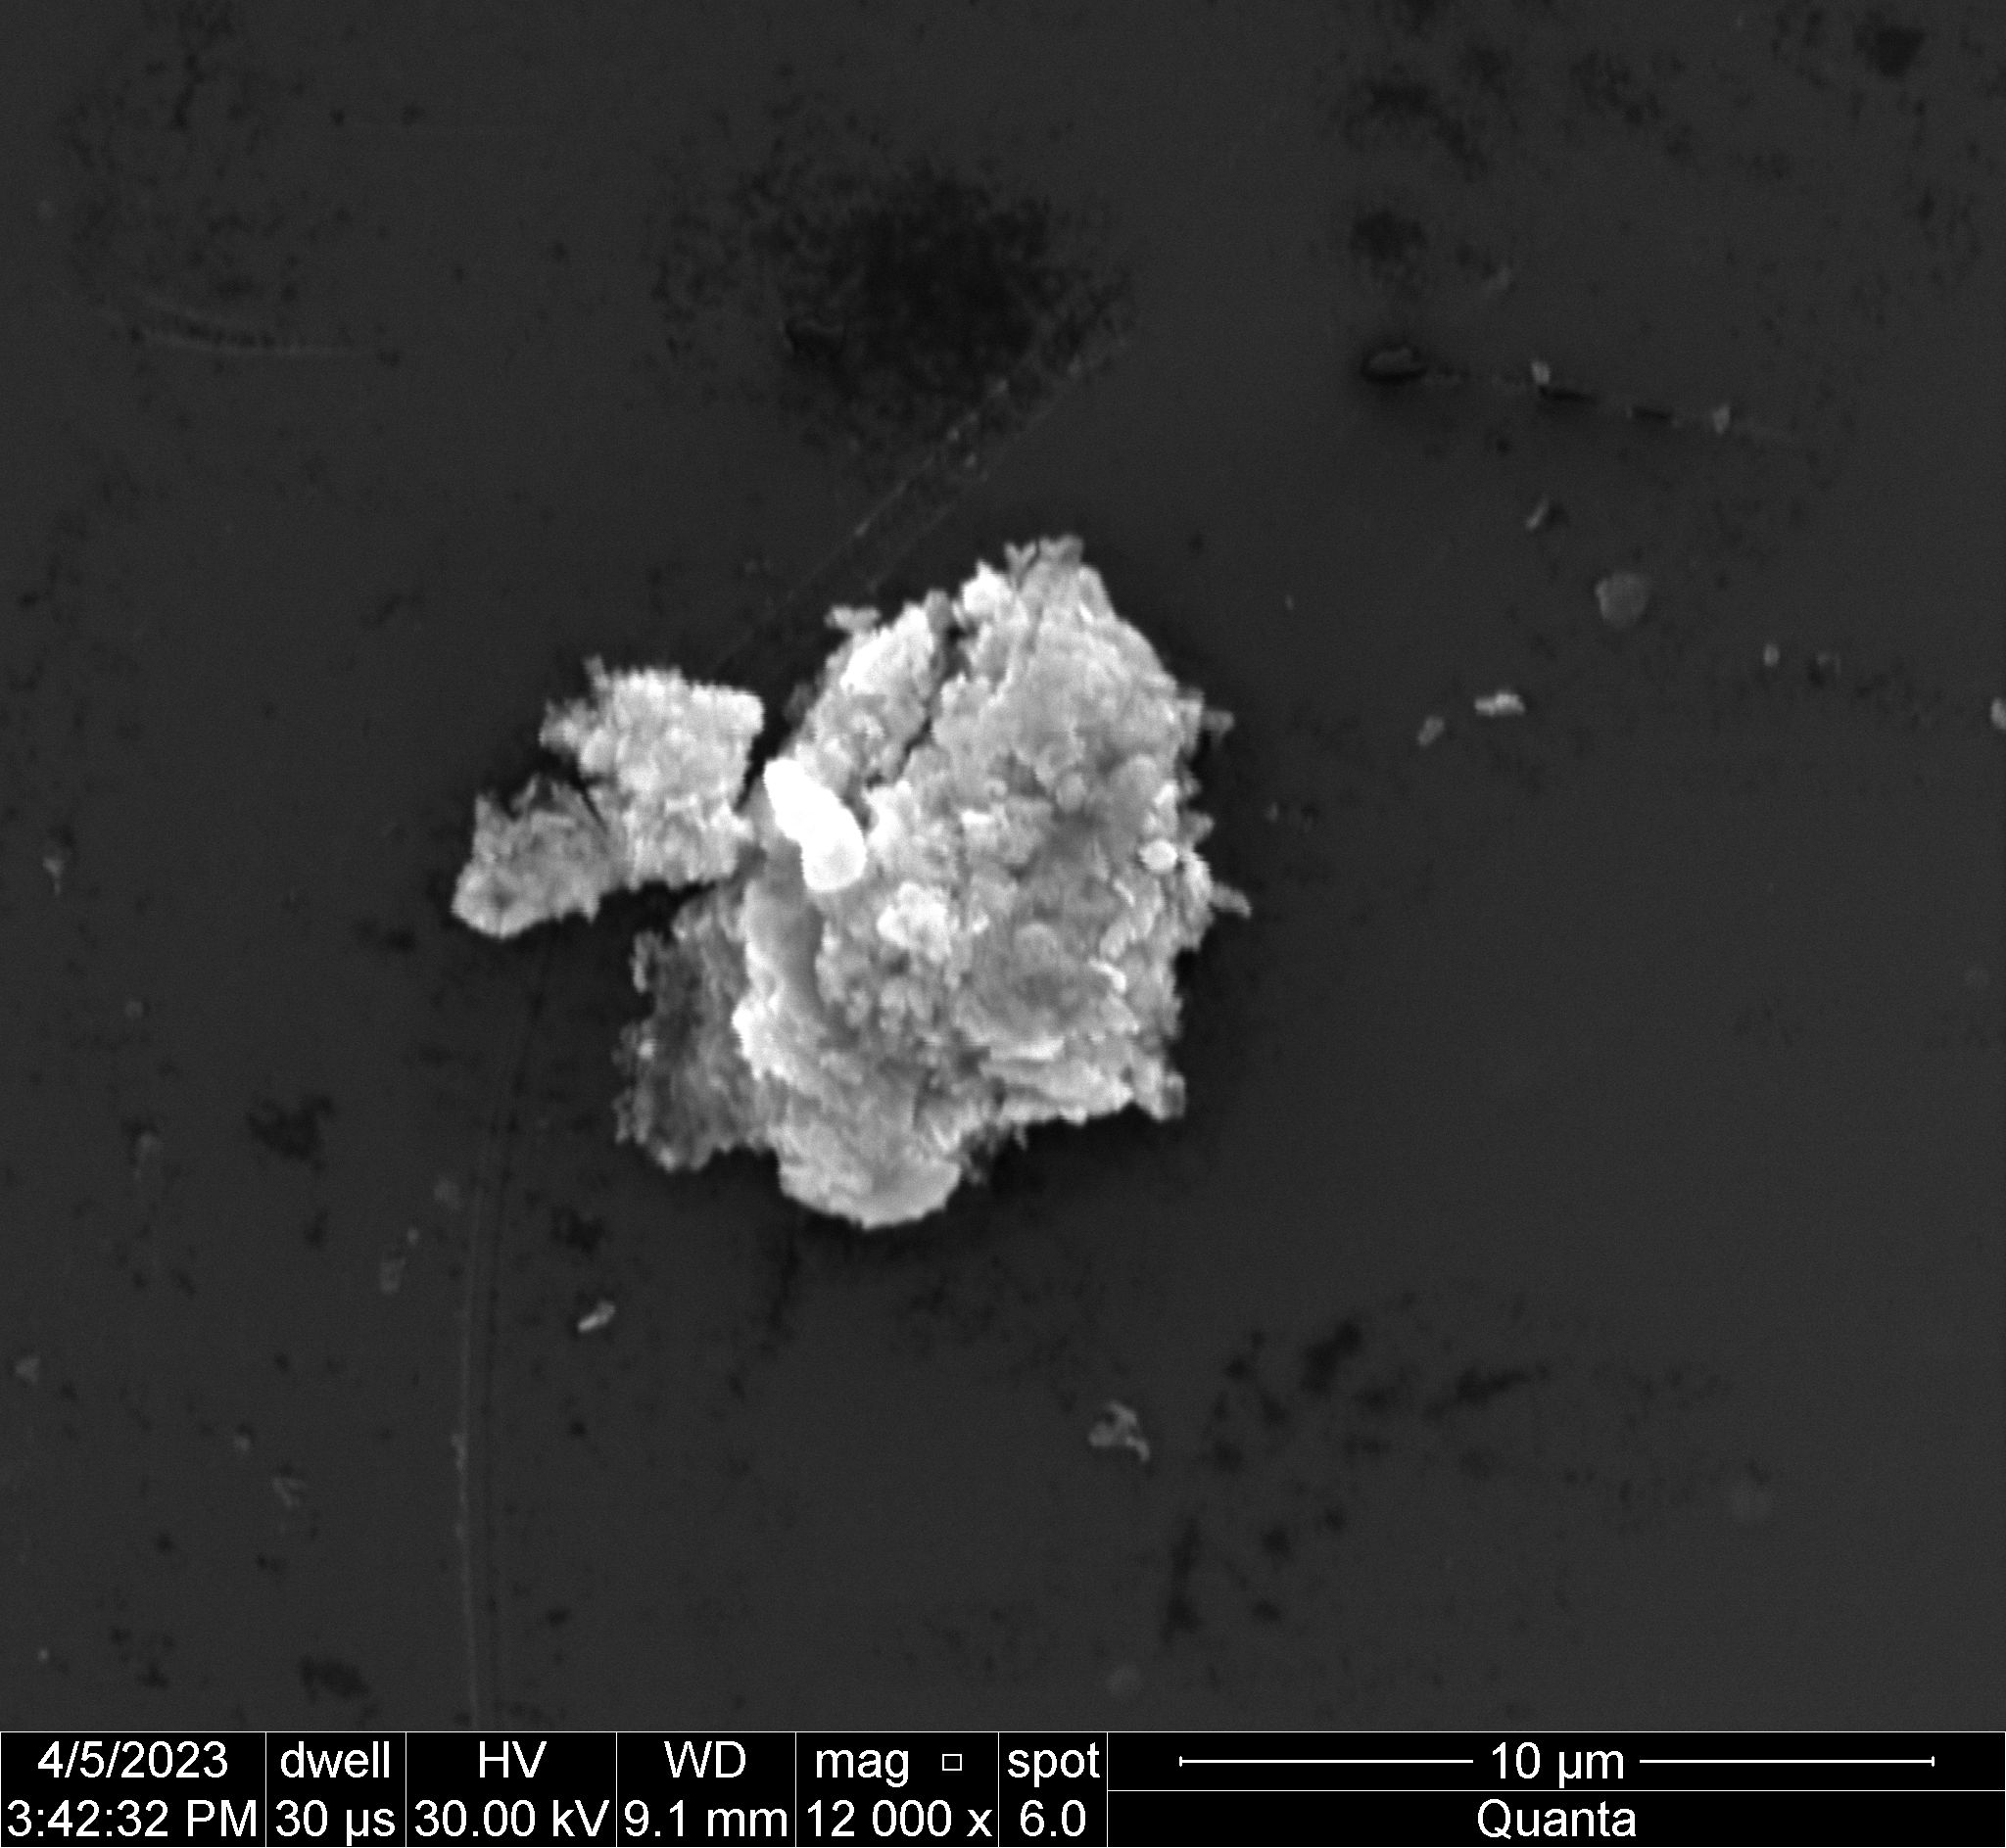
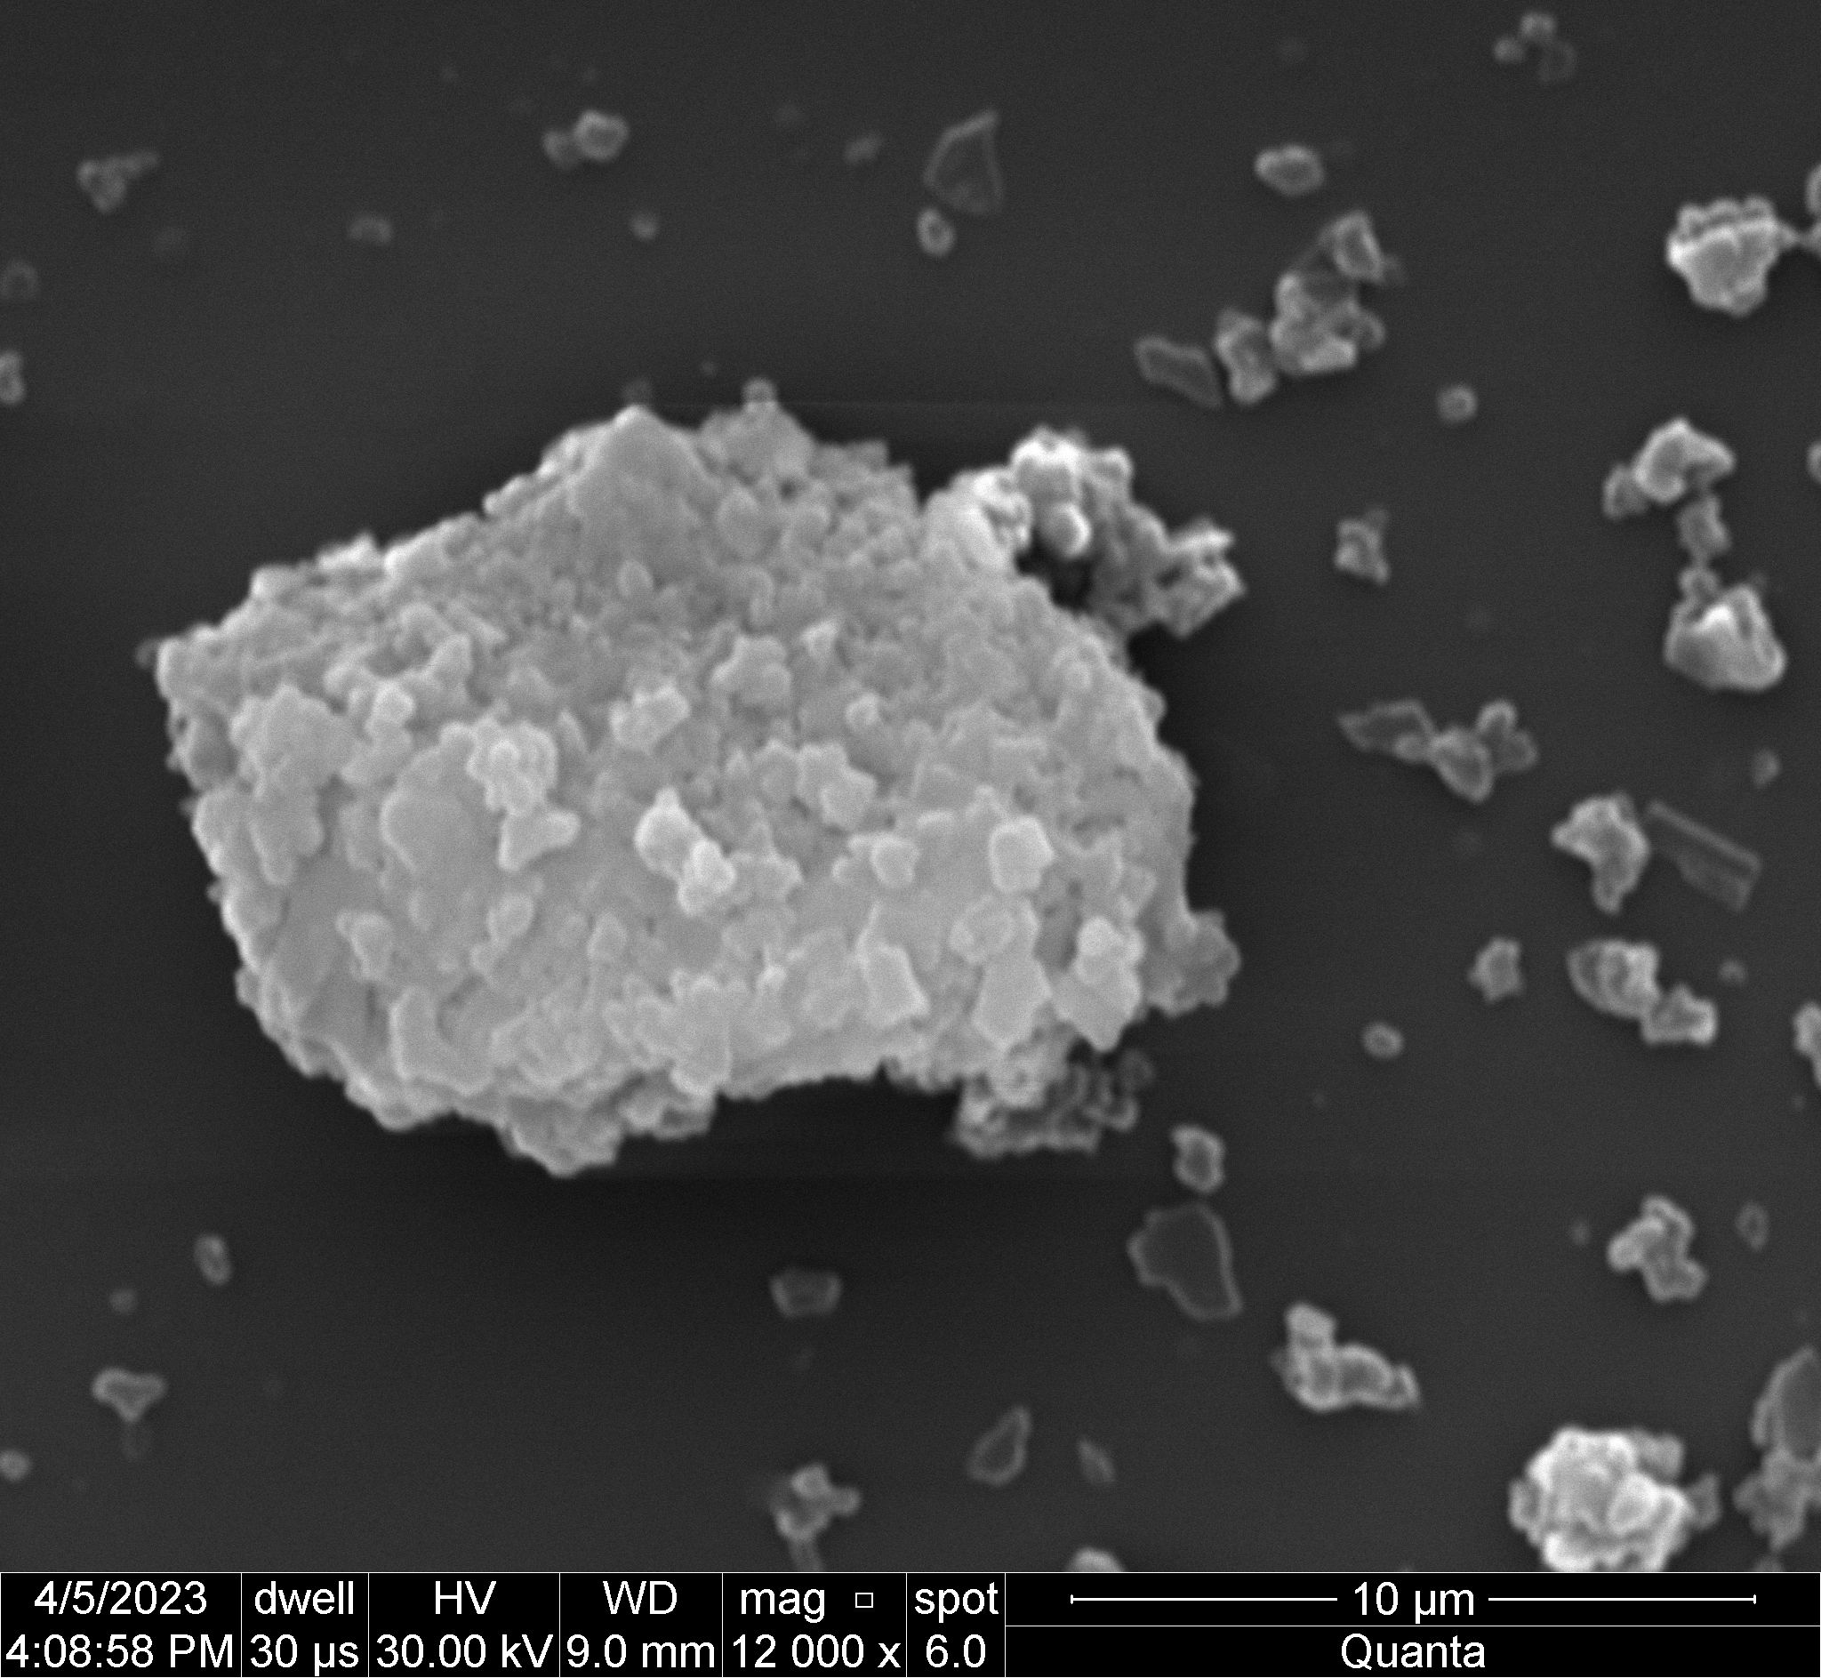
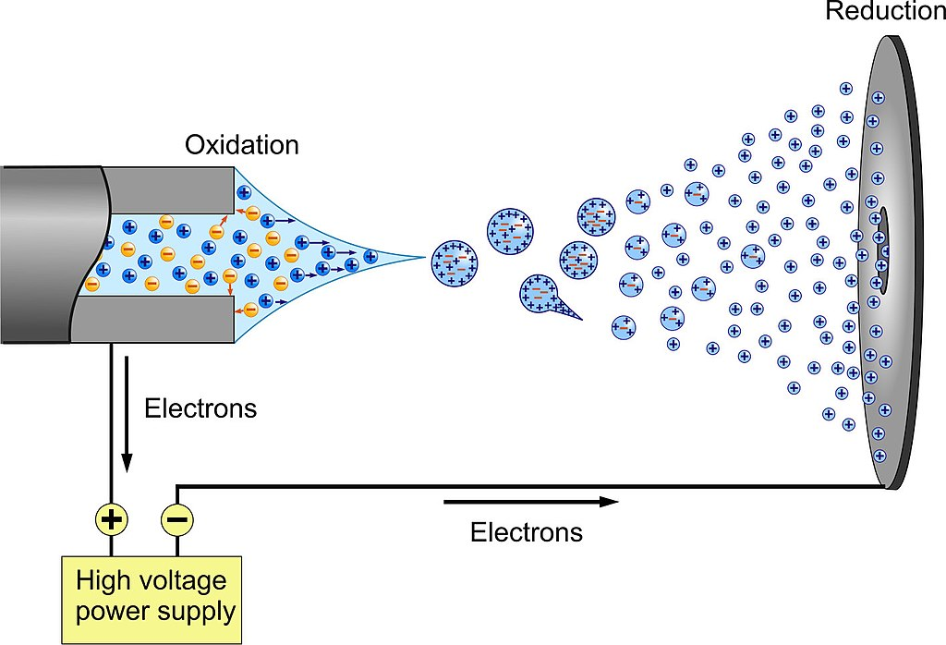
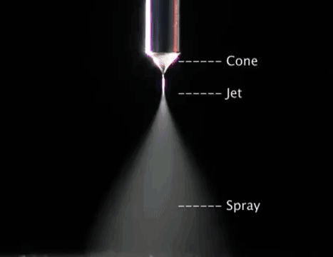
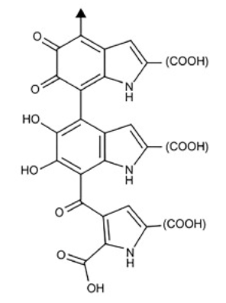
Melanin Nanoparticles for Radiation Countermeasures, presented at the 2023 NASA HRP IWS Conference
Giulia Stewart*, Aria Jafari*, Sahil Ghate, Dominic Sandell*, and Foram Madiyar
*Department of Aerospace Physiology and Neurobiology, Department of Physical Science, Embry Riddle Aeronautical University, Daytona Beach, FL
I. Introduction
III. Materials and Methods
IV. Results
Melanin, an organic dark pigment naturally produced in the skin tissues of most mammals, is known to shield cells from radiation effects by absorbing ultraviolet rays. This project’s objective is to fabricate a novel bio-inspired radiation-blocking material using melanin nanoparticles (MNPs)
Fig 6: SEM image of thin film of electrosprayed and gold-coated 10% PVA + 3% MNP solution (top)
Fig 7: SEM image of thin film of gold-coated 1% PVA + 1% MNP solution
Fig 8: SEM image of thin film of gold-coated 1% PVA + 1% purchased melanin powder
Fig 3: Representation of MNP solution
synthesis (left)
Fig 4: Image of the experimental setup for
the synthesis of MNP solutions in the laboratory fume hood (right)
Hypothesis: MNPs can absorb an x percentage of UV rays
Synthesis of 1:2 eumelanin MNPs
Conjugation of MNPs and polyvinyl alcohol (PVA)
Electrospray of thin films of PVA-MNPs
Fig 5: Image of an ideal and homogeneous spray using the electrospray technique
4. Radiation blocking tests on thin films
Fig 1: Structure of melanin, one of the most common naturally-occurring forms of melanin
II. NASA HRP IWS Conference
Group:
Radiation Countermeasures
Fig 9: EDX comparison of purchased synthetic melanin powder (red) vs experimental MNPs (orange)
Held at the Galveston Island Convention Center (TX), the NASA Human Research Program’s Investigators Workshop gave us the opportunity to communicate our findings and gather feedback from fellow scientists working on mitigating the effects of the spaceflight environment on astronauts.
IV. Future Applications
Layer of radiation-blocking material for spacesuits, space helmets, space habitats
Characterization Methods of MNPs:
- FTIR analysis
- TEM for diameter and distribution of the particles
- SEM images with Energy Dispersive X-­Ray
UV radiation blocking tests
EDX for materials composition and quality assurance
V. References
Eumelanin radiation absorption properties
C-O acts as a chromophore
Dissociation of C-O bonds
Delocalization of electrons
(1) Tran-Ly, A. N.; Reyes, C.; Schwarze, F. W. M. R.; Ribera, J. Microbial Production of Melanin and Its Various Applications. World J. Microbiol. Biotechnol. 2020, 36 (11), 170. https://doi.org/10.1007/s11274-020-02941-z.
(2) Michalak, M.; Pierzak, M.; Kręcisz, B.; Suliga, E. Bioactive Compounds for Skin Health: A Review. Nutrients 2021, 13 (1), 203. https://doi.org/10.3390/nu13010203.
Aknowledgement: We thank the Office of Undergraduate Research at ERAU for their funding and support
Fig 2: Structure of eumelanin

