Slide 1

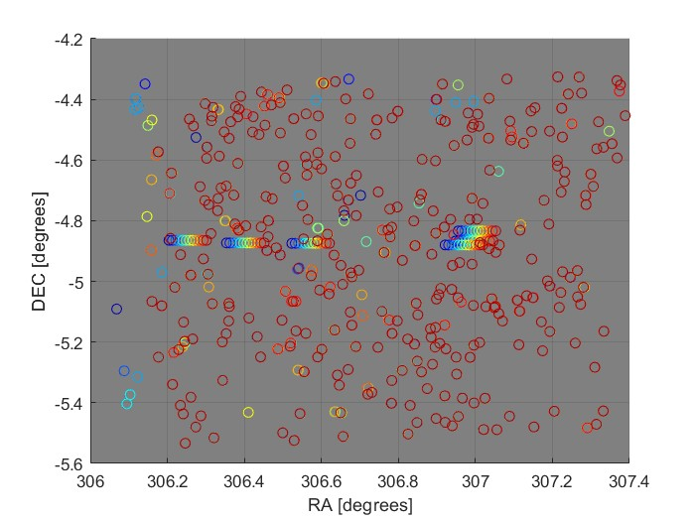
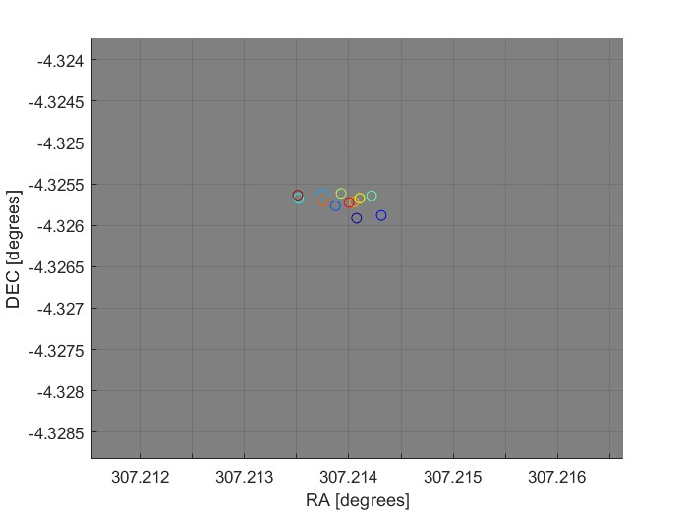
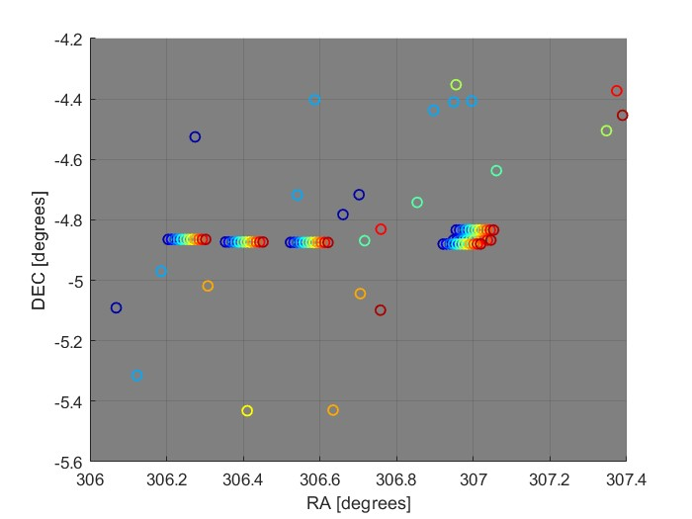
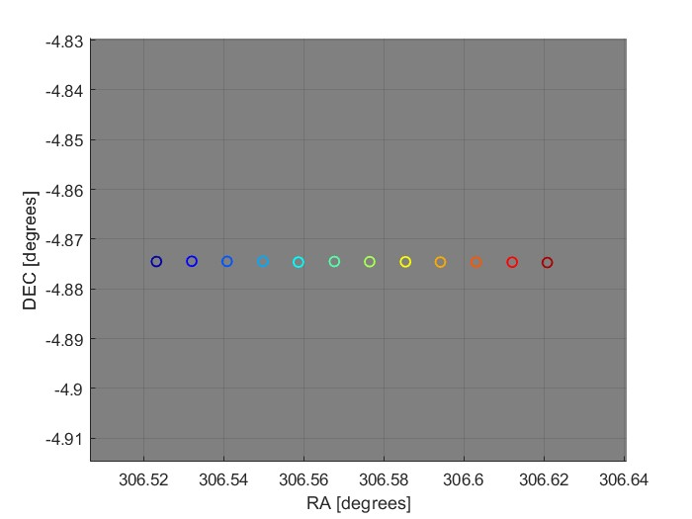
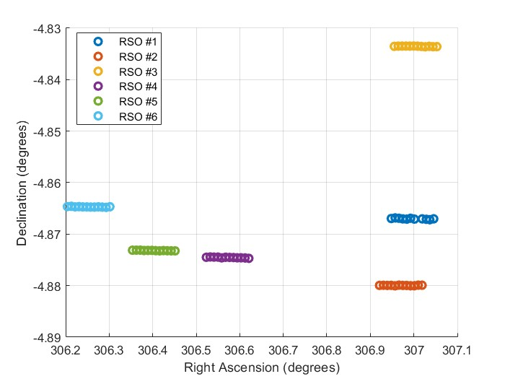
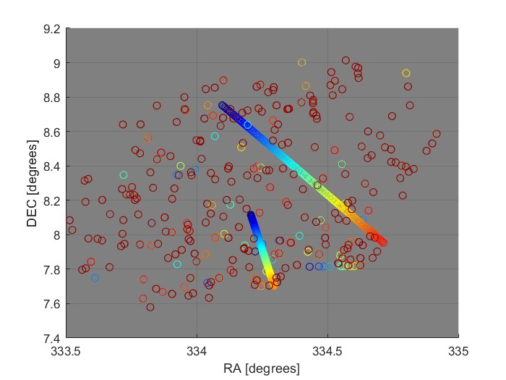
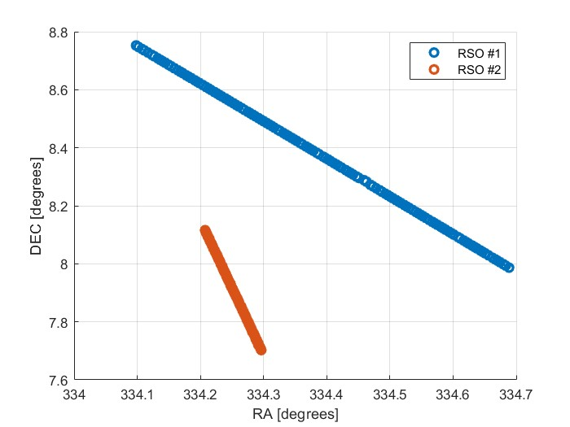
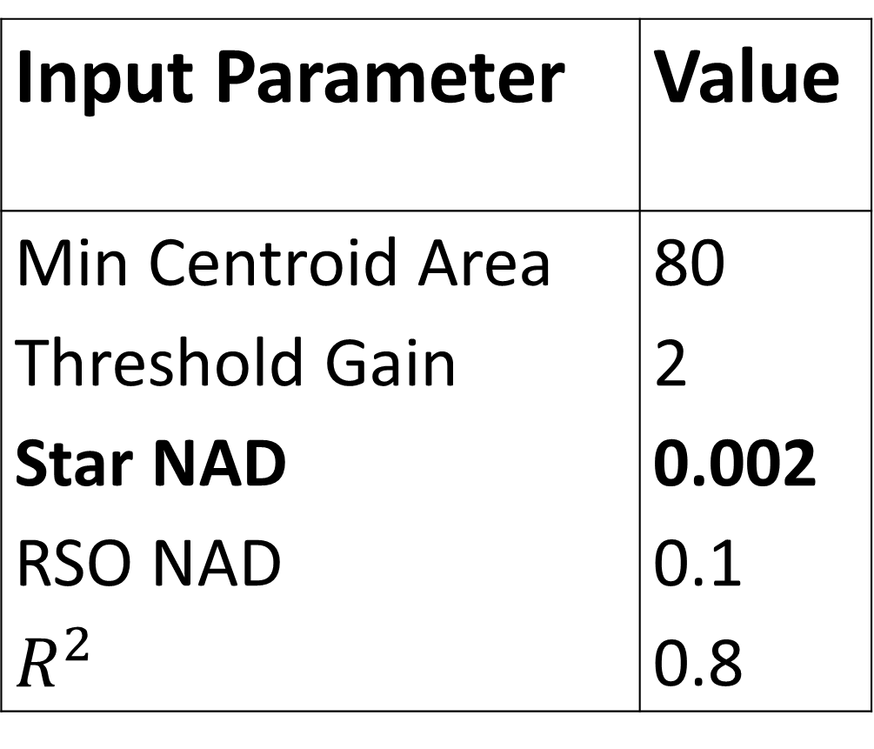
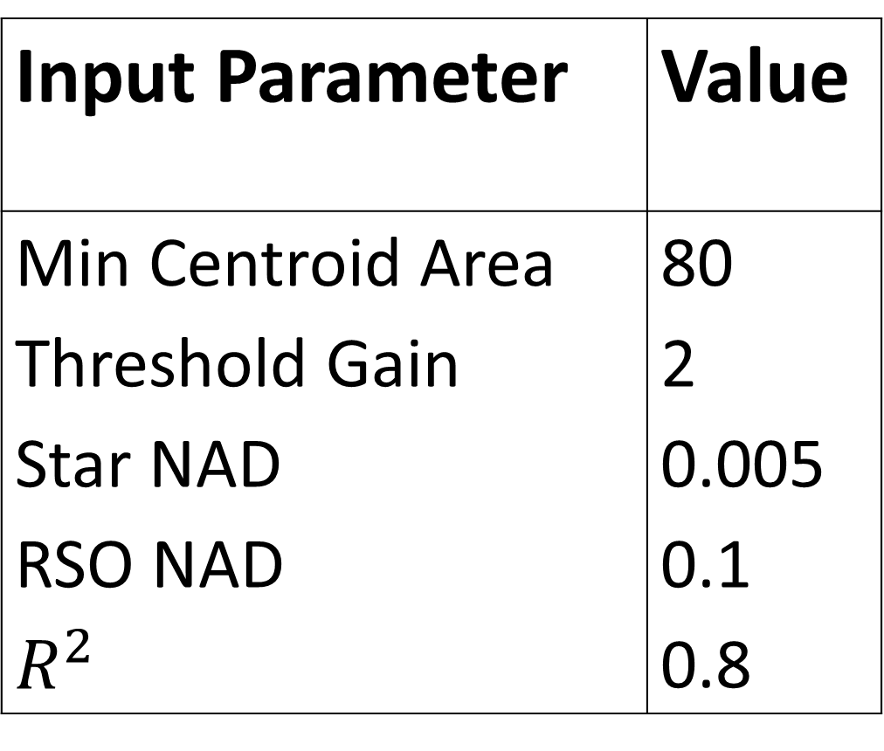
Resident Space Object Identification in Arbitrary Unresolved Space Images
Joseph Anderson, Annika Anderson, David Canales, David Zuehlke, Thomas A. Lovell
Abstract
Algorithm
Conclusions
Identifying resident space objects (RSOs) in arbitrary space imagery with little a-priori information is a challenging, yet crucial next step in space-domain awareness applications. This work proposes improvements to an existing RSO identification process for unresolved space images. The algorithm has three main phases: image processing, star elimination, and RSO association. Star elimination and RSO association use nearest neighbor association and thresholds on inertial frame-to-frame motion of observations to associate objects. Given a set of unresolved space images contiguous in time, the product of the algorithm presented is a set of measurements for orbit estimation.
Successes
Single RSO identification is successful
Multiple RSO identification was successful under certain conditions
Removing as many stars as possible allows for more accurate identification
Being able to identify if an RSO will appear in the next frame lowers the possibility of cross-tagging
Future Work
Find mathematical relationships between the threshold values and RSO ID success rates to remove the amount of tweaking.
Optimize the registration process by finding an alternative to Astrometry.
Investigate Machine Learning applications to handle thresholding.
1. Centroid FITS Images
2. Plate-solve Images
3. Detect Stars
Background
4. Eliminate Stars
5. Check Linearity of RSO Trails
Identify RSO Trails
Satellite operation environments are cluttered
with resident space objects (RSO’s), making
collision avoidance and identification of hostile
satellites imperative. With the increase in the number of objects in space, it is necessary to have a tool that will identify and associate satellites, then determine their orbit. To test this, ground based astro-images are used as test data. In general, astronomers use the following three imaging techniques to capture RSO’s:
Results
Input Parameter | Value
Min Centroid Area | 80
Threshold Gain | 2
Star NAD | 0.005
RSO NAD | 0.1
$$R^{2}$$ | 0.8
References
Inertial Stare
Aims at one place in the sky
RSO’s will move across the frame
Stars will not blur
GEO Stare
Aims at objects in the GEO belt
RSO’s are stationary in the frame
Stars blur in the background
Orbit Following
Tracks the orbit of an RSO
Has same characteristics as GEO stare
J. Anderson, A. Anderson, D. Zuehlke, T. Lovell, and D. Canales, “RESIDENT SPACE OBJECT IDENTIFICATION IN ARBITRARY UNRESOLVED SPACE IMAGES ,” 2022, submitted to 33rd AAS/AIAA conference
Input Parameter | Value
Min Centroid Area | 80
Threshold Gain | 2
Star NAD | 0.002
RSO NAD | 0.1
$$R^{2}$$ | 0.8
Acknowledgements
We would like to thank the Office of Undergraduate Research for providing the space, equipment, time, and knowledge to give us the opportunity to learn and grow. We also thank Dr. Canales Garcia for mentoring us to give us a better understanding and appreciation for the material.

