Slide 1

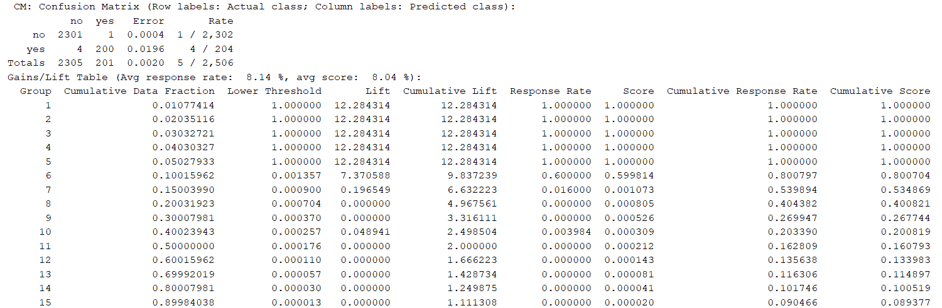
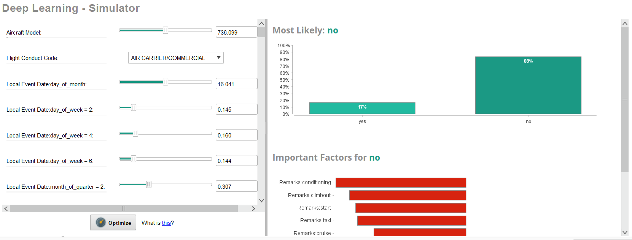
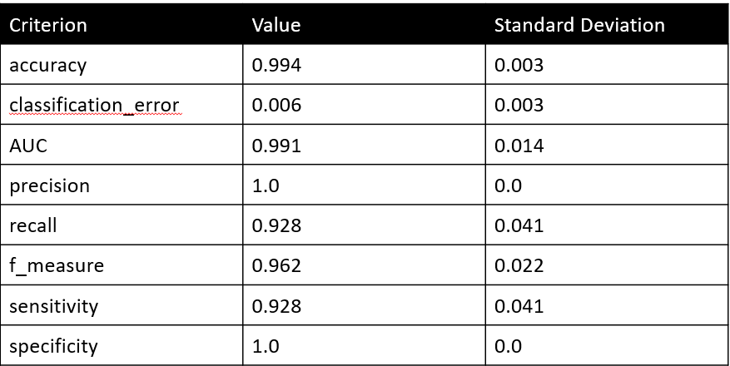
Understanding the Incidents on Legacy Airlines with Machine Learning: Case Study Top 5 US Airlines
Dean Sutherland
Dr. Burak Cankaya, ERAU
Contact: bcankaya@erau.edu for questions
  References: Anbil R., Tanga R., Johnson E.L.A global approach to crew-pairing optimization, IBM Syst. J., 31 (1) (1992), pp. 71-78, Elsayed S.M., Sarker R.A., Essam D.L.A new genetic algorithm for solving optimization problems, Eng. Appl. Artif. Intell., 27 (2014), pp. 57-69, Bazargan M.Airline Operations and Scheduling, (second ed.), Ashgate Publishing Ltd. (2004-2010)

Slide 2


Discovery Day 2023
Interpreting Understanding the Incidents on Legacy Airlines with Machine Learning: Case Study Top 5 US Airlines
Dean Sutherland
Dr. Burak Cankaya, ERAU

Slide 3
Background
The air transportation system is part of most nations critical infrastructure
Rigorous safety standards are effective; however minor accidents/incidents are somewhat frequent in comparison to major accidents even with standards in place
There are known patterns pilots see anecdotally; but the data must be analyzed
Incident have a substantial cost to the airlines, raise ticket prices, erode consumer confidence, and generate insurance claims
Modeling minor accidents to identify causal and contributing data stands to save the industry substantial costs and increase margins

Slide 4
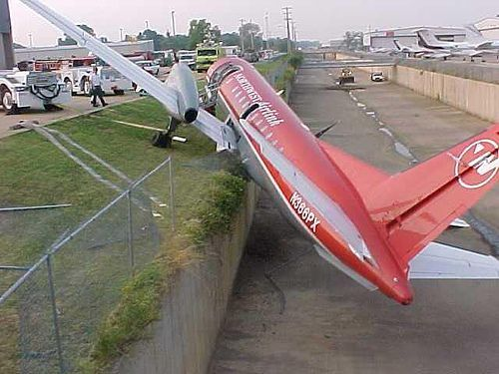
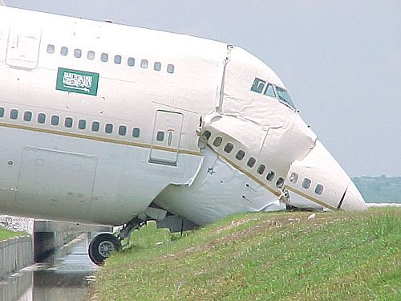
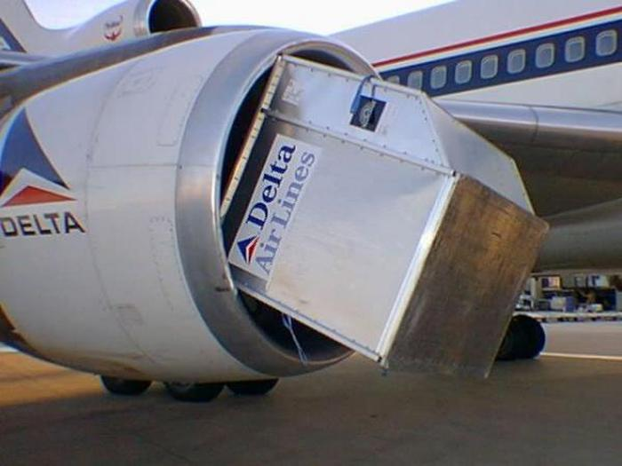
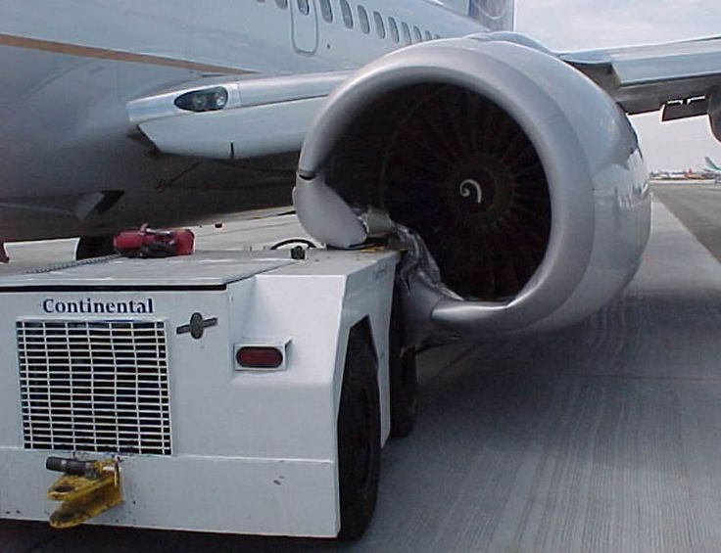

Slide 5
Literature
Main Relevant Research Problems
qualitative/quantitative approaches to detect anomalous aircraft behavior (Hwang et al, 2008)
assess the safety, and quantify the risk associated
causal models, collision risk models, human error models, and third-party risk models (Netjasov and Janic, 2008 )
automatically detect flight trajectory anomalies (Di Ciccio et al, 2016)
A hybrid model blending SVM and DNN ensemble prediction for aviation incidents (Zhang et al. 2019)
Gap: Predicting Incident Damage Type and Impacting Variables is not addressed

Slide 6

Methodology
Logistic Regression
Deep Learning
Support Vector Machines

Slide 7
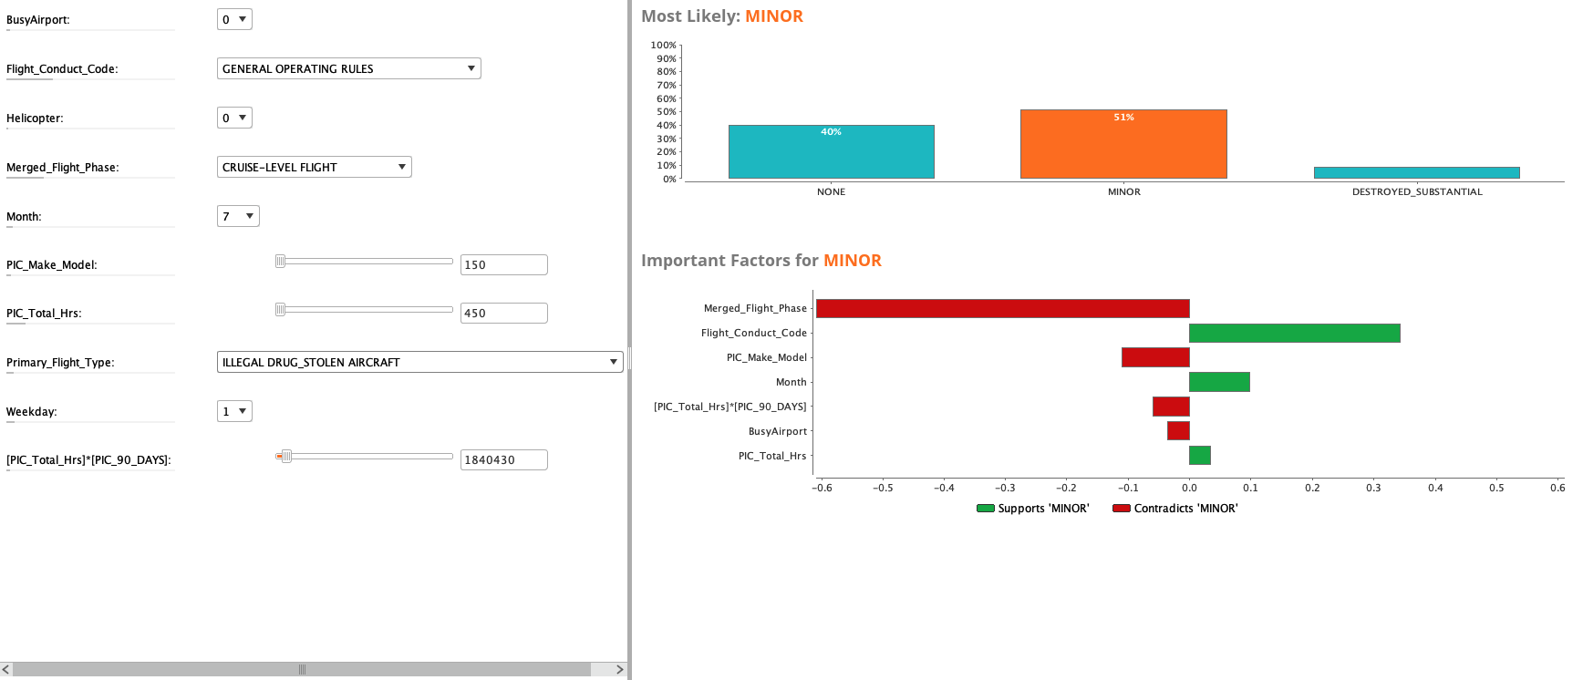
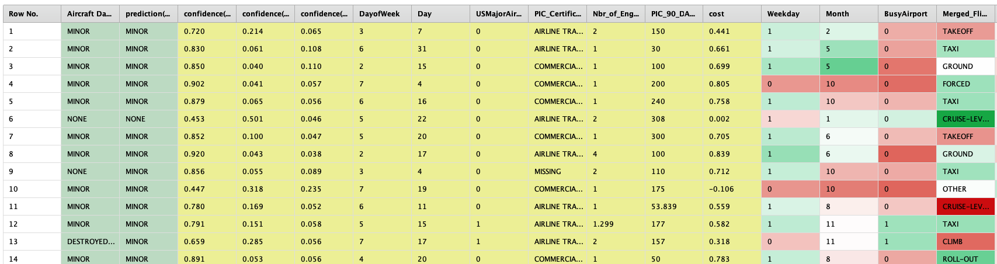
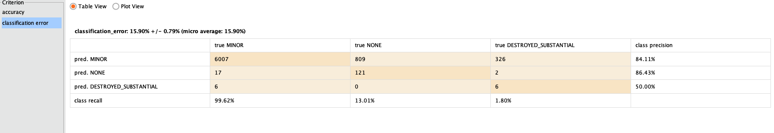
Deployment
Data Understanding
FAA
Created Data
Collection
Cleaning
Filtering
Missing Treatment
Transform
Variable Selection
Split
Data Preparation
Aviation Business Understanding
Evaluation
Modeling
10-fold stratified cross validation
SVM
Logistics Regression
Deep Learning

Slide 8
Results
 |  | Method Accuracy
 | Deep Learning | Logistic Regression | SVM
Accuracy | 99.4 | 97.1 | 100
Class Recall | 92.7 | 64.4 | 100
AUC | 0.99 | 0.87 | 1

Slide 9
Results

Slide 10
Results
Criterion | Value | Standard Deviation
accuracy | 0.994 | 0.003
classification_error | 0.006 | 0.003
AUC | 0.991 | 0.014
precision | 1.0 | 0.0
recall | 0.928 | 0.041
f_measure | 0.962 | 0.022
sensitivity | 0.928 | 0.041
specificity | 1.0 | 0.0

Slide 11
Results
Table 1: Text Mining Important Terms
Term Cutoff | Topic | Topic ID
0.051 | +flight attendant, +attendant, flight, +injure, turbulence | 1
0.053 | +engine, fire, evacuation, takeoff, NR2 | 2
0.056 | aircraft, +crew, landing, +report, emergency | 3
0.05 | +seat, +belt, +seat belt, +sign, +sign | 4
0.049 | clear, air turbulence, air, turbulence, +encounter | 5
0.053 | +fall, overhead, bin, +passenger, +open | 6
0.055 | cart, +door, +service, service cart, galley | 7
0.051 | people, +injure, turbulence, fire, +encounter | 8

Slide 12
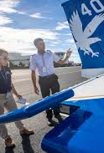
Results
It is possible to predict the severity of the incidents by knowing the pilot-aircraft-flight conditions
Companies evaluate their pilot-aircraft-flight for better safety standards
Most Impactful Variables and relations between variables
Train crew to be aware of hot spots in the data where incidents are likely
  Text Mining Variables

Slide 13
Conclusions
Minor damages category can be significantly predicted
Weights by correlations define the essential variables in prediction for minor damages.
The relations between variable is meaningful for SME

Slide 14
Future Work / Implications
Airlines spend a substantial amount of money on repairs, claims, and AOG downtime. These costs can be saved with crew training and interventions in hot spot areas.
Compare model with the Industry and Academic Literature
Text mine contributing and causal factors to focus crew training in areas of likely minor damage (e.g., low light/poor weather taxi)
Develop a front-end risk calculator to check the risks for flights based on known hot spots in the data

Slide 15
References
C. Di Ciccio, H. Van der Aa, C. Cabanillas, J. Mendling, J. Prescher,Detecting flight trajectory anomalies and predicting diversions in freight transportation, Decision Support Systems, 88 (2016), pp. 1-17
F. Netjasov, M. Janic, A review of research on risk and safety modelling in civil aviation, Journal of Air Transport Management, 14 (4) (2008), pp. 213-220
I. Hwang, C.E. SeahIntent-based probabilistic conflict detection for the next generation air transportation system, Proceedings of the IEEE, 96 (12) (2008), pp. 2040-2059
Xhang X., Mahadevan S., (2019), Ensemble machine learning models for aviation incident risk prediction, Decision Support Systems, 116 p48-63

Slide 16
Thanks
Dr. Burak Cankaya - bcankaya@erau.edu
Dean Sutherland – Sutherd3@my.erau.edu

