Slide 1
Designing a Circularly Polarized Antenna for EagleSat
Dadija Bliudzius
Aerospace Engineer
NASA Space Grant

Slide 2
Overview
Linear versus Circularly Polarized Antenna
  Circularly Polarized Antenna
Antenna Requirements
Theory
Wire Length Calculations
Equipment
Program
Testing
Goals
Summary & Conclusion

Slide 3
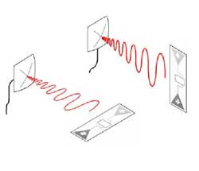
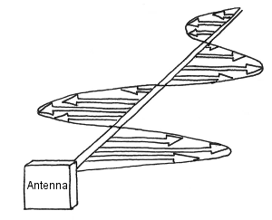
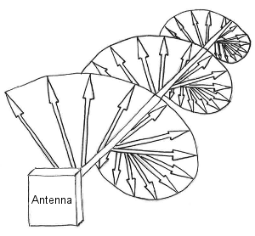
Linear versus Circular Antennas
Linear Antenna
  Can only communicate with other antennas
    who's waves oscillate in the same plane
Circularly Polarized Antenna
  Able to communicate with all antennas
  No power loss due to polarization mismatch

Slide 4
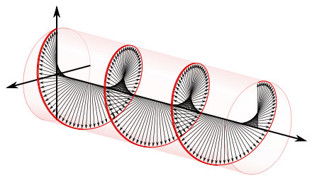
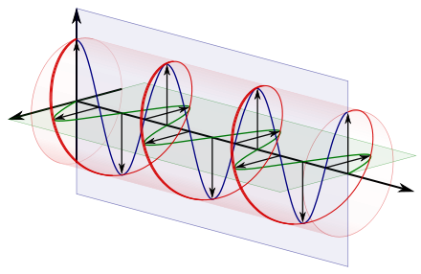
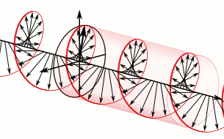
Circularly Polarized Antenna
Electromagnetic wave does not change strength, but rotates around a central axis
Divided into two components; at right angles to each other
  The vertical components in blue
  The horizontal components in green.
  The horizontal component leads the vertical component by one quarter of a wavelength

Slide 5

Theory
Phase shifting
  Achieves circular polarization
  Wire lengths
  Power splitters
Antenna Length
  $λ=\frac{c}{f}$
  c = speed of light
  $f$ = frequency (436MHz )
  $λ$ = 0.687597 m
  Quarter dipole

Slide 6
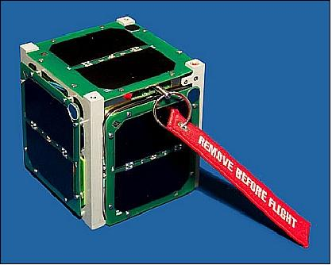
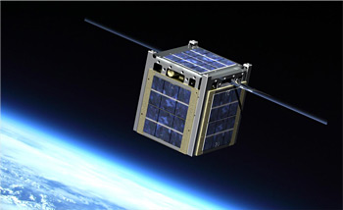
Antenna Requirements
Transmit and Receive on 436MHz
Fit within 10 x 10 x .16 cm
Weigh < 70g
Impedance of 50Ω
Connect to a communication board
Deploy antennas to a fixed position

Slide 7
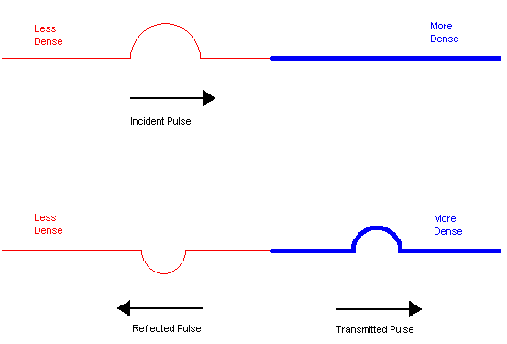
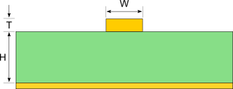
Theory (cont.)
Impedance Matching
  Mismatch causes reflection (not all power reaches antenna)
Microstrip design
  Calculator to design for 50Ω impedance
  Transmission line on top and ground
  plane on bottom for directional signal
Precise wire length
  Phase shifting
  Designed for 50Ω impedance
  Permittivity
Inputs | Measurements
Trace Thickness (T) | 35 um
Substrate Height (H) | 1.6 mm
Trace Width (W) | 3.31 mm
Substrate Dielectric (Er) | 4.25

Slide 8
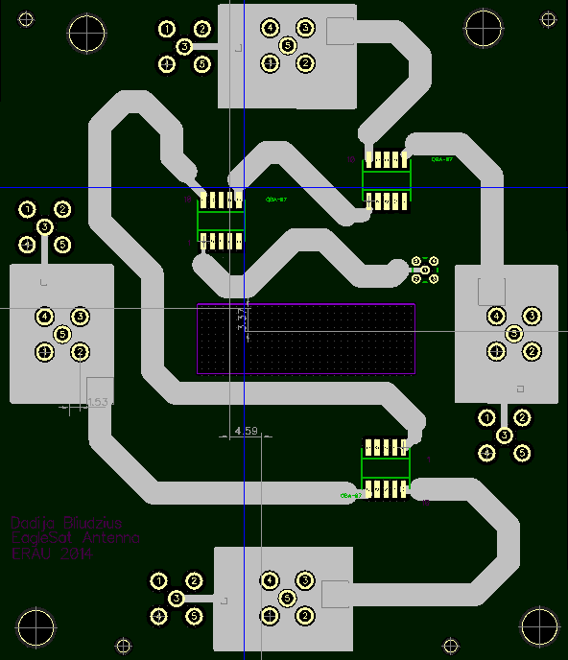

Wire Length Calculations
Wavelength in air ≠ wavelength through PCB
Antenna wire length difference: ¼$λ$
  Power splitter used to minimize wire lengths
Wavelength | In Air (cm) | In FR4 PCB (m)
¼ | 17.19 | 9.86
½ | 34.78 | 19.72
1 | 68.76 | 39.44

Slide 9
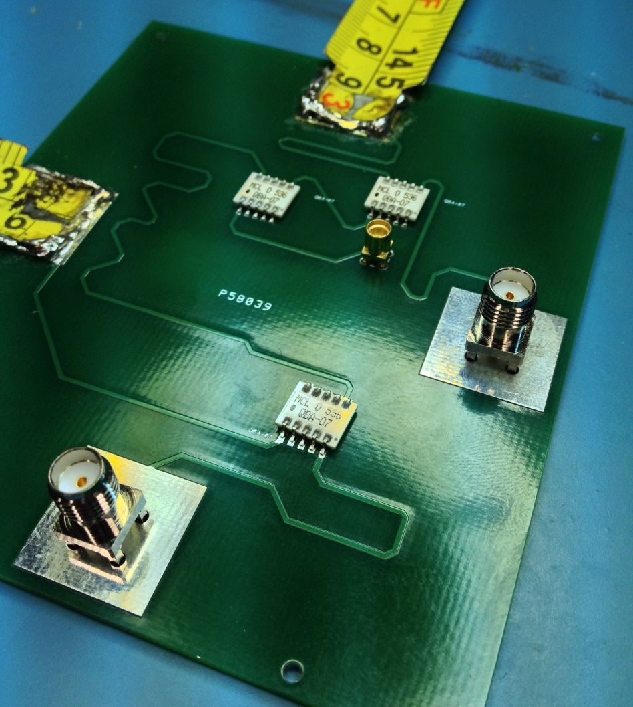
Equipment
Printed Circuit Board
  FR4 Material
  Low permittivity
Antenna
  Tape measure
  Flexible, metal, easy and cheap
  to acquire
Power splitter
  Delays the signal by ¼ wavelength
Coax
  Connects between boards
SMA Connecter
  Test the phase shifting

Slide 10
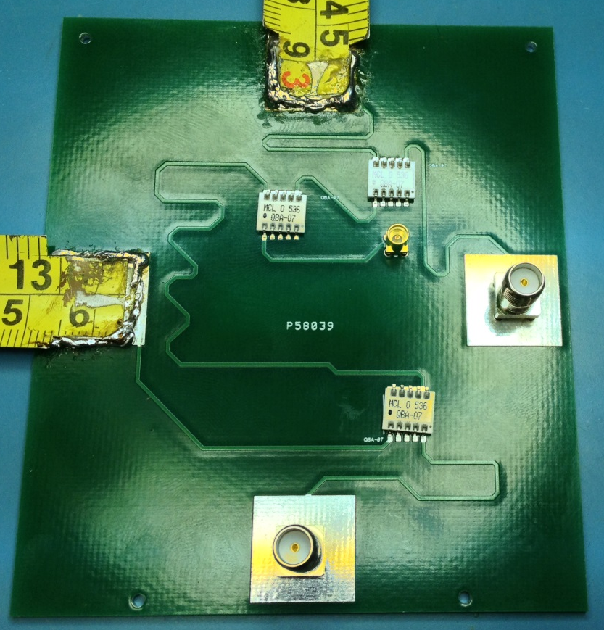
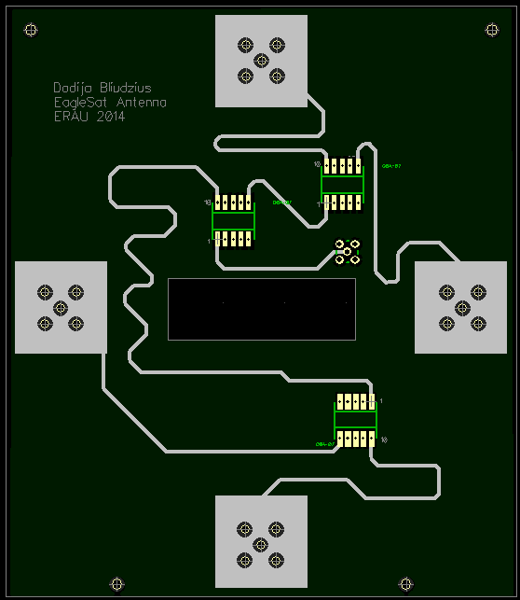
Program: Diptrace
Designs the entire PCB
Pads for connectors
Pads for antennas
Mounting holes

Slide 11
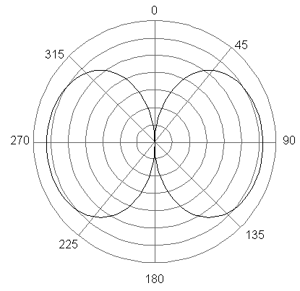
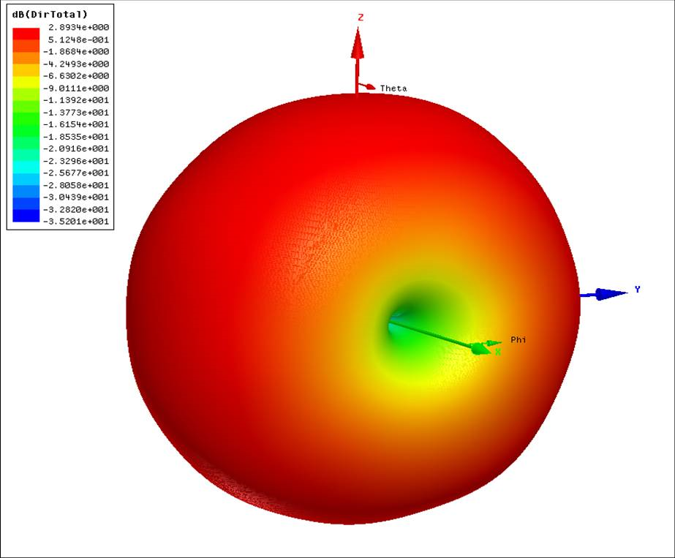
Program: Matlab
Examines radiation pattern
  Directional dependence of the strength of the radio waves
Currently looking at an omnidirectional antenna
Plot the radiation pattern when finished building

Slide 12
Testing
Network analyzer
  Tests and maps out the phase shifting
GPS Antenna on a balloon launch
  April 10, 2014
  Tests the clarity of signal
HASP
  August 2014
  Examining the antenna’s transmissions and interactions with other subsystems
Testing different scenarios
  Vacuum chamber

Slide 13
Conclusion & Summary
Antenna development slow
Should be able to meet deadlines
Future work:
  Expand antenna knowledge
  Create a flight-ready antenna
  Become more familiar with radiation pattern

Slide 14
Acknowledgements
Jack Crabtree
Dr. Post
Dr. Yale
NASA SpaceGrant & interns

