Slide 1
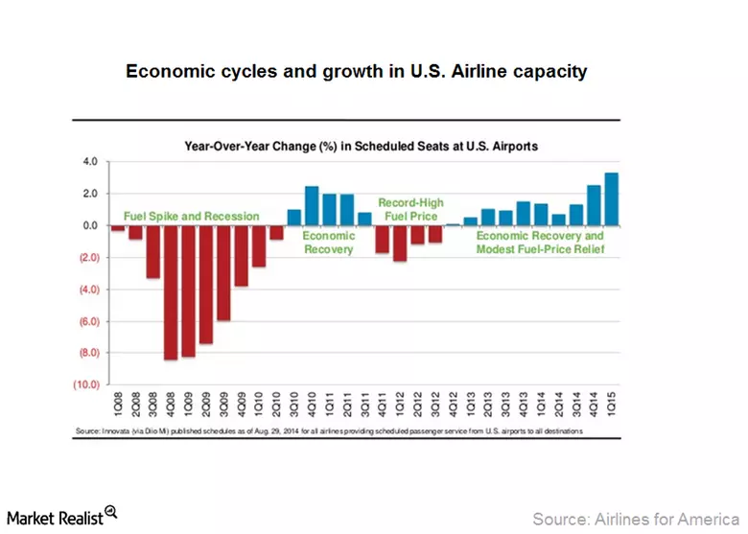
A Longitudinal Analysis on the Cyclical
Pattern of the US Airline Industry
Michelle Bennett, Dr. Brent Bowen, Dr. Jacqueline Luedtke, Dr. Dean Headley, Dr. Timothy Holt
College of Aviation, Embry-Riddle Aeronautical University, Prescott, AZ
Abstract
AQR Formula
Analysis
The Airline Quality Rating (AQR) is the nation’s most comprehensive study of airline performance and quality for over two decades. AQR provides consumers and industry watchers a means to compare performance quality among different US airlines using objective performance-based data. This research looks to analyze the cyclical patterns present in AQR in order to identify trends and factors contributing to the changes in these results each year. This research utilizes the application of a longitudinal analysis methodology which will provide the correlation between factors identified and the indicators affected.
$$AQR=\frac{\left(+8.63×OT\right)+\left(−8.03×DB\right)+\left(−7.92×MB\right)+(−7.17×CC)}{(8.63+8.03+7.92+7.17)}$$
Looking at the 23 years of data, there are several distinct ebbs and flows in the data including the dip between 1999 -2001, 2006 -2008, and 2014-2015. Several factors may contribute to these changes including the condition of the economy, new policies, and technological advancements.
Methods
Analyzing the data over the past 23 years (1993-2016) this research utilizes the application of a longitudinal analysis methodology.
This offers a way to track the ebbs and flows of airlines’ operational performance, and the ability to develop theories explaining the shifts in data.
Both airports and airlines suffered from economic factors including spikes in jet fuel prices and the recession.
Background
AQR Criteria & Weights
On-Time (OT), Weight- 8.63
Denied Boarding (DB), Weight- 8.03
Mishandled Baggage (MB) Weight- 7.92
Customer Complaints (CC) Weight- 7.17
Flight Problems, Over sales, Fares,
Ticketing, Refunds, etc.
Next Steps
Next steps include further identifying and analyzing factors influencing operational performance of airlines. Specifically, how oil prices may have contributed to changes in ratings, and how legislation post 2001 changed operations in the airline industry.
Spike in fuel prices
Spike in fuel prices
.
*Changes in aviation policies, new regulations
Selected References
Economic downturn, start of the Recession
Albers, S., Daft, J, (2013) A conceptual framework for measuring airline business model convergence. Journal of Air Transport Management, Volume 28, May 2013, Pages 47–54
Bowen, B. D., & Headley, D. E. (2017). Airline Quality Rating 2017. , (). Retrieved from https://commons.erau.edu/aqrr/27
Bowen, B. D., & Headley, D. E. (2014). Airline Quality Rating 2014.
Bowen, B. D., & Headley, D. E. (2010). Airline Quality Rating 2010.
Cederholm, T. (2014, September 15). Must-Know: Key Indicators impacting airline industry performance. Retrieved January 6, 2014
Fareena Sultan Merlin C. Simpson, Jr, (2000) “International service variants: airline passenger expectations and perceptions of service quality”, Journal of Services Marketing, Vol 14 Iss 3 pp. 188-216
Ragin, Charles C. The Comparative Method: Moving Beyond Qualitative and Quantitative Strategies. University of California Press 1987.
Industry standard is set by AQR providing consumers and industry watchers objective performance-based data to compare performance quality among different US airlines.
Data used in this research are readily available from the Department of Transportation.
September 11st terrorist attacks and policy changes
*factors influencing AQR have not been determined yet

